Slide 2

Notes:
https://www.youtube.com/watch?v=WPA-KpldDVc

Slide 3
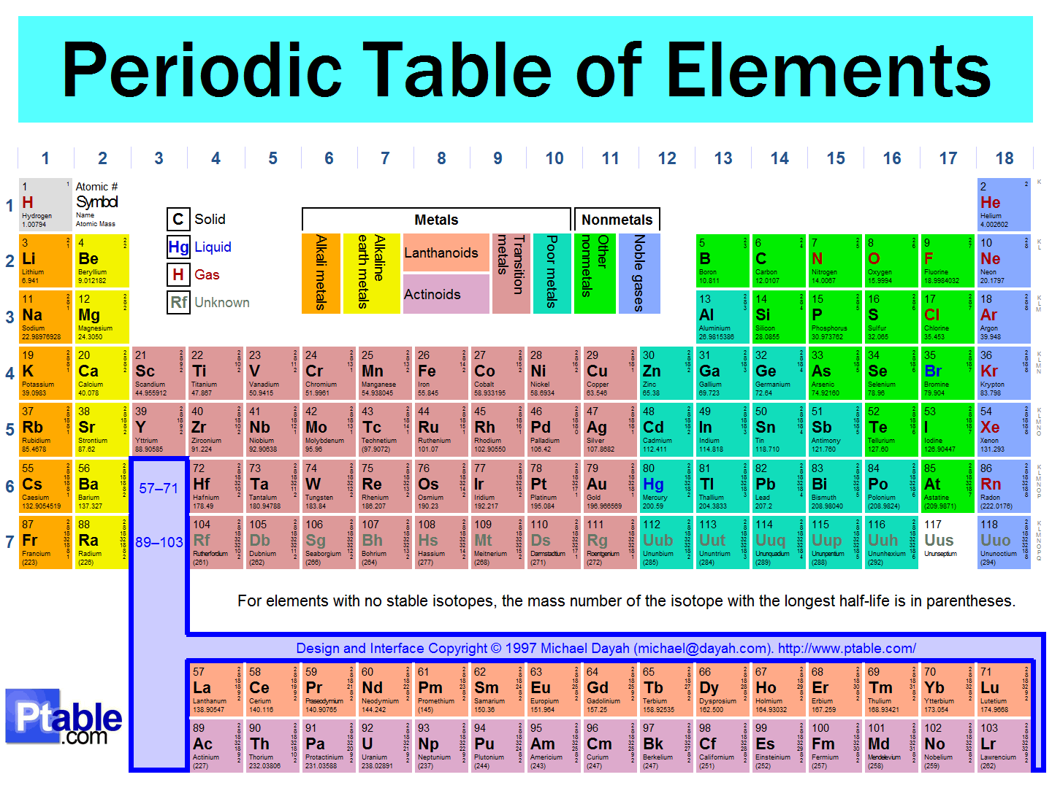
Atoms and Molecules
Atomic number is the number of protons.
Atomic mass number,
# of protons + # of neutrons
Notes:
on the board show how it is written: 1H 4He, 12C – how many neutrons in 1H? in 12C?

Slide 4
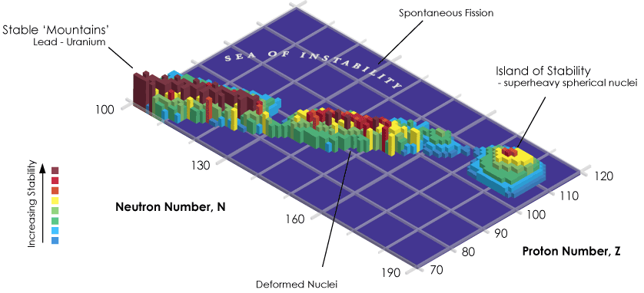
Notes:
http://www.scientificamerican.com/article/superheavy-element-117-island-of-stability/

Slide 5

Ideal Gas Law
PV = nRT
MAY OR MAY NOT HAVE HAPPENED
MAY OR MAY NOT HAVE HAPPENED
Estimate the pressure of the air in this room. Assume the dimensions are 5.00 m x 3.00 m x 2.50 m, at 20.0° C. The density of air is 1.225 kg/m³ The molar mass of air is 0.02900 kg/mol.

Slide 6
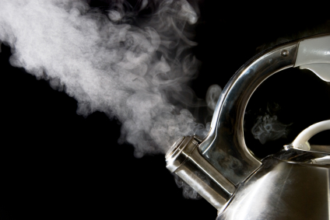
Conservation of Energy
ΔK + ΔU + ΔE_{th}
ΔE_{sys} =
ΔK = 0
ΔU = 0
ΔE_{th} > 0
Total energy of the system increases,
But…W_{ext} = 0
Heating water in a tea kettle
Notes:
when heating a tea kettle – DK = 0, DU = 0, Wext = 0, but Deth does not equal zero

Slide 7


Slide 8
Let’s talk about Heat Transfer . . .
Conduction
Convection
Radiation

Slide 9
Heat Transfer and Temperature Change
temperature change (K)
heat transferred (J)
Q = McΔT
c ~ specific heat: how many J energy it takes to raise 1 kg by 1 K (J/kg K)
mass of the substance (kg)

Slide 10
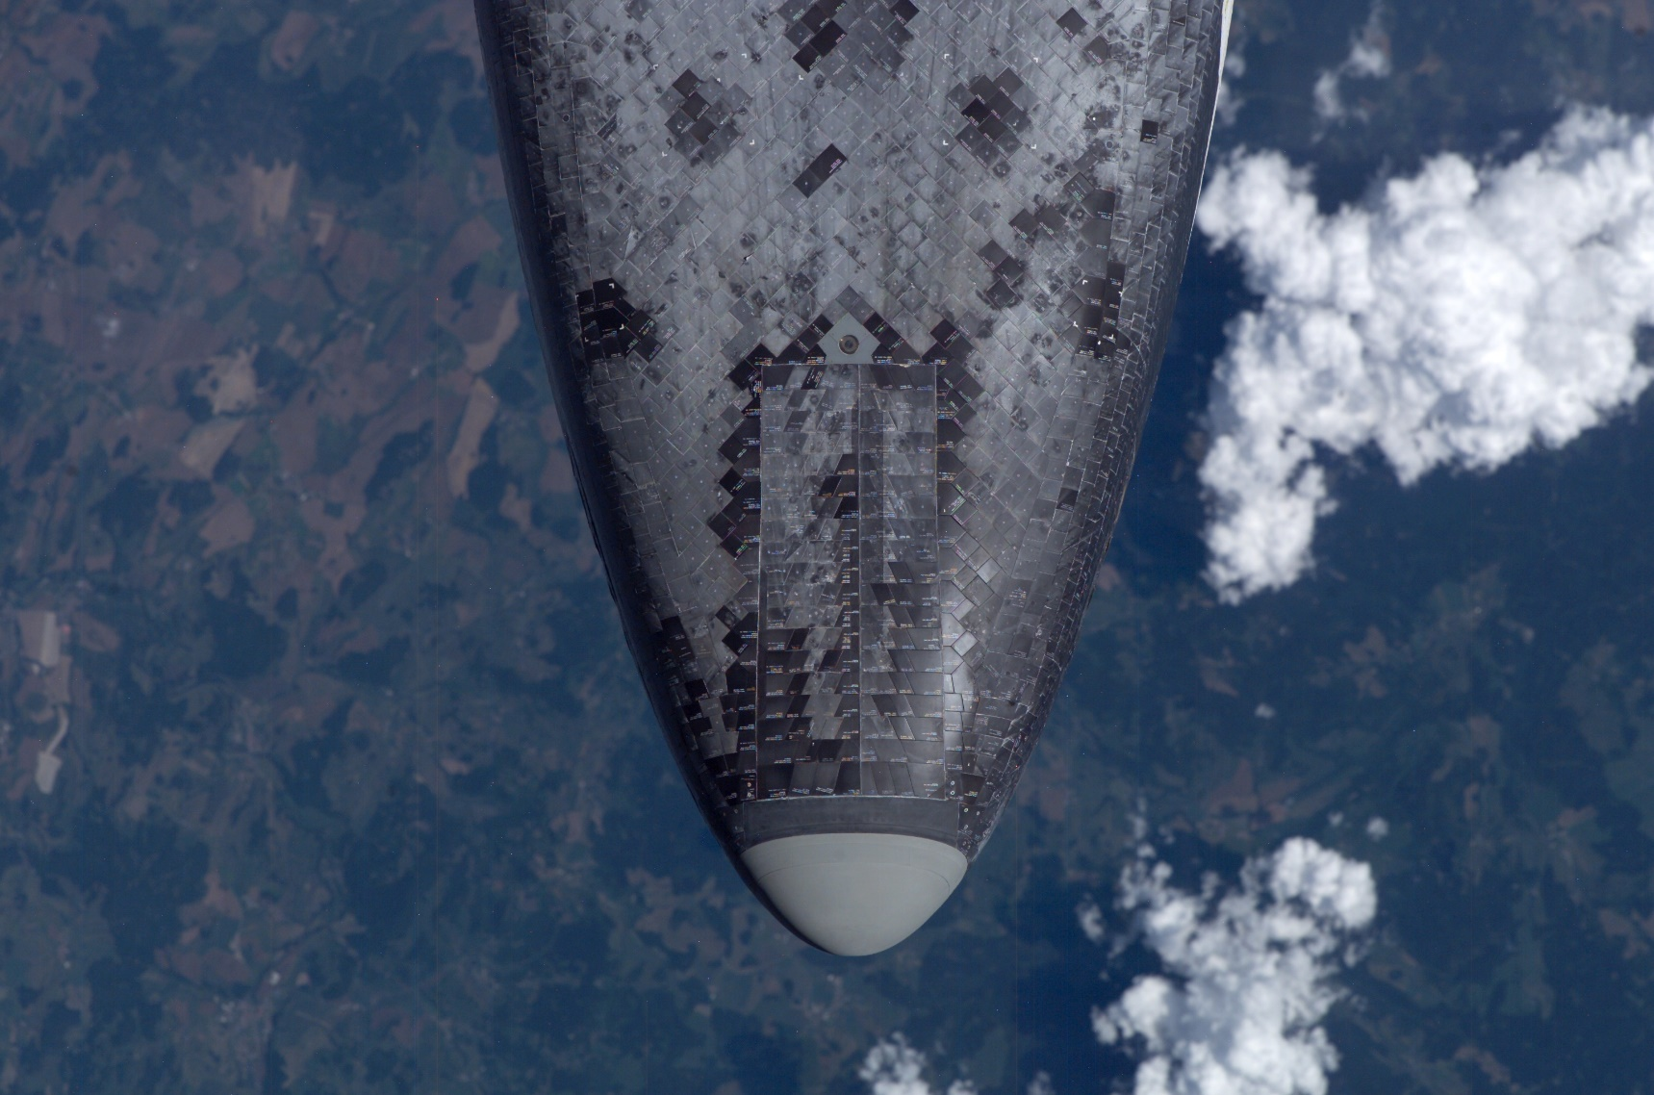
Heat Shield: Conduction, Convection, Radiation

Slide 11
The Space Shuttle design presented many thermal insulation challenges. The system not only had to perform well, it had to integrate with other subsystems. The Orbiter’s surfaces were exposed to exceedingly high temperatures and needed reusable, lightweight, low-cost thermal protection. The vehicle also required low vulnerability to orbital debris and minimal thermal conductivity. NASA decided to bond the Orbiter’s thermal protection directly to its aluminum skin, which presented an additional challenge.
The External Tank required insulation to maintain the cryogenic fuels, liquid hydrogen, and liquid oxygen as well as to provide additional structural integrity through launch and after release from the Orbiter. The challenge and solutions that NASA discovered through tests and flight experience represent innovations that will carry into the next generation of space programs.
- NASA

Slide 12
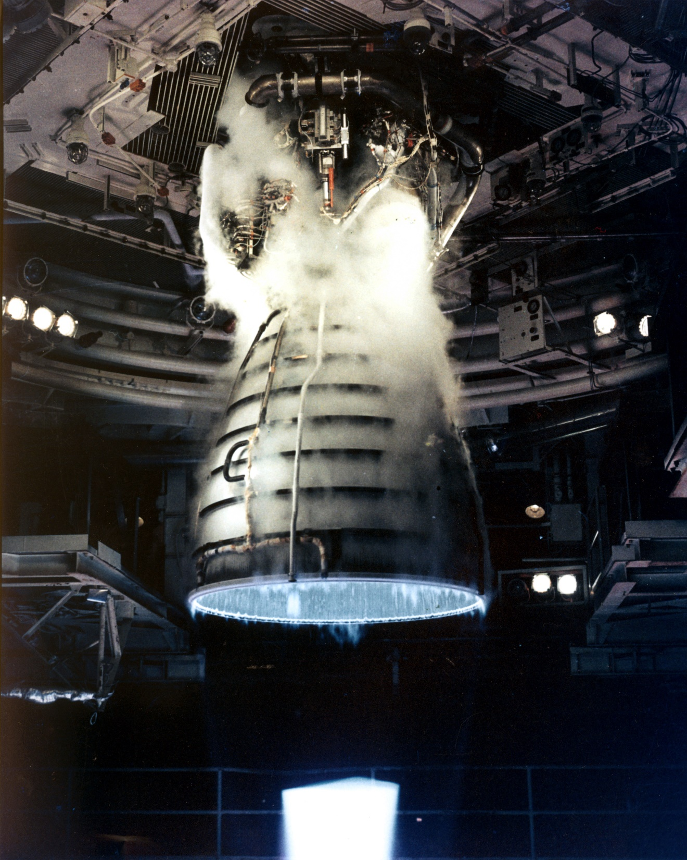

Slide 13
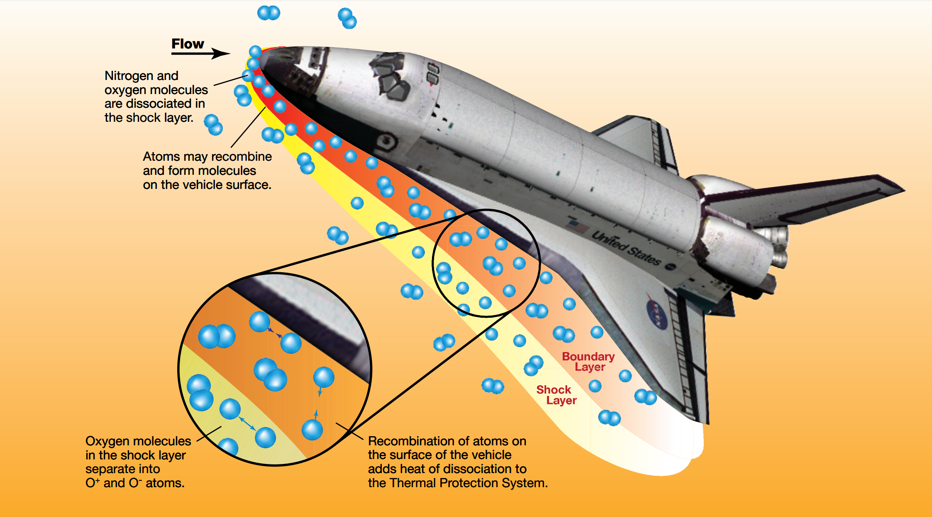
Homework! We will discuss this Monday.
http://www.nasa.gov/centers/johnson/pdf/584728main_Wings-ch4b-pgs182-199.pdf
Notes:
Would you like to know more?
http://www.nasa.gov/centers/johnson/pdf/584728main_Wings-ch4b-pgs182-199.pdf

Slide 14
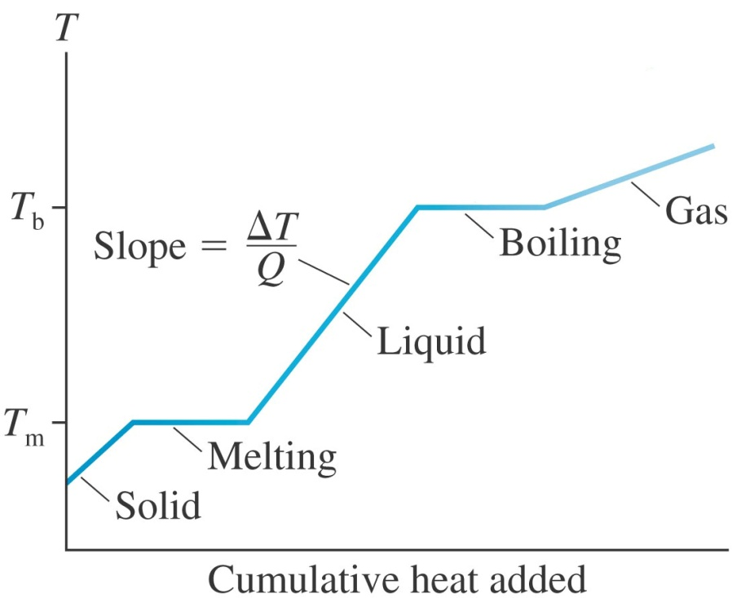
Heat Transfer and Phase Change
Thermal energy can change without a change in temperature when the phase of the substance changes.
Latent heat of fusion (J/kg)
±ML_{f}
±ML_{v}
Q =
Latent heat of vaporization (J/kg)
Notes:
draw on the board – latent heats of fusion, latent heat of vaporization

Slide 15
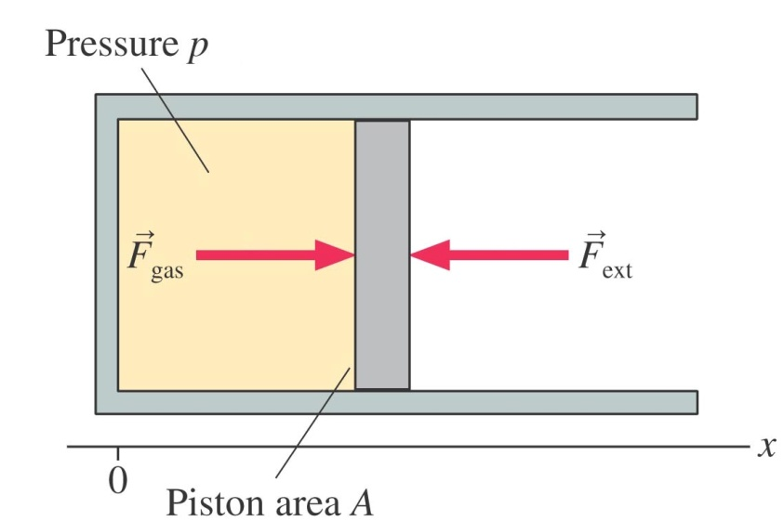
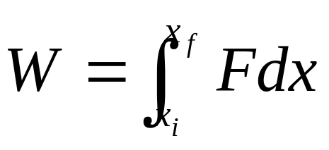
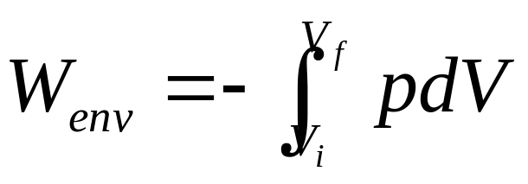
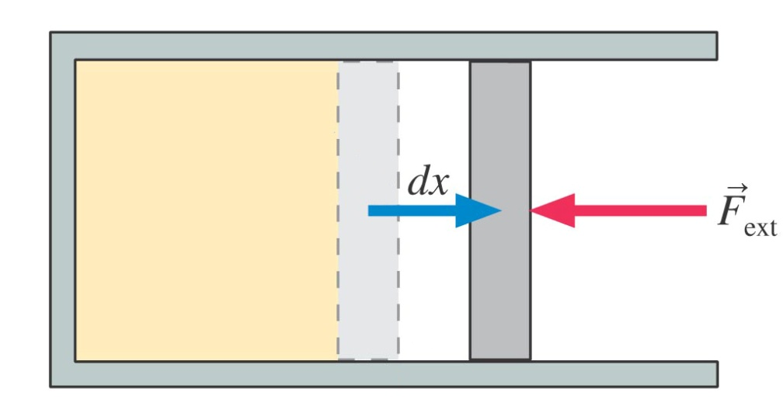
Work and Ideal-Gas Processes
work done on the gas by the environment
Notes:
review – you doing positive work, you doing negative work – now let’s talk about this gas – there’s a gas pressure which exerts a force Fgas – balanced by Fext – if the piston is moved to the left, external force has done positive work, gas has done negative work – how much work did the gas do? calculate using an integral – emphasize, it is always defined as work done ON the gas – PASS OUT WORK CARD – any time I say “work” stand up and we all say, “work done ON the system”

Slide 16
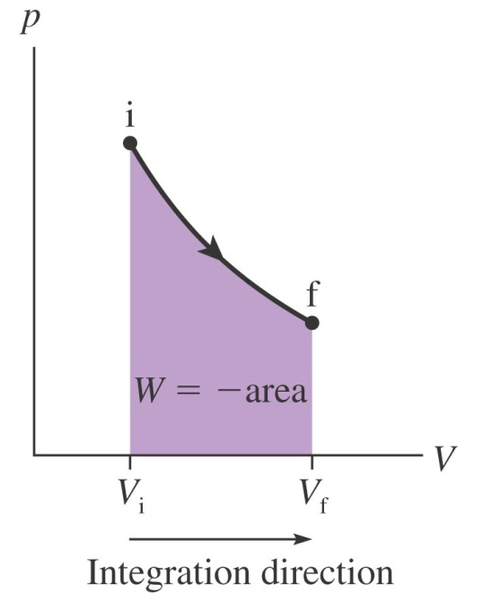
Work and Ideal-Gas Processes
If volume increases, W_{env} is –
f
i
If volume decreases, W_{env} is +
V_{f}
V_{i}
Notes:
any time you have an integral, it’s like the area under a curve – demonstrate how the direction of integration determines the sign, and is super important

Slide 17
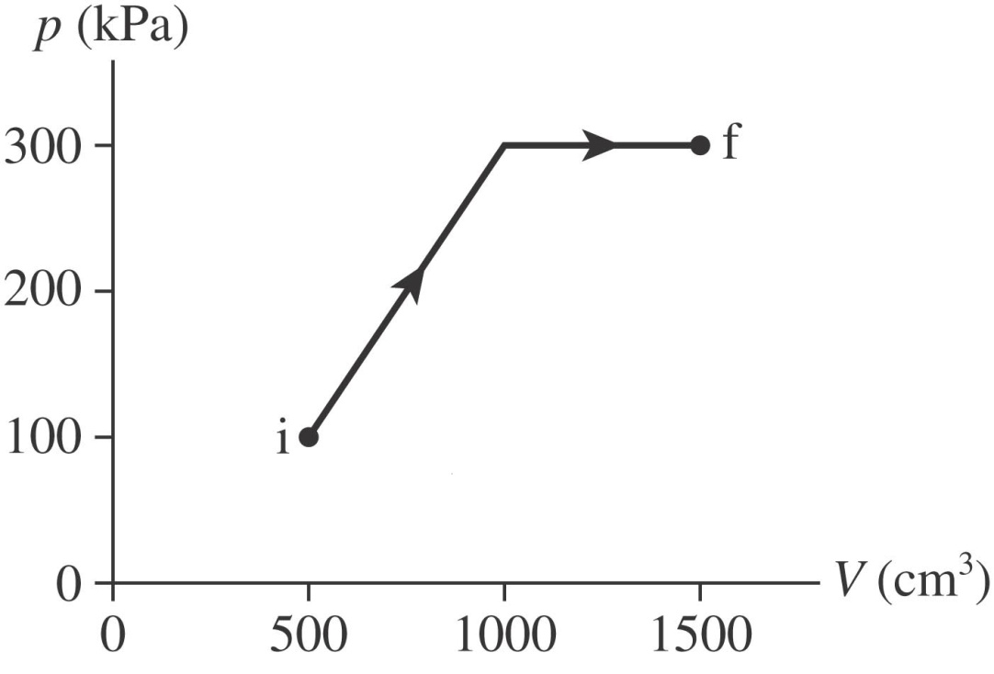
How much work is done on the gas in the ideal–gas process shown below?
Notes:
PAIR SHARE – first, is work going to be positive or negative? who wins?

Slide 18
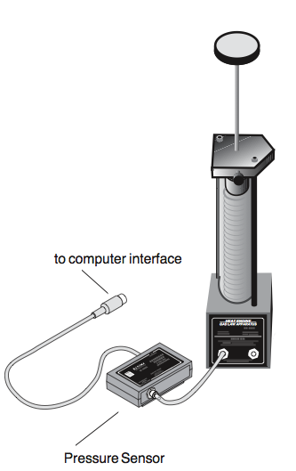
If you pushed down on a piston and measured the pressure and volume of the gas. As you push down on the piston,
W_{env} is +
W_{env} is –
W_{env} is 0
Can’t be determined
Notes:
color card check with examples, graphs and words or PAIR SHARE – give an example (word description, pV graph) when W is +, – and 0

Slide 19
Isothermal Expansion: Constant Temperature
Isochoric Expansion: Constant Volume
Isobaric Expansion: Constant Pressure
One mol of gas initially at STP (1) undergoes an isochoric increase in pressure until its pressure is doubled (2). It then undergoes an isothermal expansion until its volume is doubled (3). It then experiences an isobaric compression and returns to its initial volume (4). Draw a pV diagram for this process. What are the pressure, temperature and volume at each point (1–4)?

Slide 20
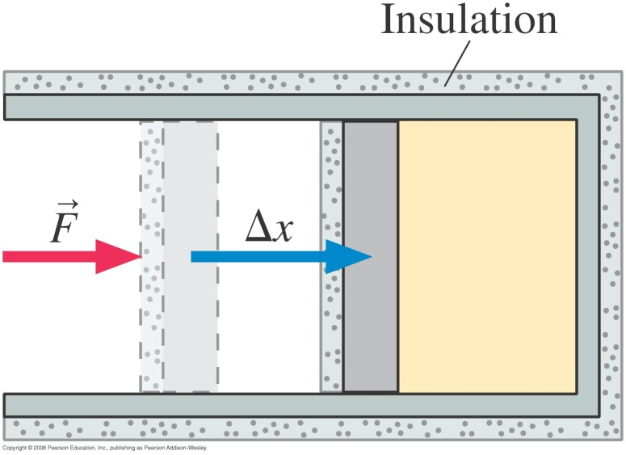
A gas cylinder and piston are covered with heavy insulation. The piston is pushed into the cylinder compressing the gas. In this process, the gas temperature:
Increases
Decreases
Stays the same
Cannot be determined
Notes:
what are the signs of Deth, Q and W?
how could we do this and keep it at a constant temperature? remove the insulation – then what would happen – W is +, Q is -

Slide 21
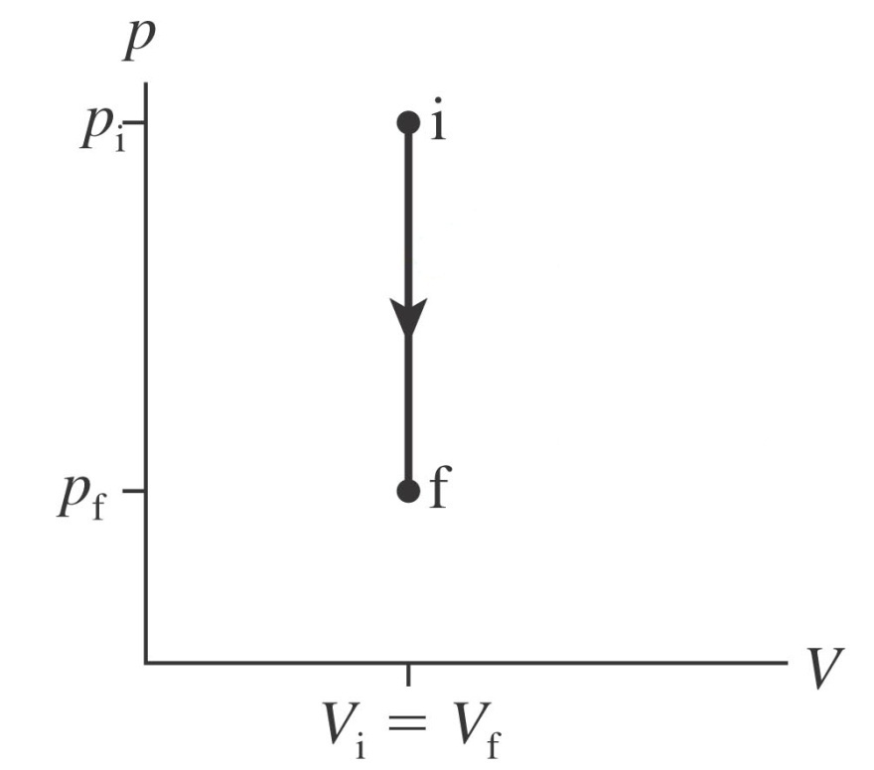
Isochoric Processes
ΔV = 0
W_{env} = 0
area under curve is zero
Notes:
show from the integral definition - PASS OUT ISOCHORIC CARD

Slide 22
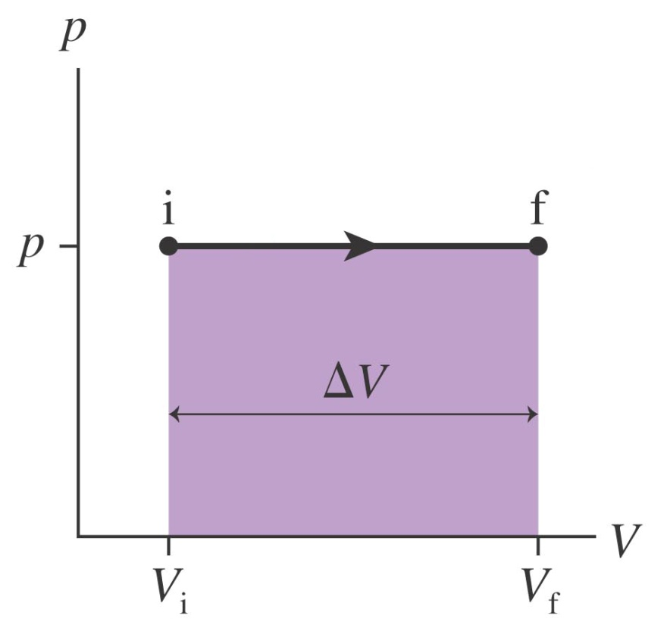
Isobaric Processes
W_{env} = –pΔV
Notes:
pressure is constant, so it can come out of the integral – on board draw the reverse process and show that the work is +

Slide 23
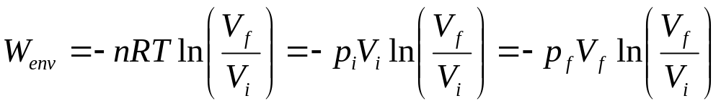
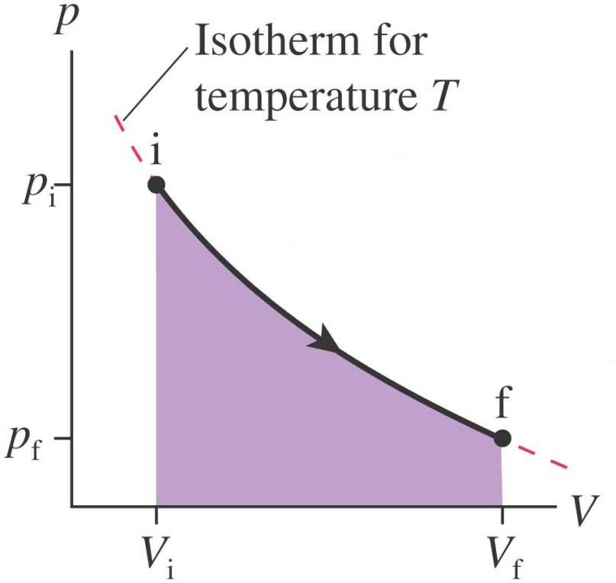
Isothermal Processes
Notes:
is work here + or - ? - go through integral to get to formula

