Slide 1
Physics 152
Dr. Gamble
Thermodynamics
Electricity
Circuits
Magnetism

Slide 2
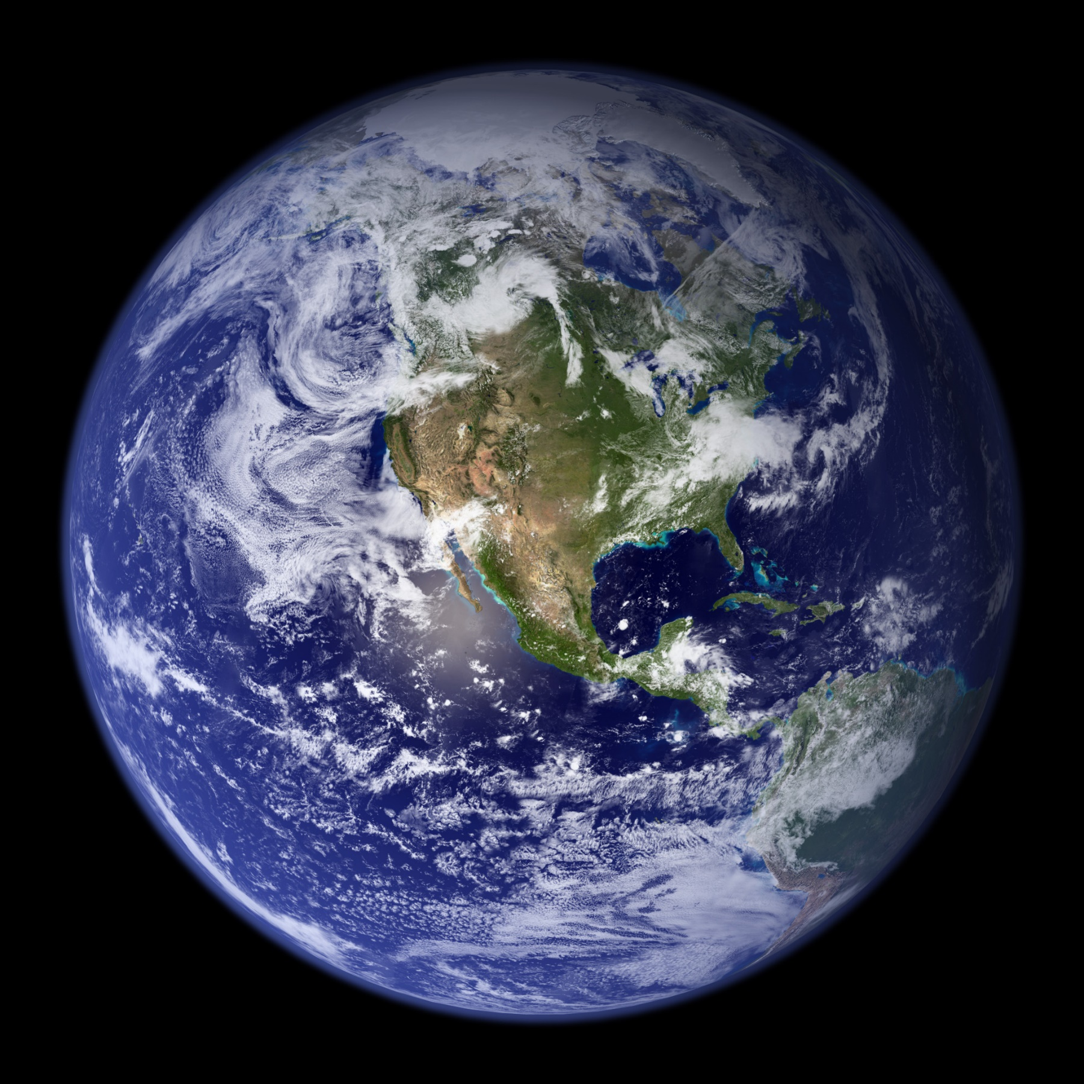

Slide 3

Notes:
https://www.youtube.com/watch?v=WPA-KpldDVc

Slide 4
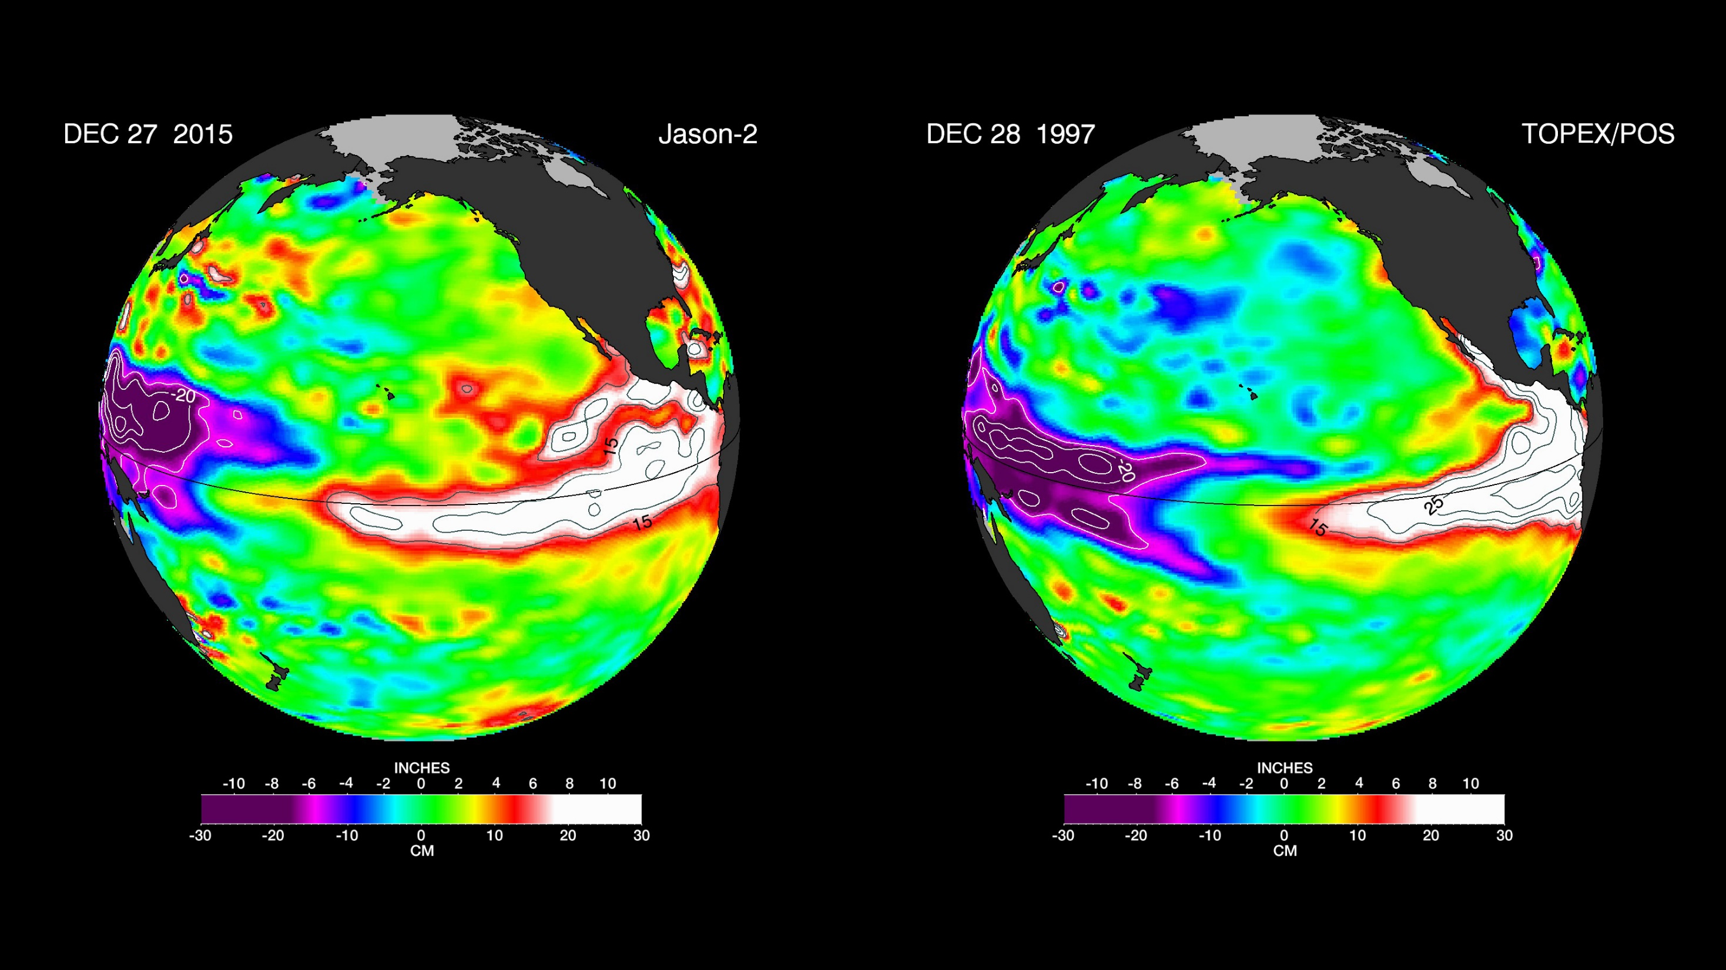

Slide 5
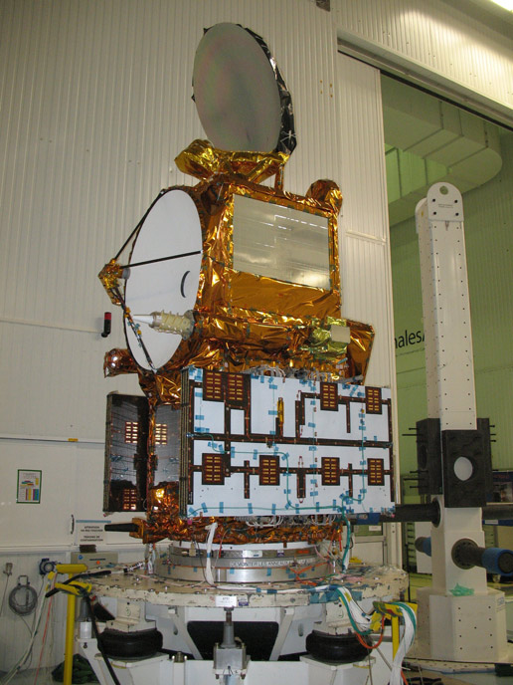
Notes:
https://www.youtube.com/watch?v=QXIhMS4JTGc&index=1&list=PLTiv_XWHnOZocOSyXQu0KjgxylcBMFqRh

Slide 7
Thermodynamics
Electricity
Circuits
Magnetism

Slide 8
“Magnetism is a force, but it has no energy of its own,” says David Cohen-Tanugi, vice president of the MIT Energy Club and a John S. Hennessy Fellow in MIT’s Materials Science and Engineering department. Still, he adds, “magnetism is extremely useful for converting energy from one form to another. About 99% of the power generated from fossil fuels, nuclear and hydroelectric energy, and wind comes from systems that use magnetism in the conversion process.”

Slide 9
Thermodynamics
The transfer of heat energy
Descriptions of matter
Heat and work
Heat engines
Notes:
What is thermodynamics? look at the word – heat, moving – how heat energy is transformed into other types of energy – energy is conserved, but it can change form – can change into heat like we talked about last time – give an example of mechanical energy turning into heat energy – now we’ll talk about going the other way
macroscopic description of matter, heat and work, macro/micro connection, heat engines

Slide 10
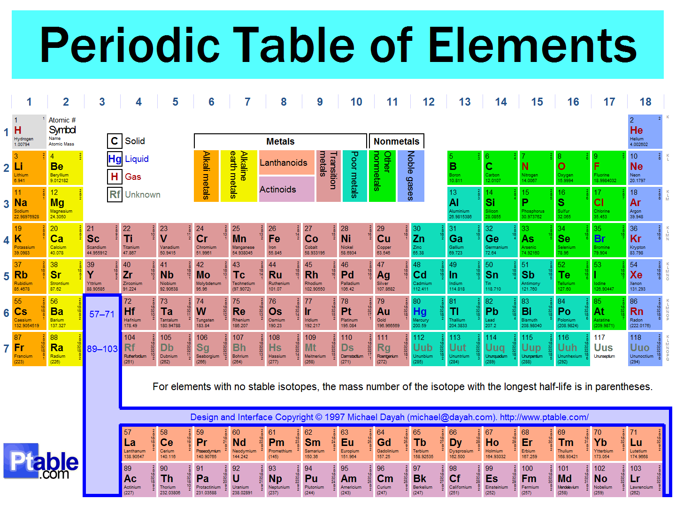
Atoms and Molecules
Atomic number is the number of protons.
Atomic mass number,
# of protons + # of neutrons
Notes:
on the board show how it is written: 1H 4He, 12C – how many neutrons in 1H? in 12C?

Slide 11
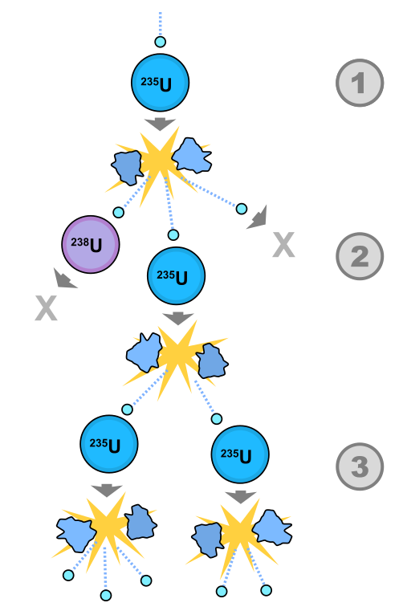

Slide 12
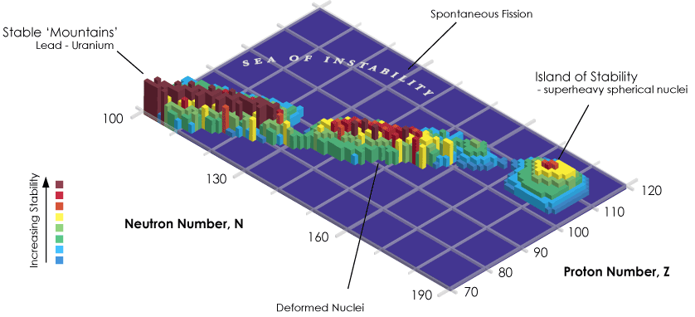
Notes:
http://www.scientificamerican.com/article/superheavy-element-117-island-of-stability/

Slide 13
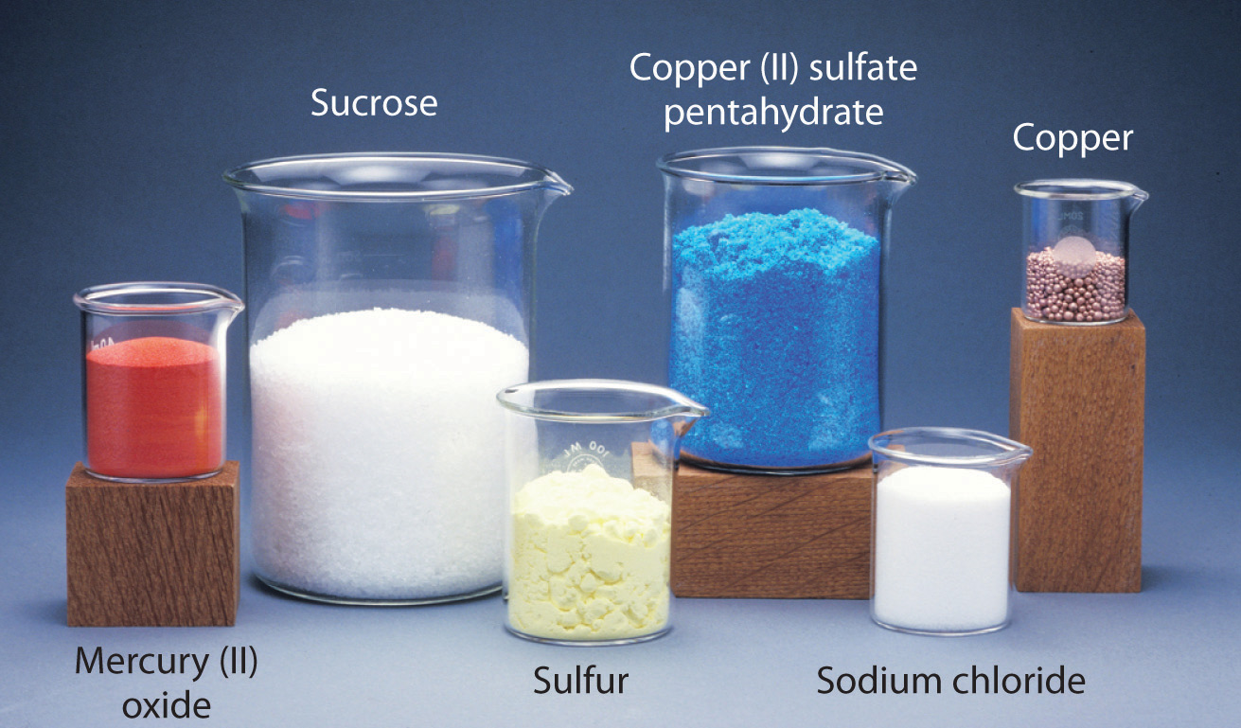

Slide 14
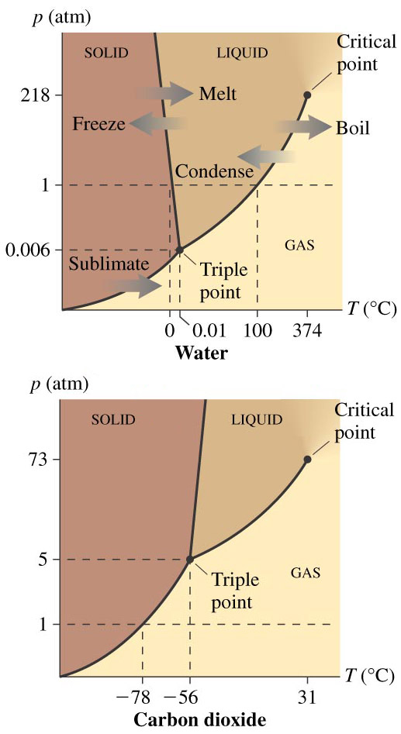
Phase Diagrams
What is the highest temperature at which ice can exist?
What is the highest temperature at which solid CO₂ can exist?
What is the lowest temperature at which liquid CO₂ can exist?
What is the lowest temperature at which liquid water can exist?
Notes:
PAIR SHARE – discuss the following with a partner – some might be trick questions

Slide 15
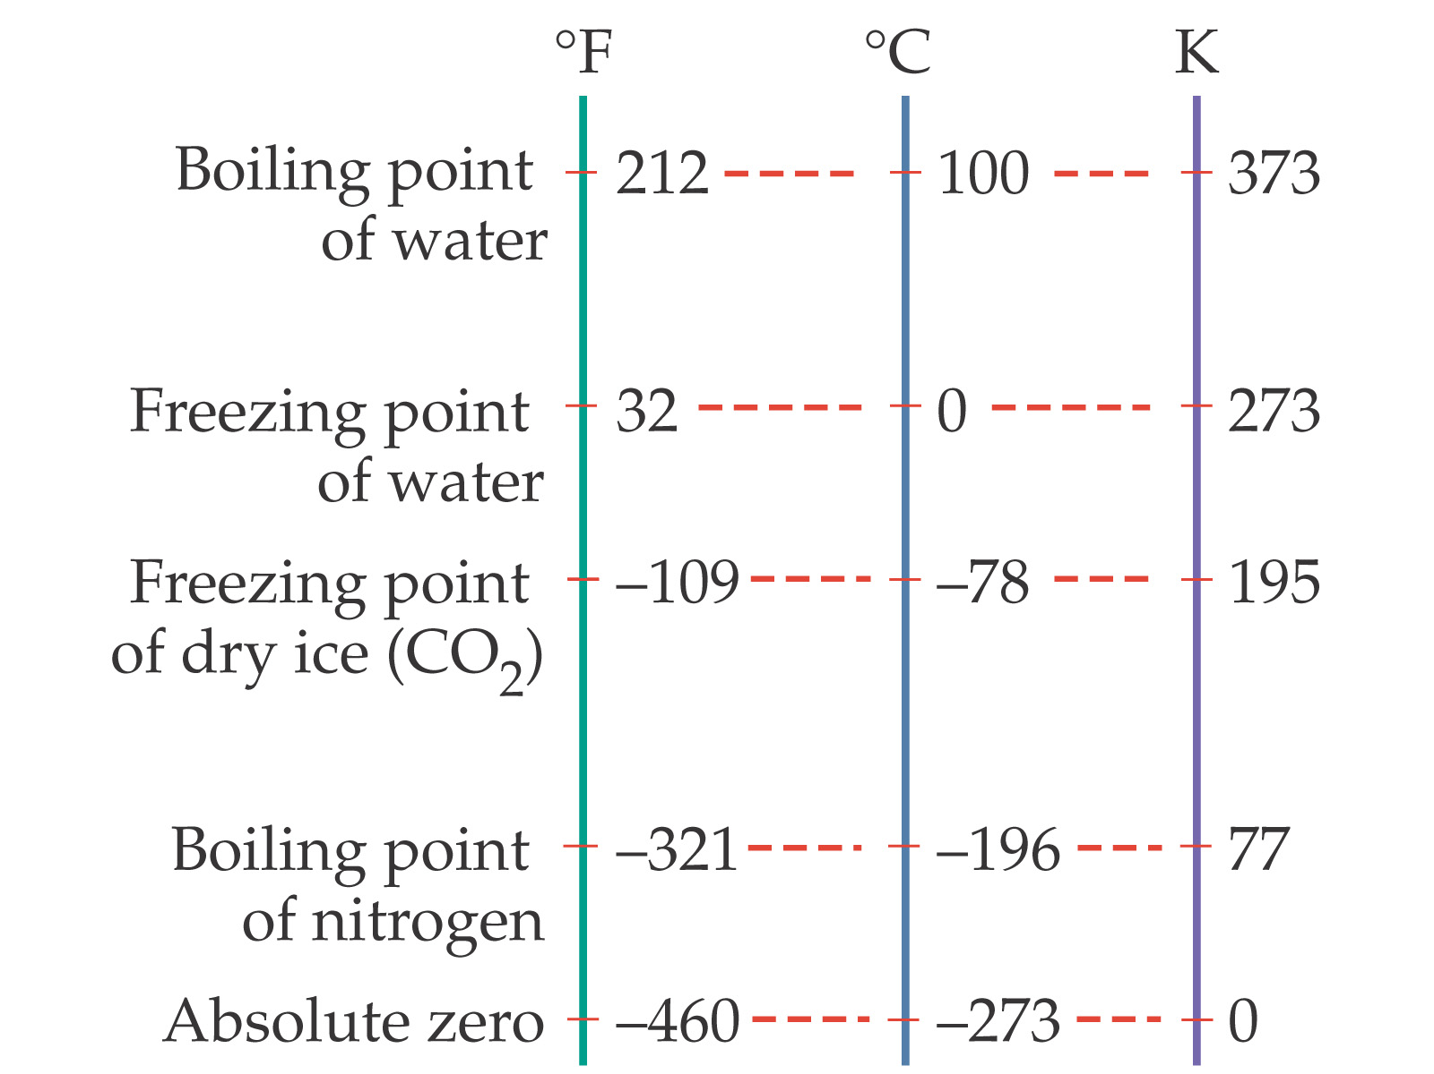


Slide 16

Ideal Gas Law
PV = nRT
Estimate the pressure of the air in this room. Assume the dimensions are 5.00 m x 3.00 m x 2.50 m, at 20.0° C. The density of air is 1.225 kg/m³ The molar mass of air is 0.02900 kg/mol.

Slide 17
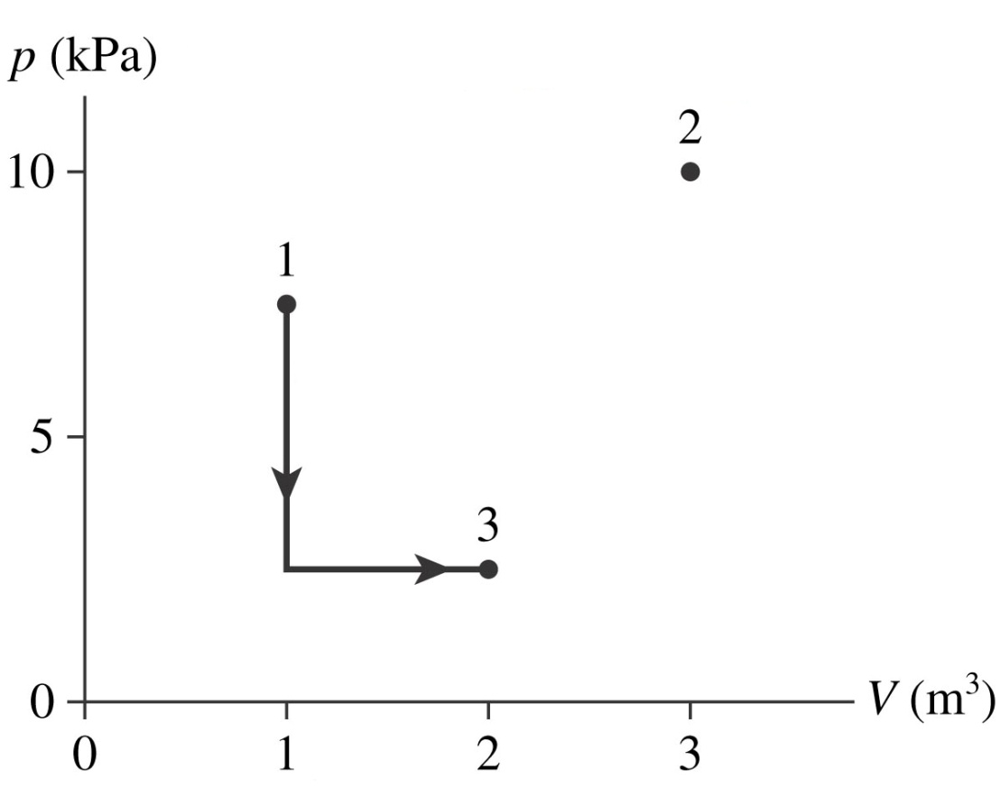
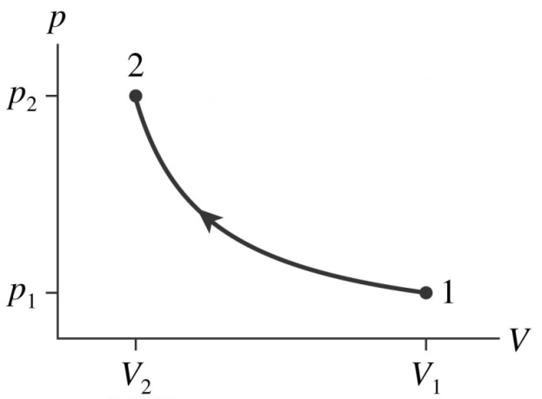
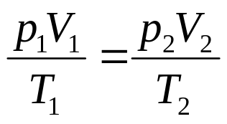
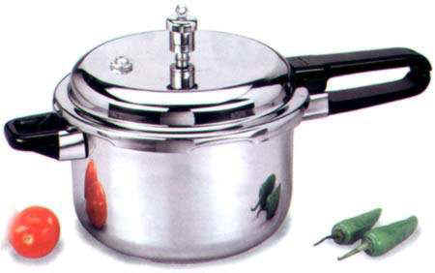
Pressure - Volume
PV = nRT
In a sealed container:
In a sealed container:

Slide 18
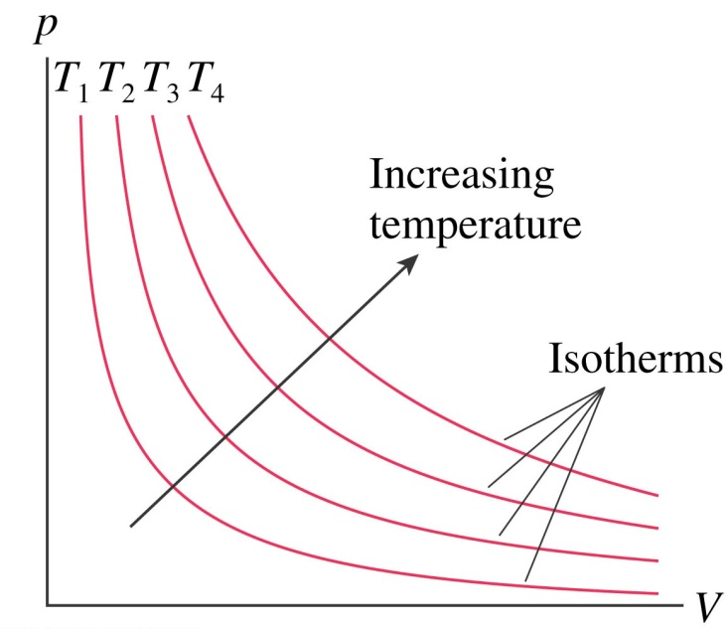
Isothermal Expansion
“The change occurs slowly enough to allow the system to continually adjust to the temperature of the reservoir through heat exchange.”

Slide 19
Isothermal Expansion: Constant Temperature
Isochoric Expansion: Constant Volume
Isobaric Expansion: Constant Pressure
One mol of gas initially at STP (1) undergoes an isochoric increase in pressure until its pressure is doubled (2). It then undergoes an isothermal expansion until its volume is doubled (3). It then experiences an isobaric compression and returns to its initial volume (4). Draw a pV diagram for this process. What are the pressure, temperature and volume at each point (1–4)?

Slide 20
Notes:
http://www.scientificamerican.com/article/superheavy-element-117-island-of-stability/

