Slide 1
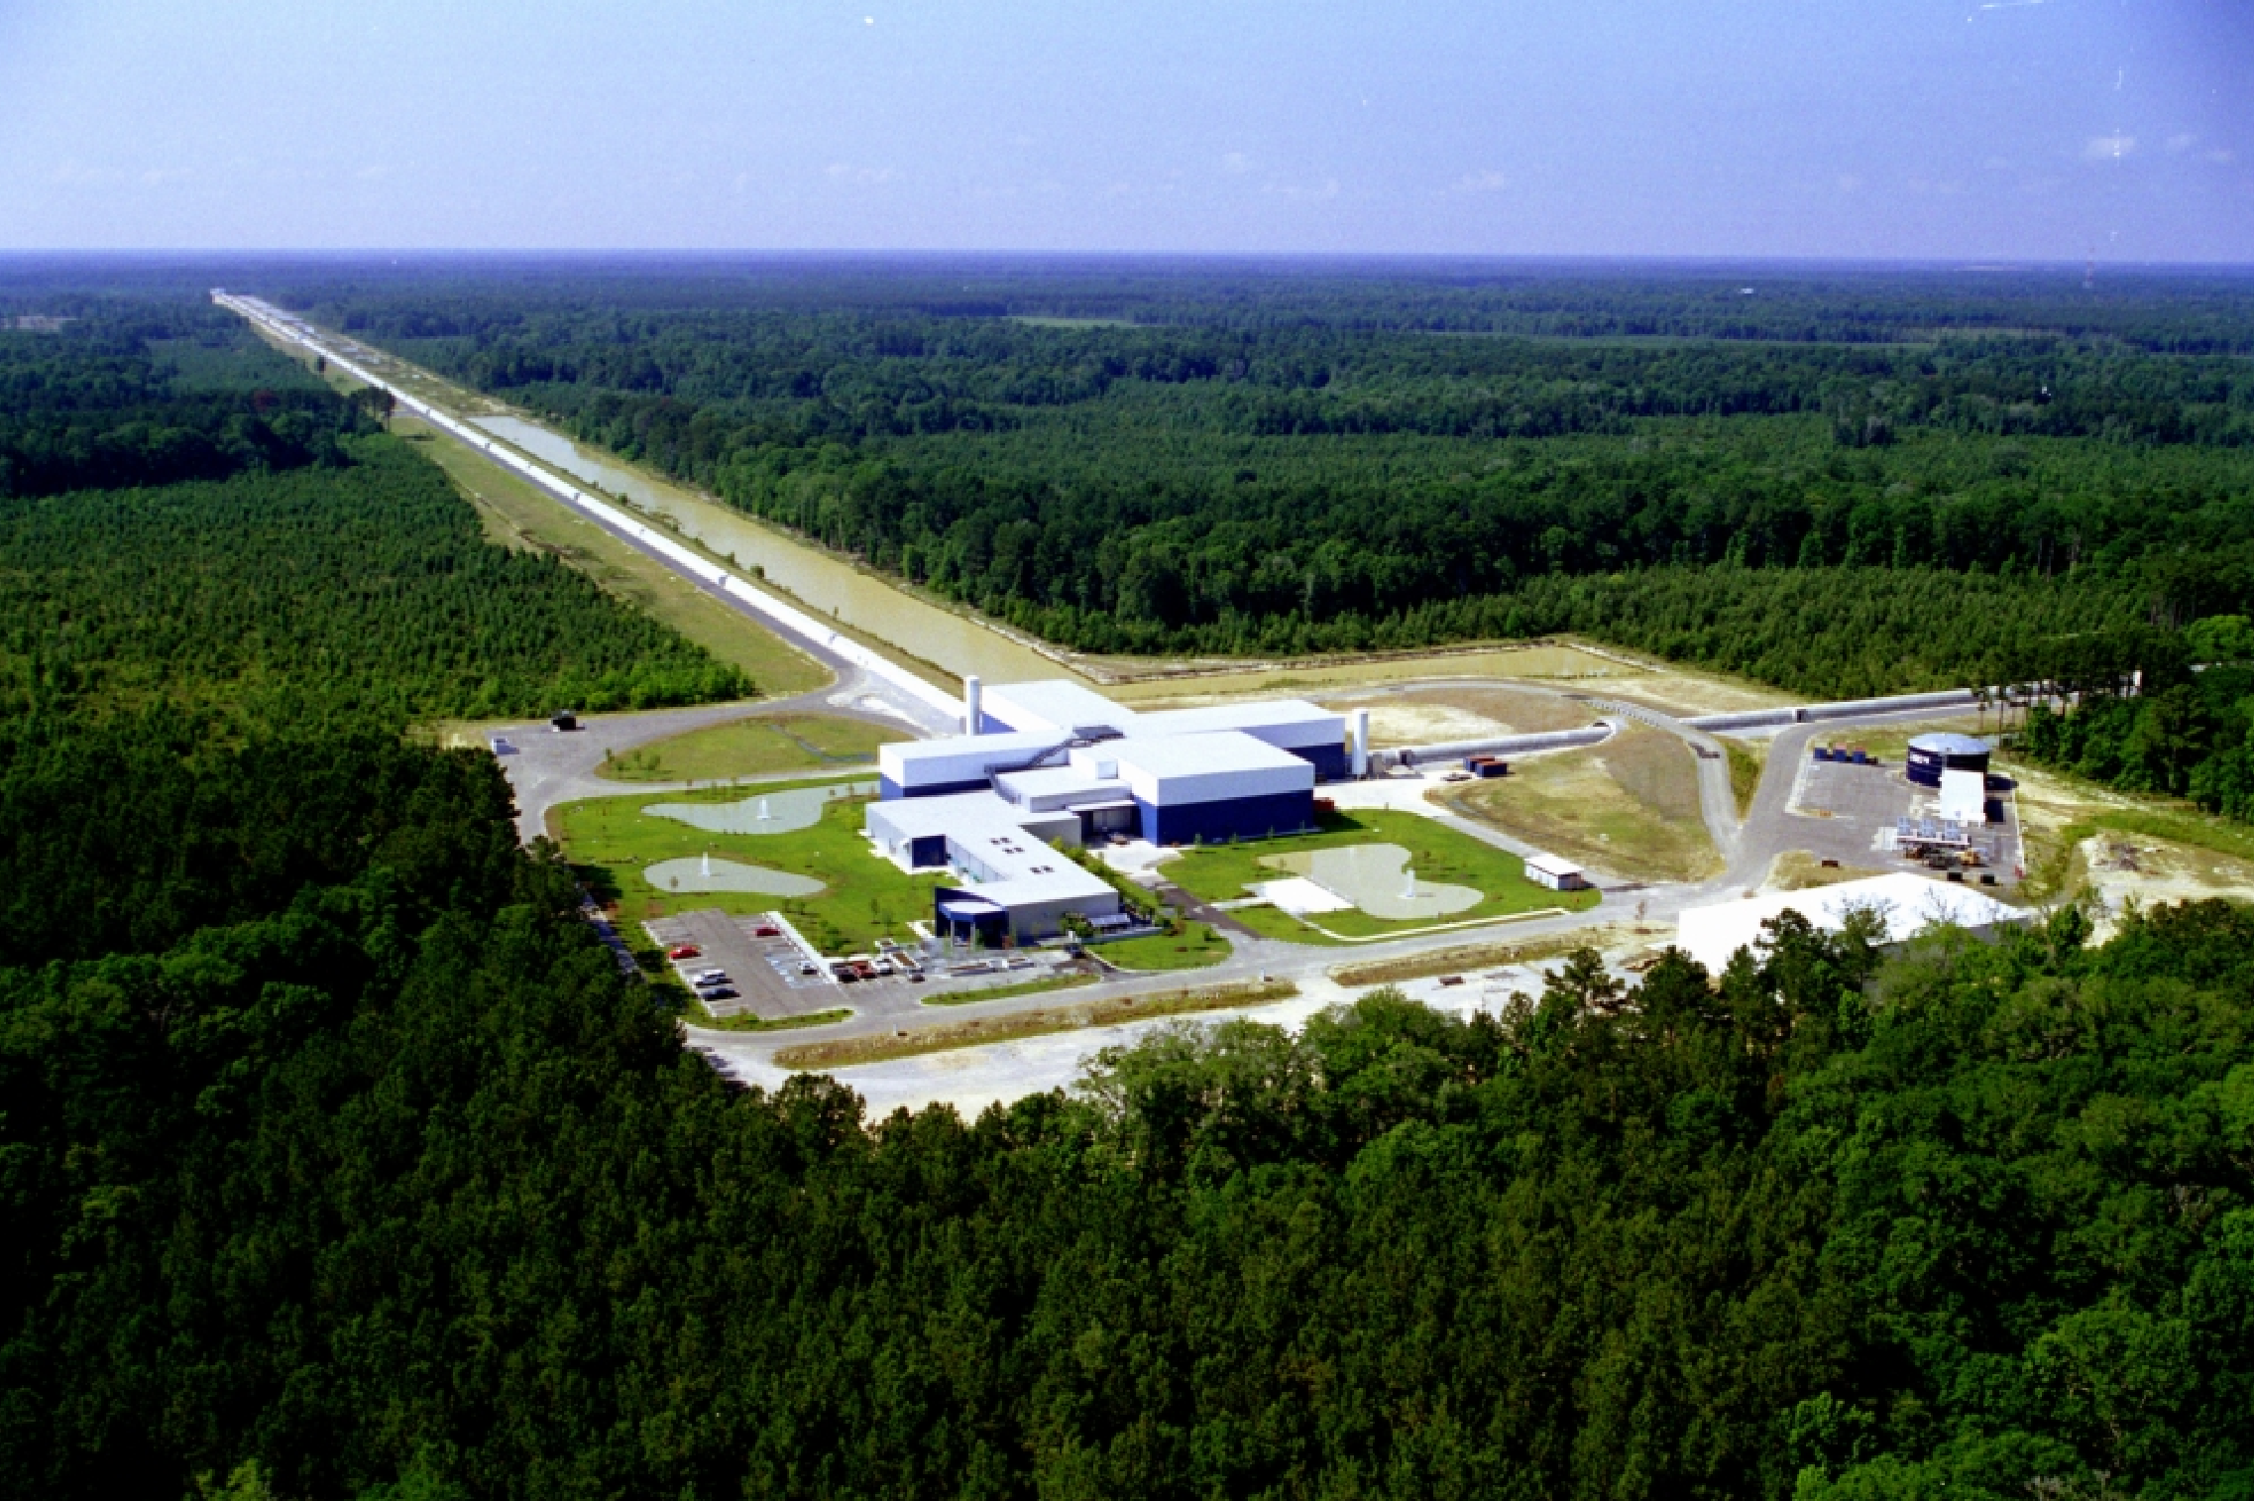
LIGO Interferometry Experiment
Notes:
https://www.youtube.com/watch?v=5N6PtJvT-3o

Slide 2
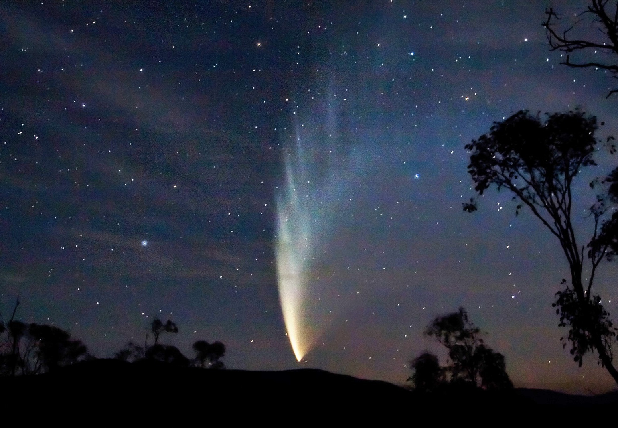
Comets, Asteroids, Meteors

Slide 3
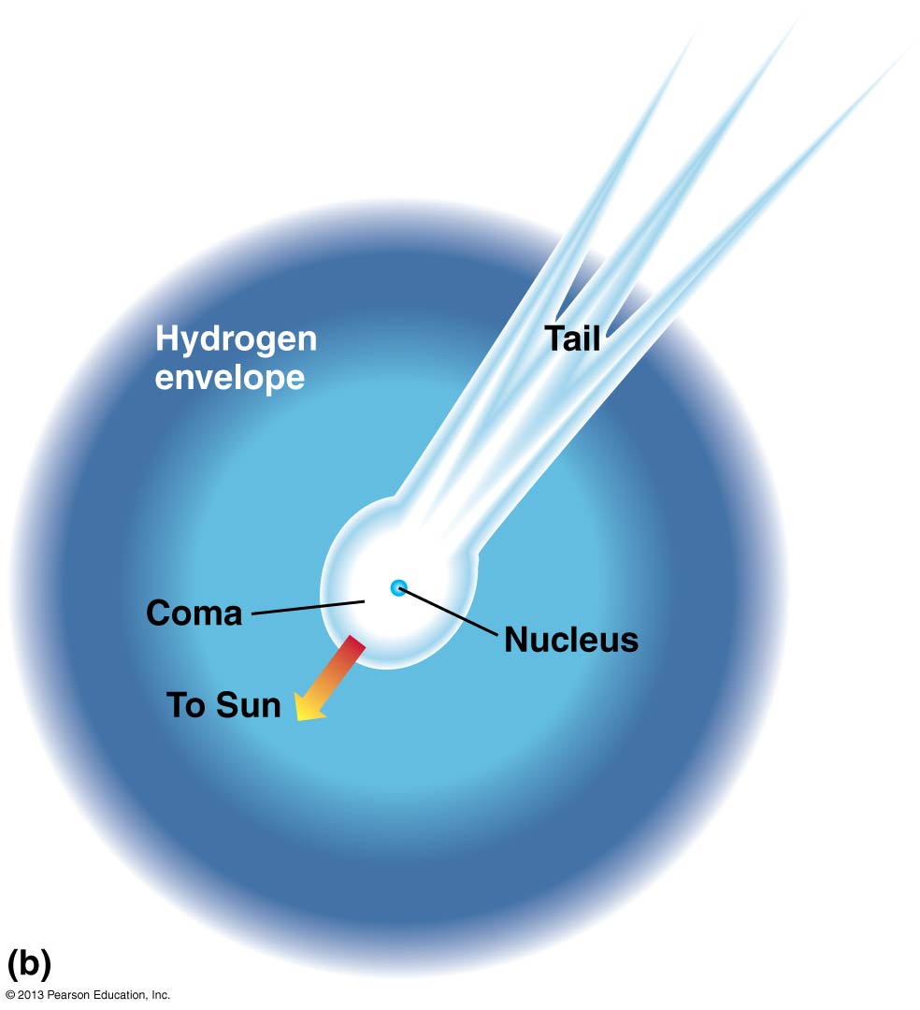
Comets, Asteroids, Meteors

Slide 4
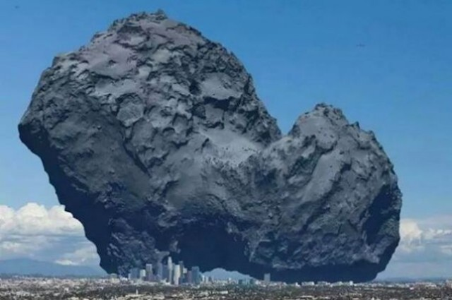
Comets
Notes:
https://www.youtube.com/watch?v=aeDFWqAW-9Y
https://www.youtube.com/watch?v=ktrtvCvZb28
http://www.esa.int/spaceinvideos/Videos/2014/01/Rosetta_s_orbit_around_the_comet

Slide 5
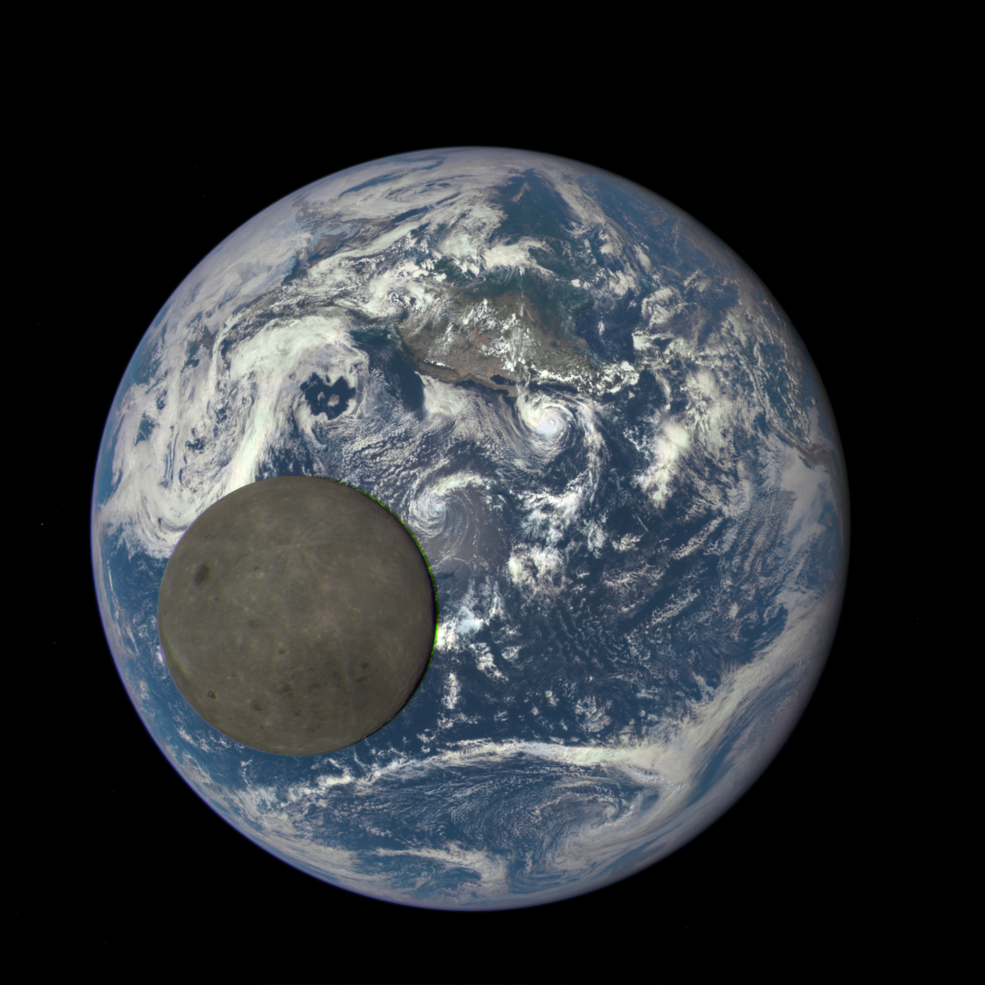
Notes:
Taken in Jan 2016 by the Deep Space Climate Observatory

Slide 6
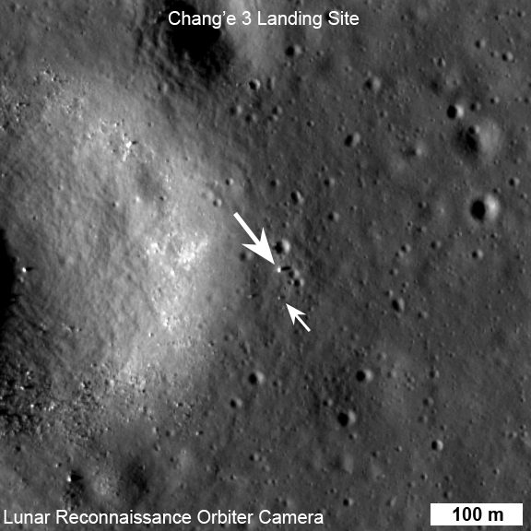

Slide 7
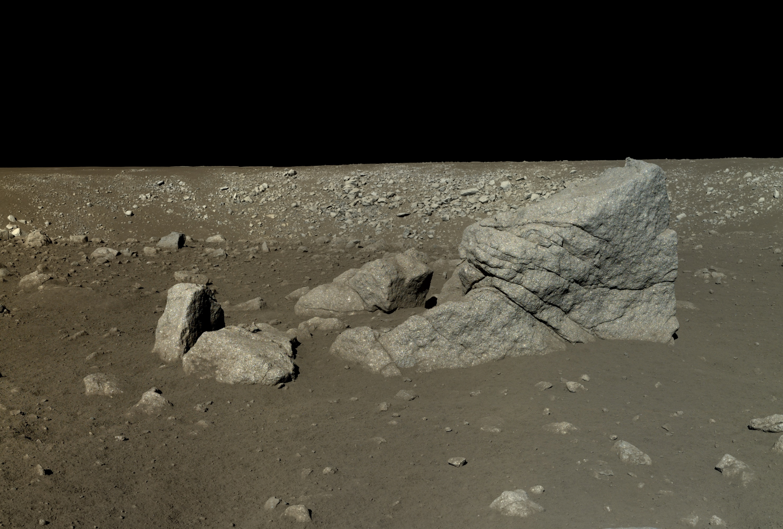
Notes:
Nice view: http://www.wired.com/2014/01/moon-panorama-change/

Slide 8
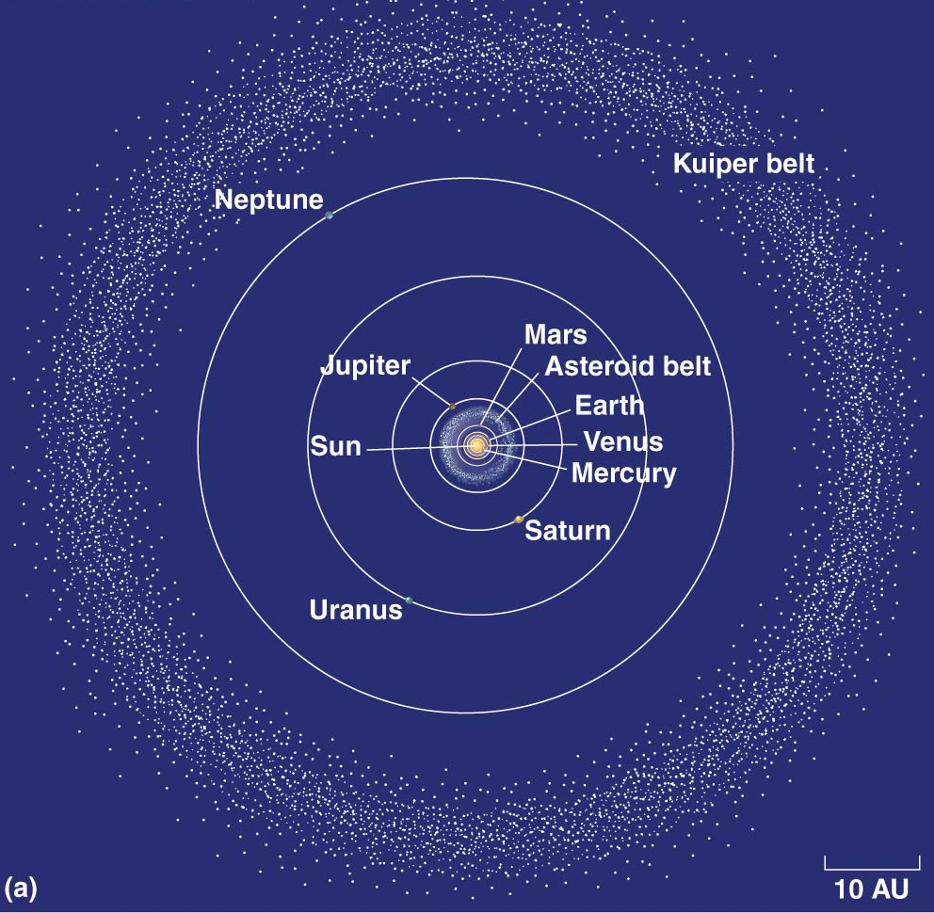
The Kuiper Belt is a 2D belt, consisting of comets, that lies outside Neptune’s orbit.
The Kuiper Belt contains Pluto and it’s sister dwarf planet, Charon
The Kuiper Belt is much, much smaller than the Oort Cloud (next slide)!

Slide 9
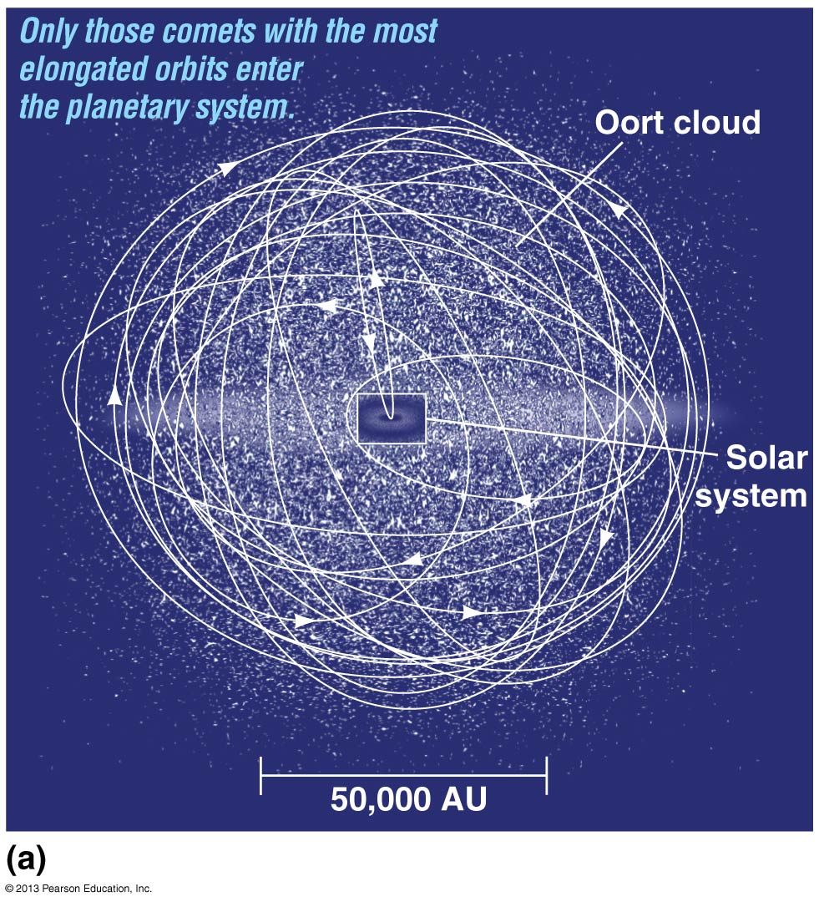

Slide 10
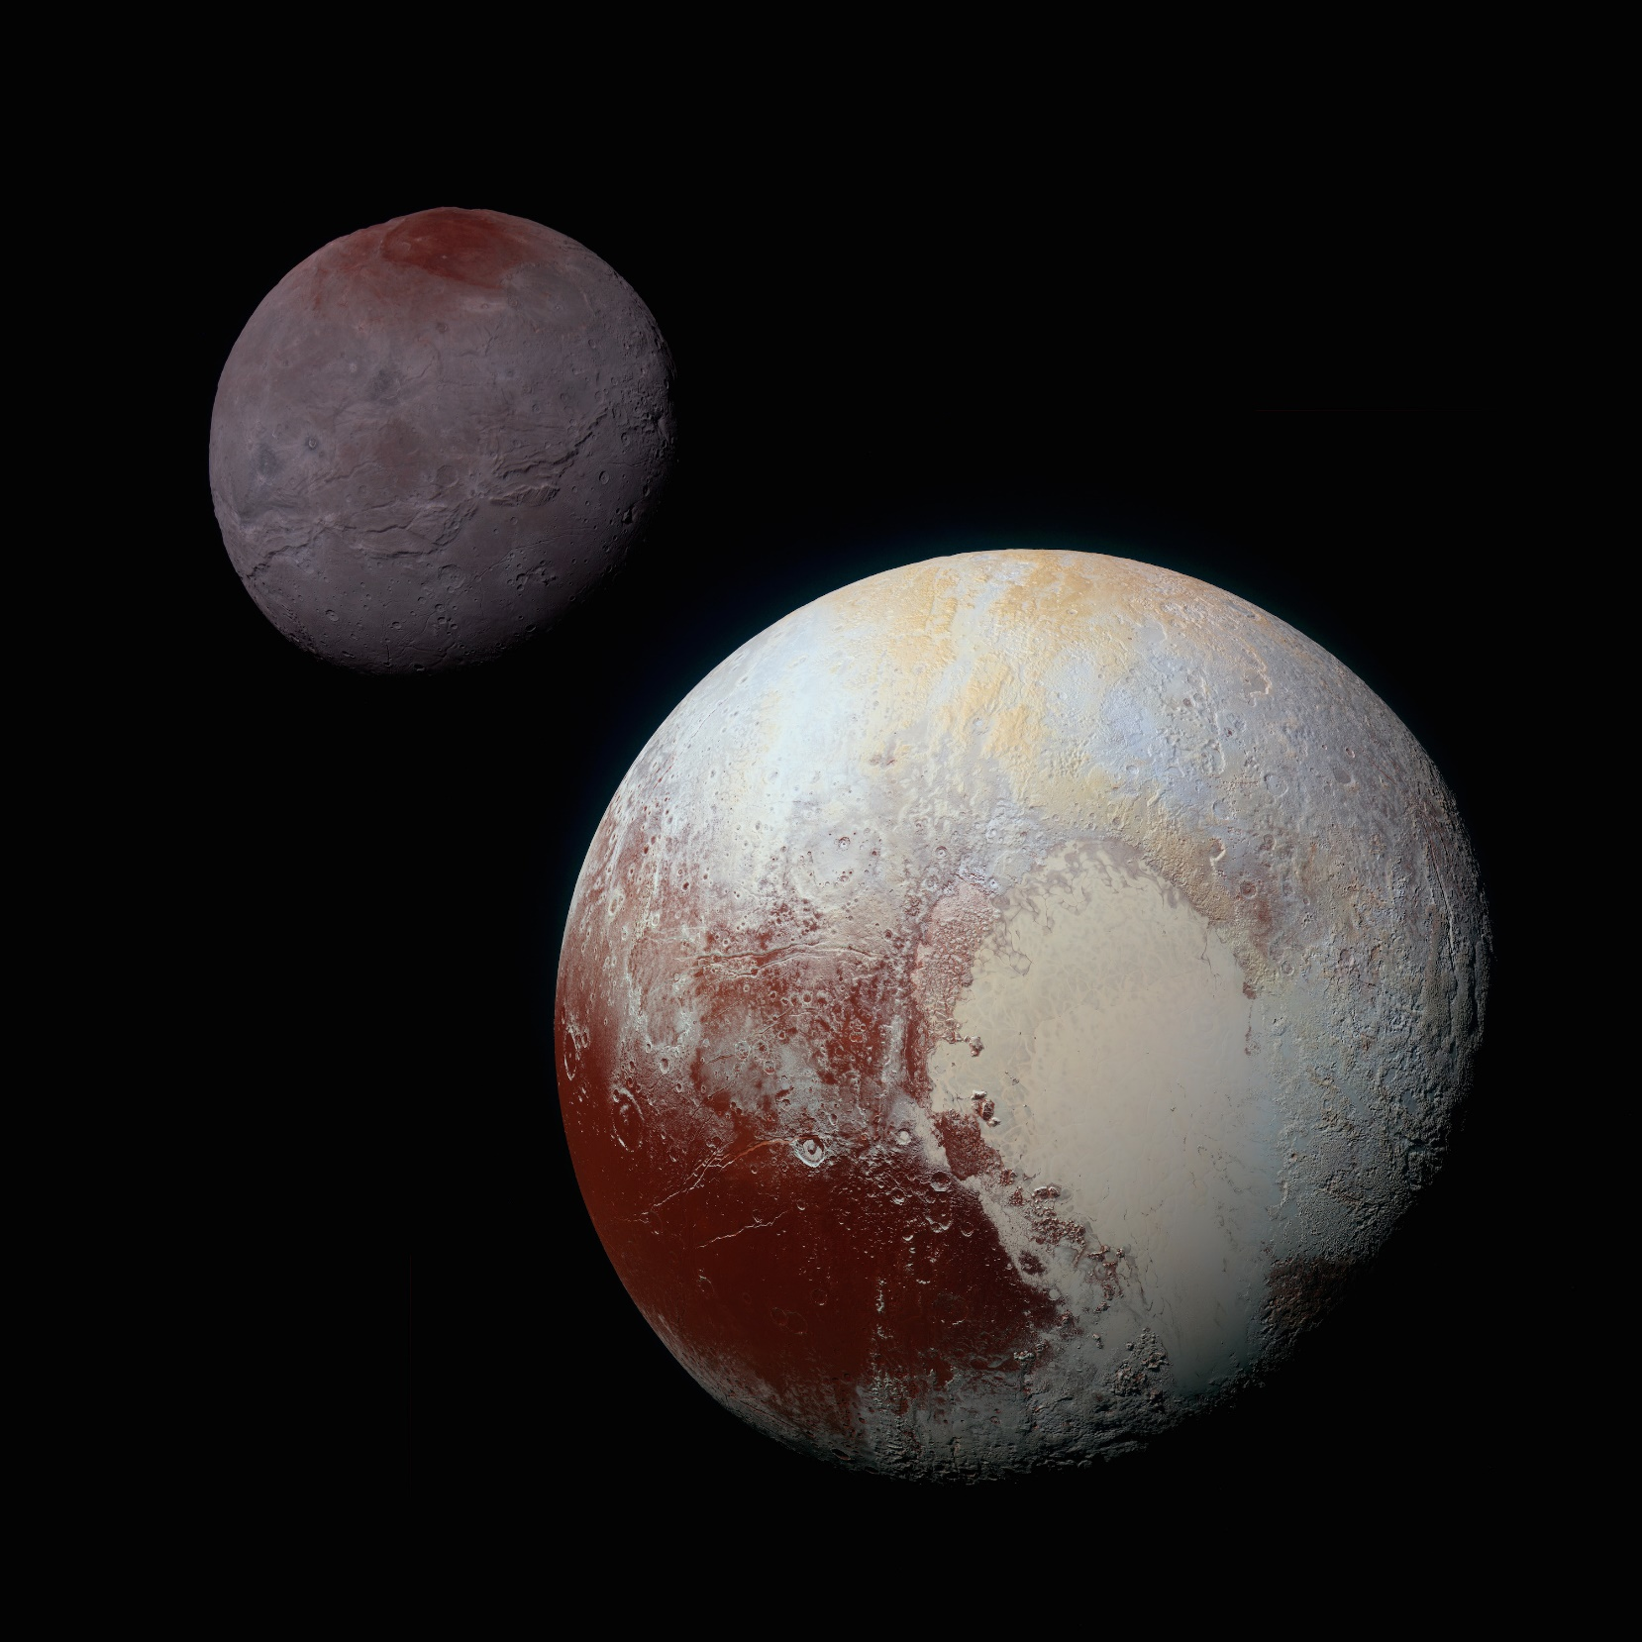
Charon
Photos taken by New Horizons spacecraft in September 2015!!
Pluto

Slide 11
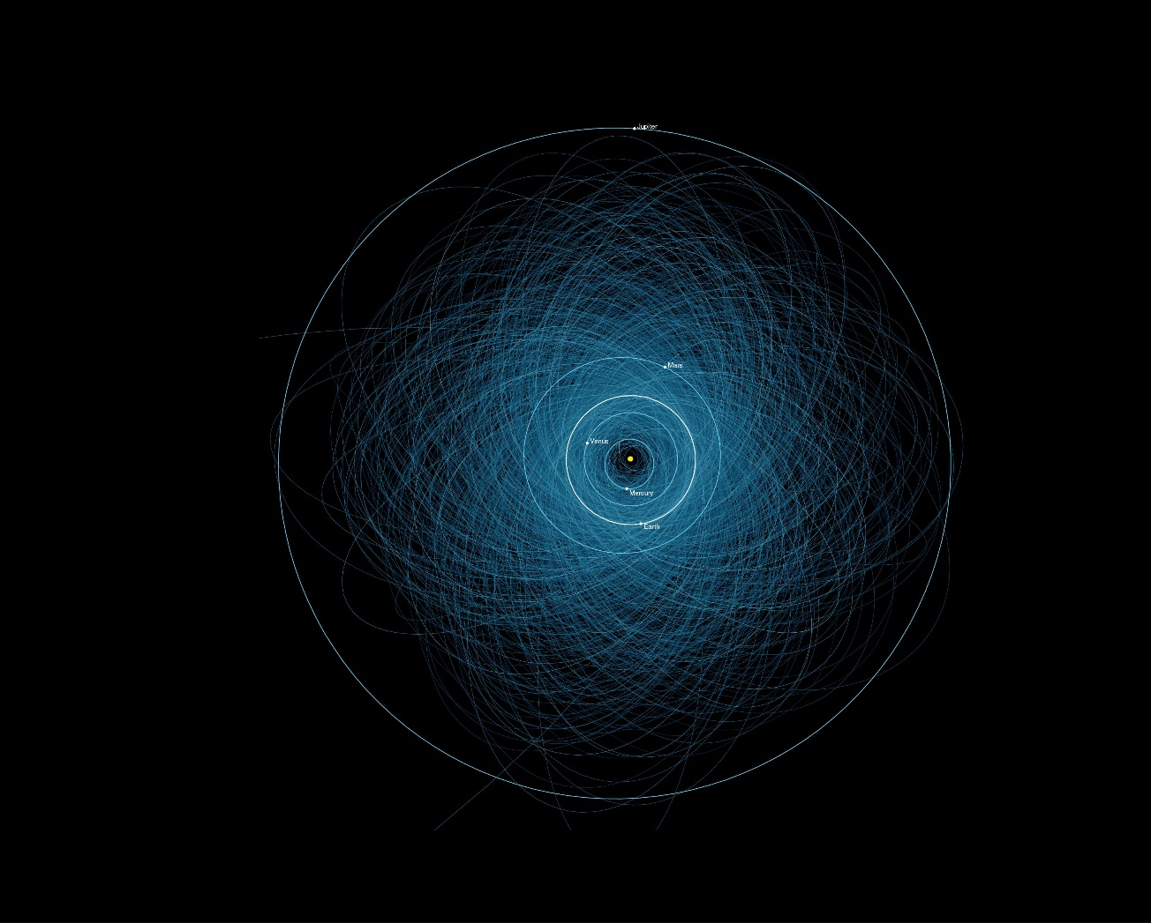
Notes:
Potentially Hazardous Asteroids

Slide 12
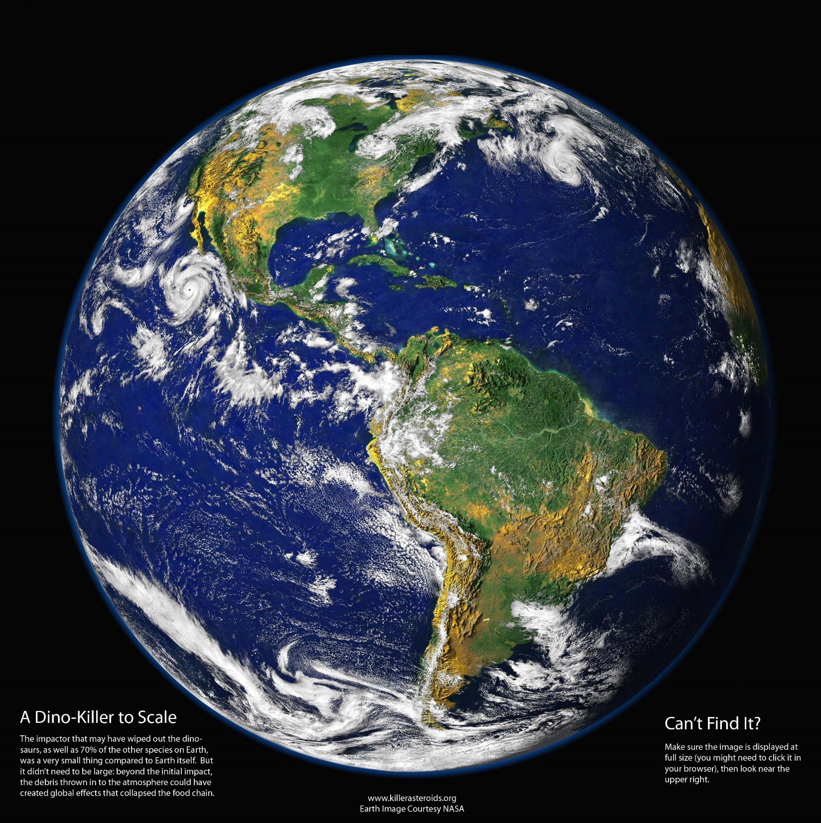

Slide 13
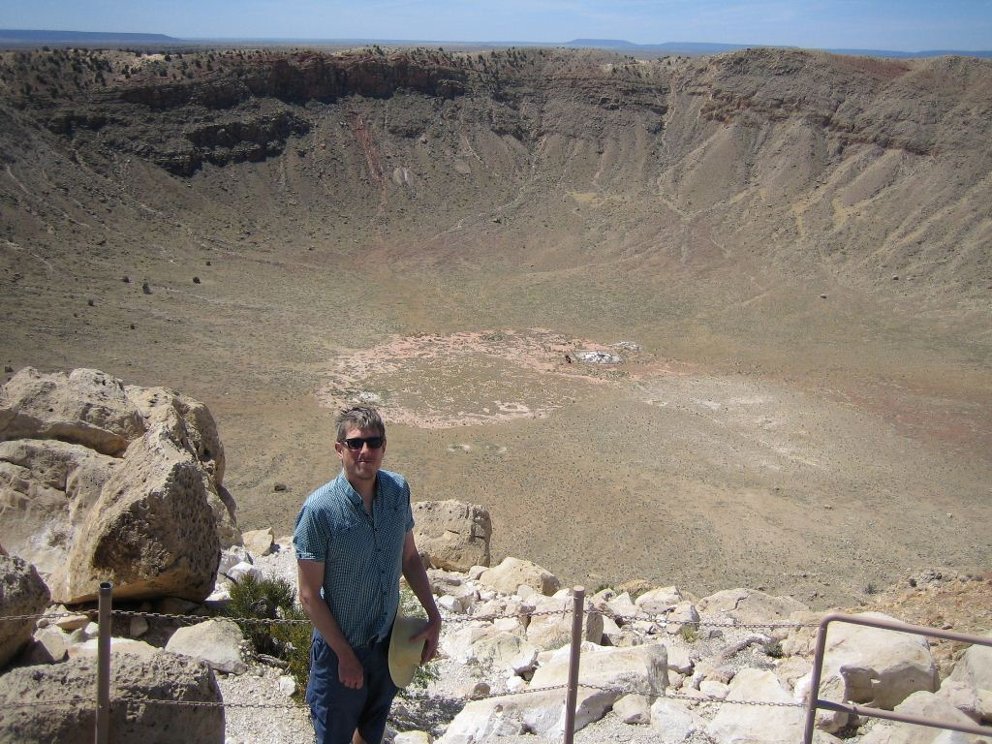

Result from asteroid impact.
Again, there are 1605 Potentially Hazardous Asteroids.
It is now accepted that an asteroid impact in Mexico (not this one!) caused or greatly accelerated the extinction of our dinosaur friends, based on analysis of impact glass and known dinosaur fossil records.
Most Asteroids are “safe”. They lie on the Main Asteroid Belt.
Notes:
The impact associated with the crater is thus implicated in theCretaceous–Paleogene extinction event, including the worldwide extinction of non-avian dinosaurs. This conclusion has been the source of controversy. In March 2010, 41 experts from many countries reviewed the available evidence: 20 years' worth of data spanning a variety of fields. They concluded that the impact at Chicxulub triggered the mass extinctions at the K–Pg boundary.^{[6][7]} In 2013 a study compared isotopes in impact glass from the Chicxulub impact with the same isotopes in ash from the boundary where the extinction eventoccurred in the fossil record; the study concluded that the impact glasses were dated at 66.038 ± 0.049 Ma, and the deposits immediately above the discontinuity in the geological and fossil record was dated to 66.019 ± 0.021 Ma, the two dates being within 19 kyr of each other, or almost exactly the same within experimental error.^{[8]}

Slide 14

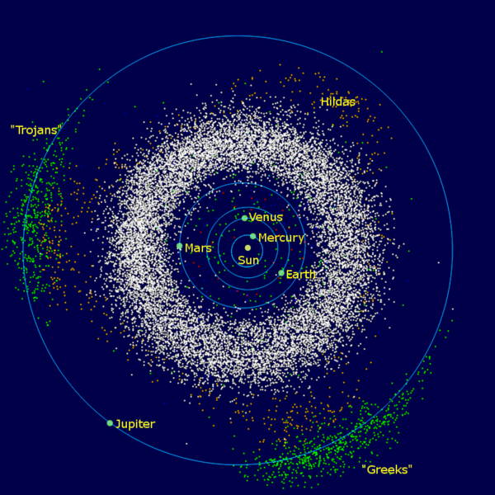
Main Asteroid Belt
Notes:
https://www.youtube.com/watch?t=6&v=3UkEximY6lc

Slide 15
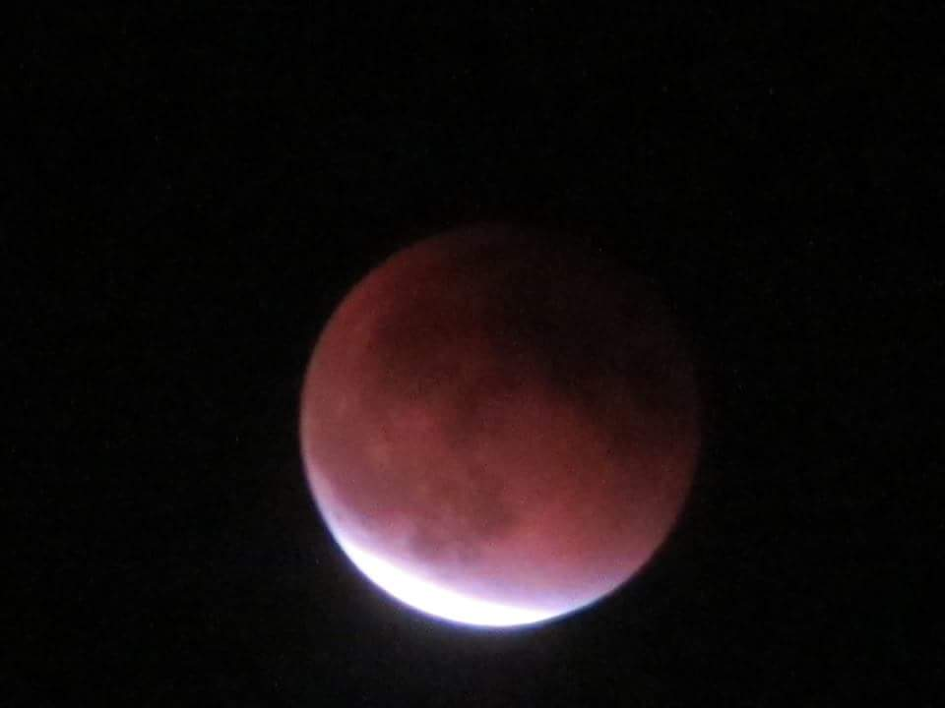

Slide 16
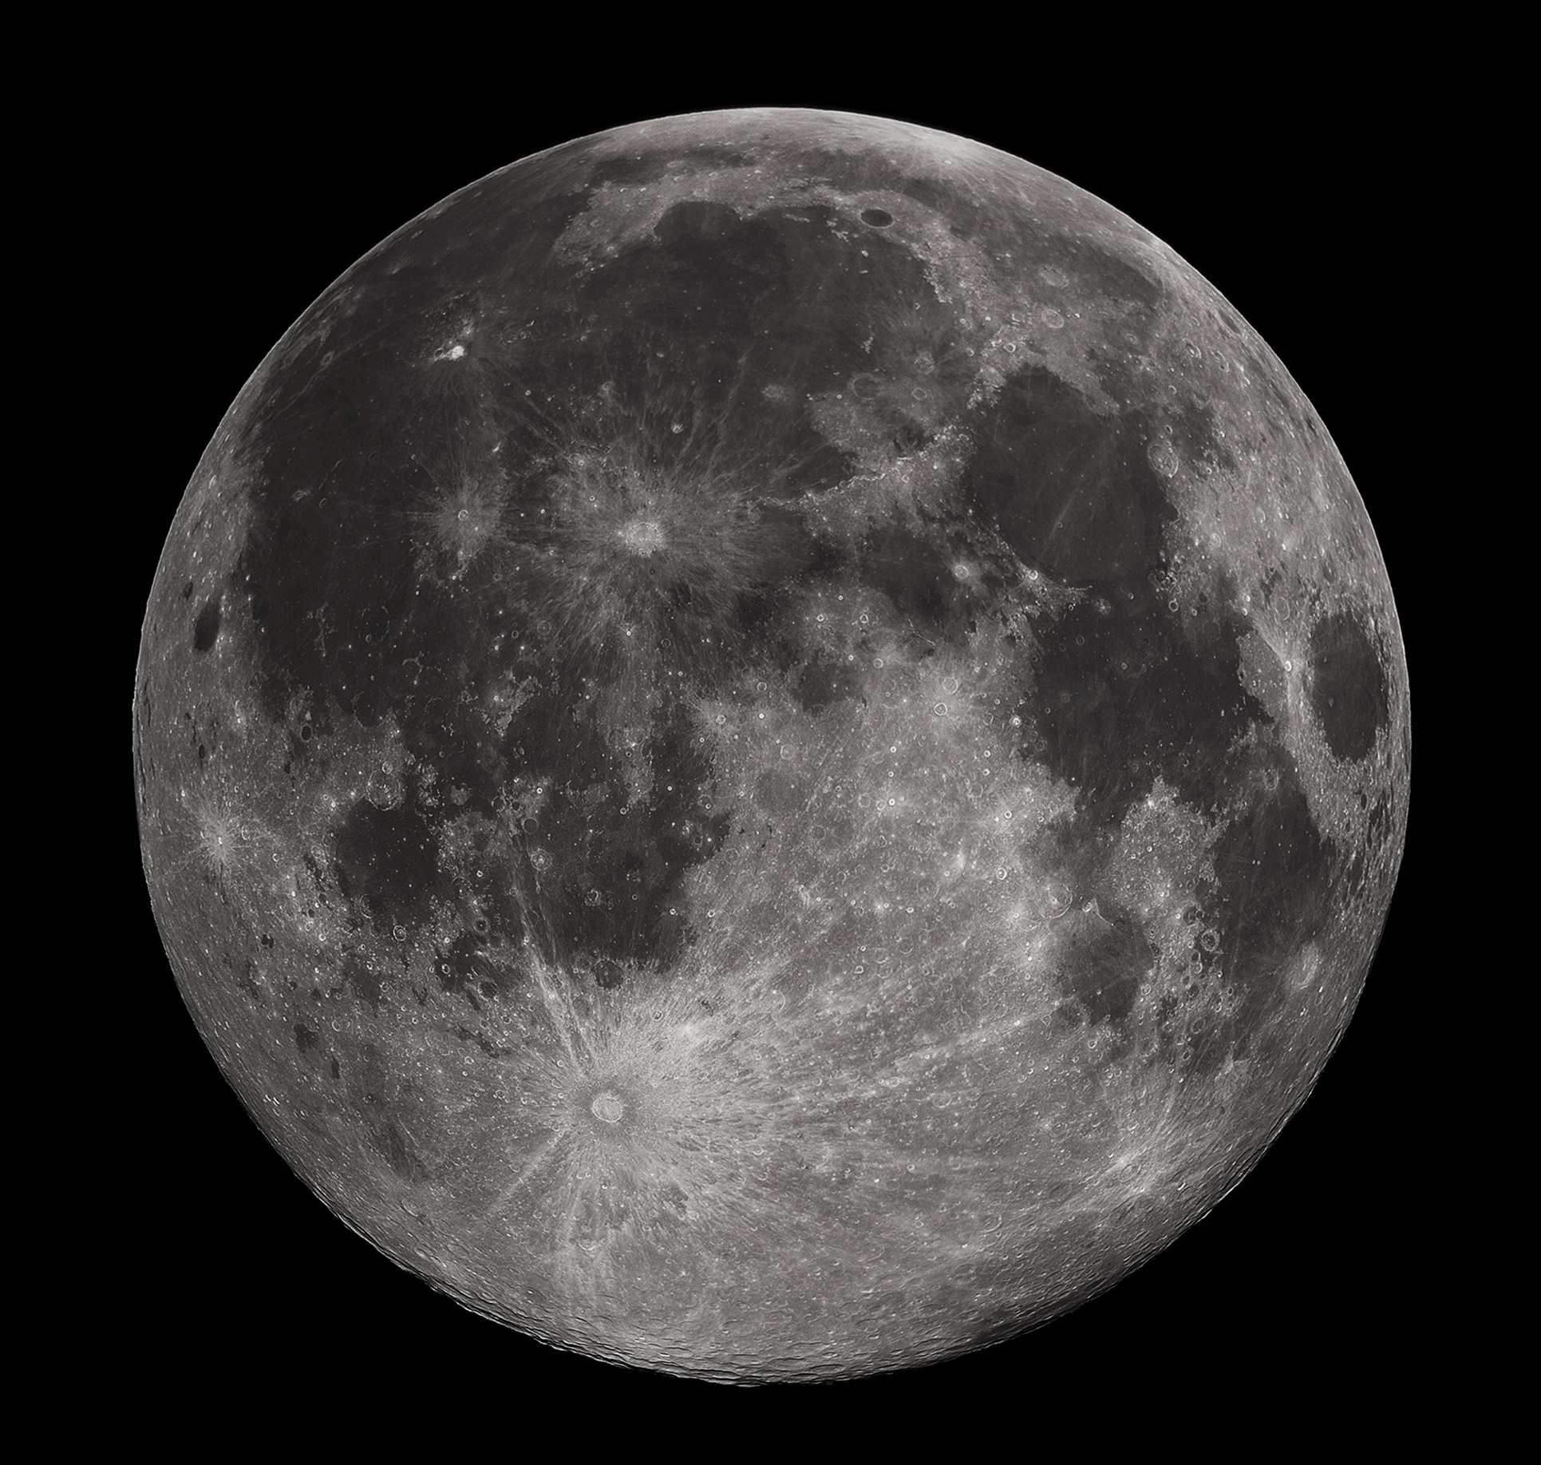
Let’s talk about the Moon:
Orbital Period
Rotation Period
Roche Limit
Tidal Locking (and Ocean Tides!)
Roche Limit

Slide 17
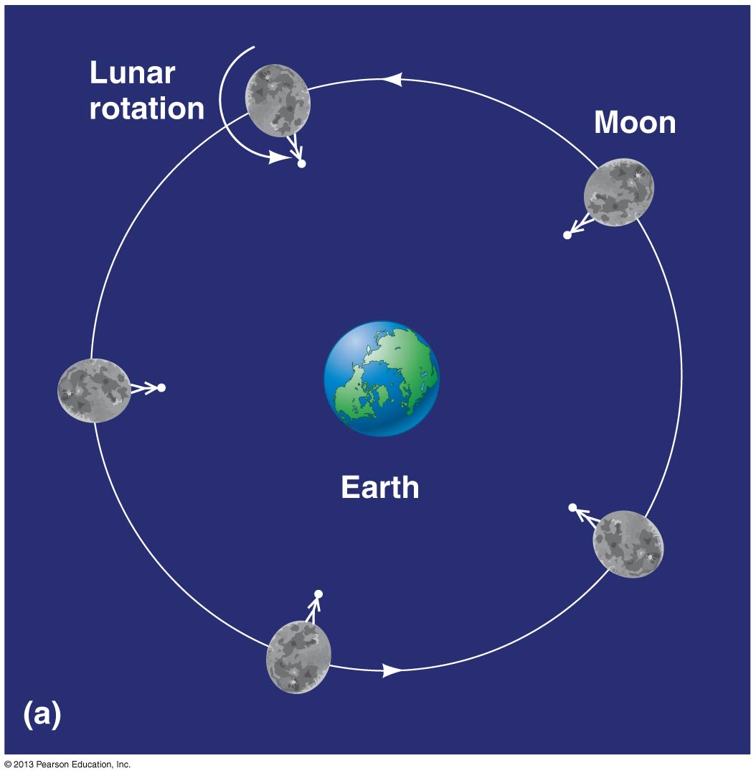
Tidal Locking

Slide 18
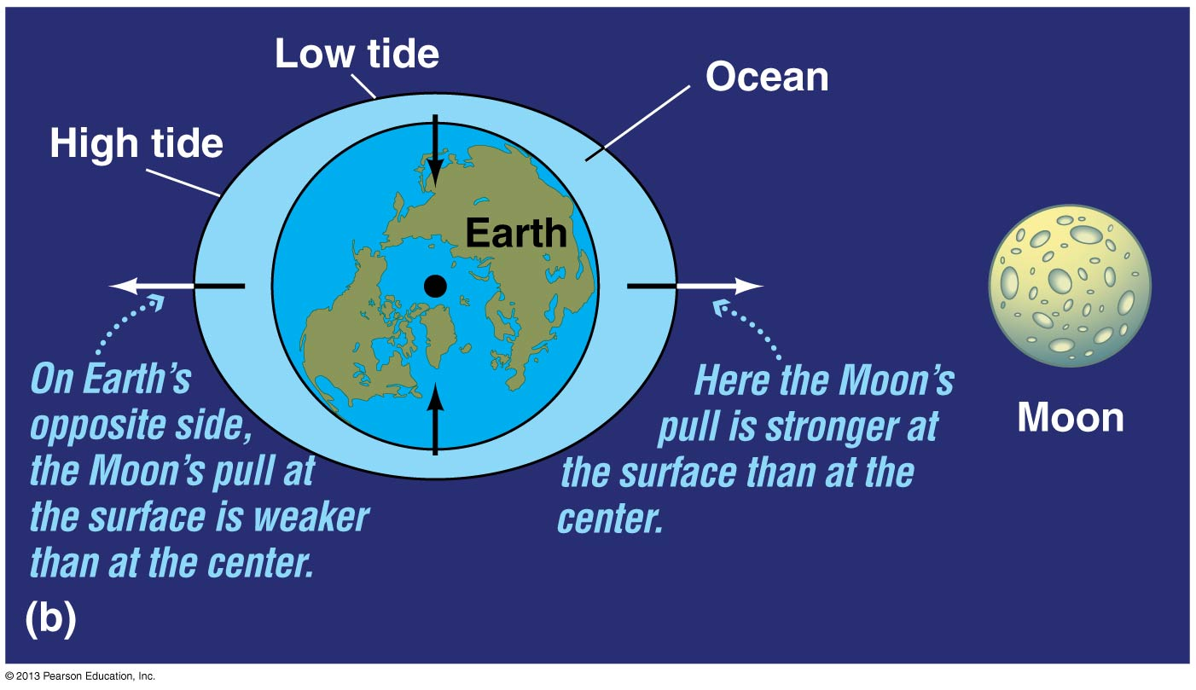
Notes:
https://www.youtube.com/watch?v=sTBIr65cL_E

Slide 19
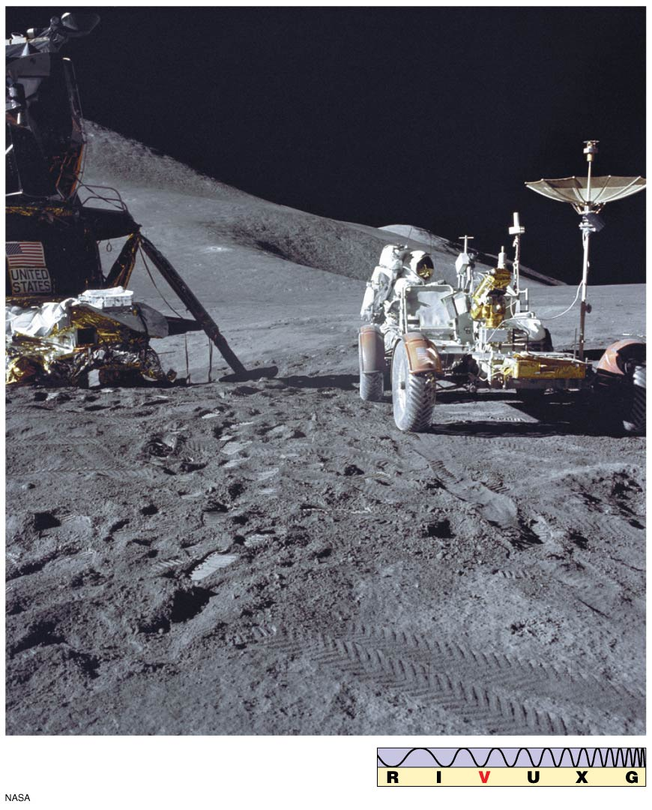
Notes:
https://www.youtube.com/watch?v=sTBIr65cL_E

Slide 20
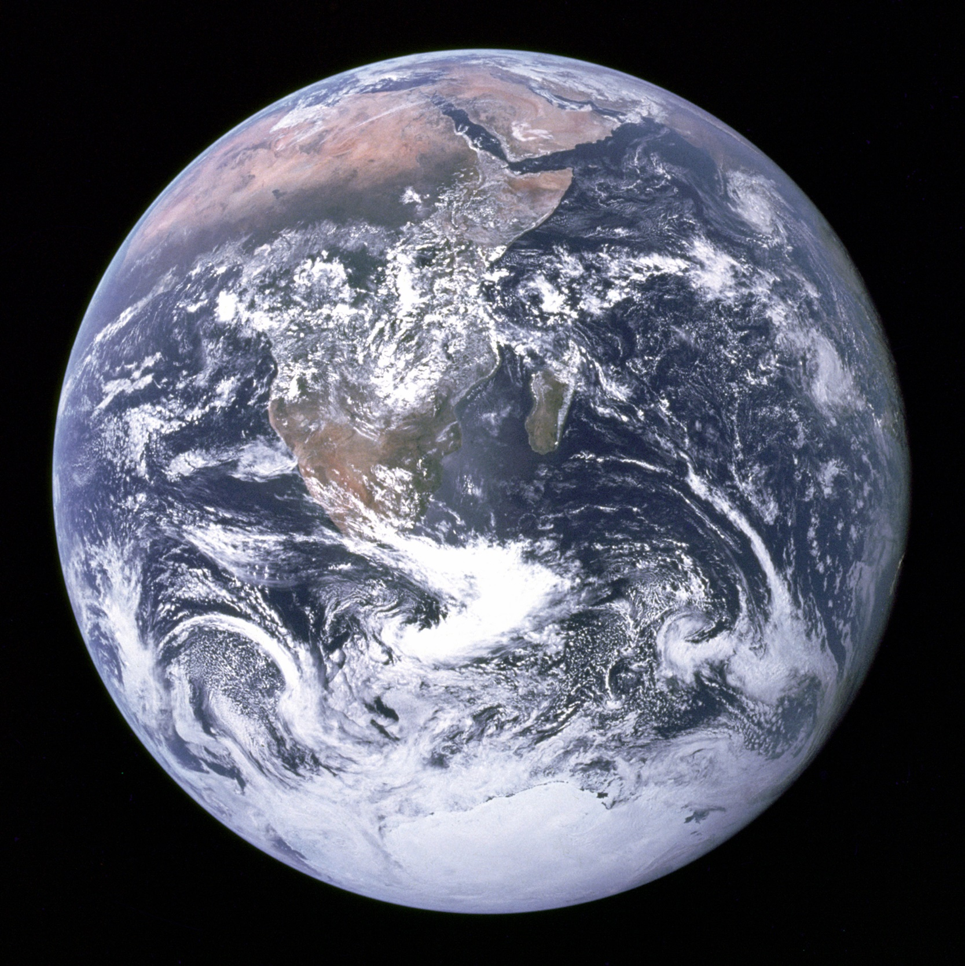
Let’s talk about the Earth:
Magnetosphere
Aurora Borealis
Greenhouse Effect
Ozone Layer
Van Allen Belt (inner, outer)

Slide 21
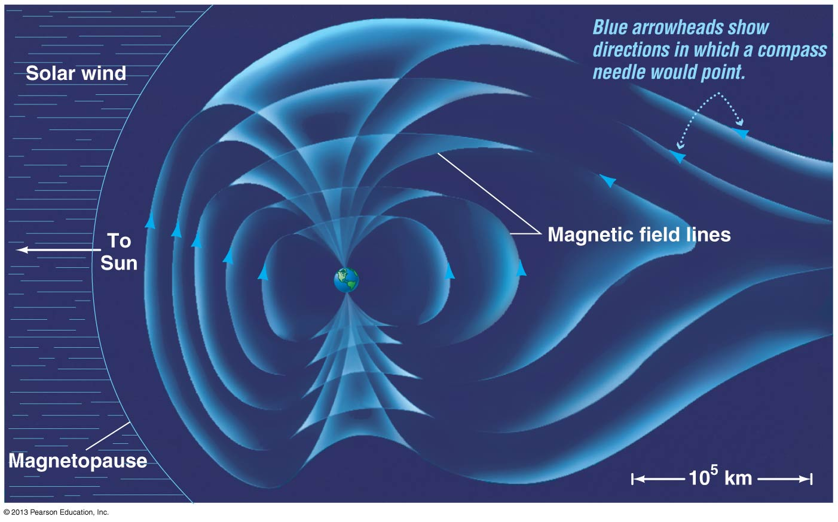

Slide 22


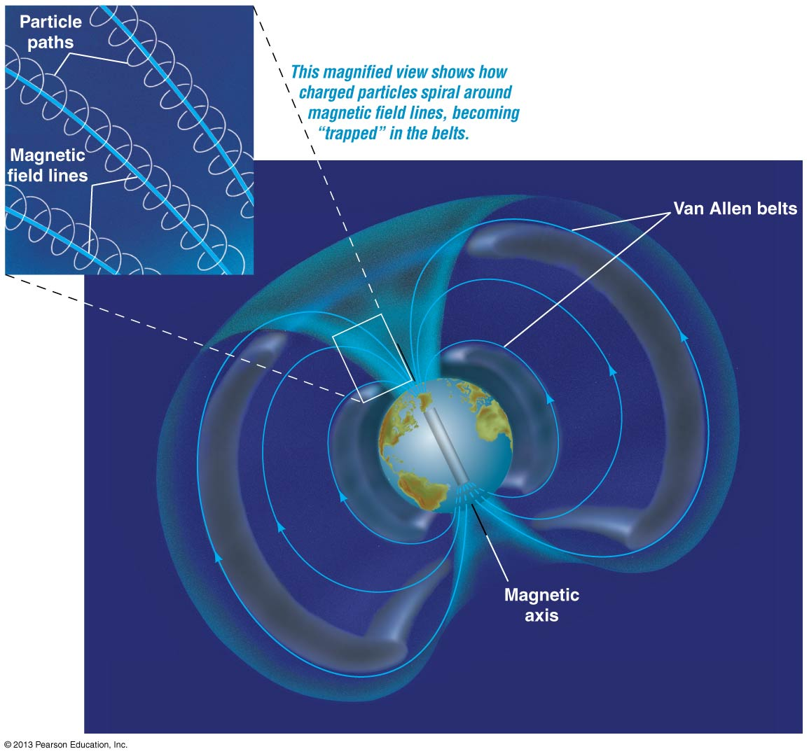

Slide 23
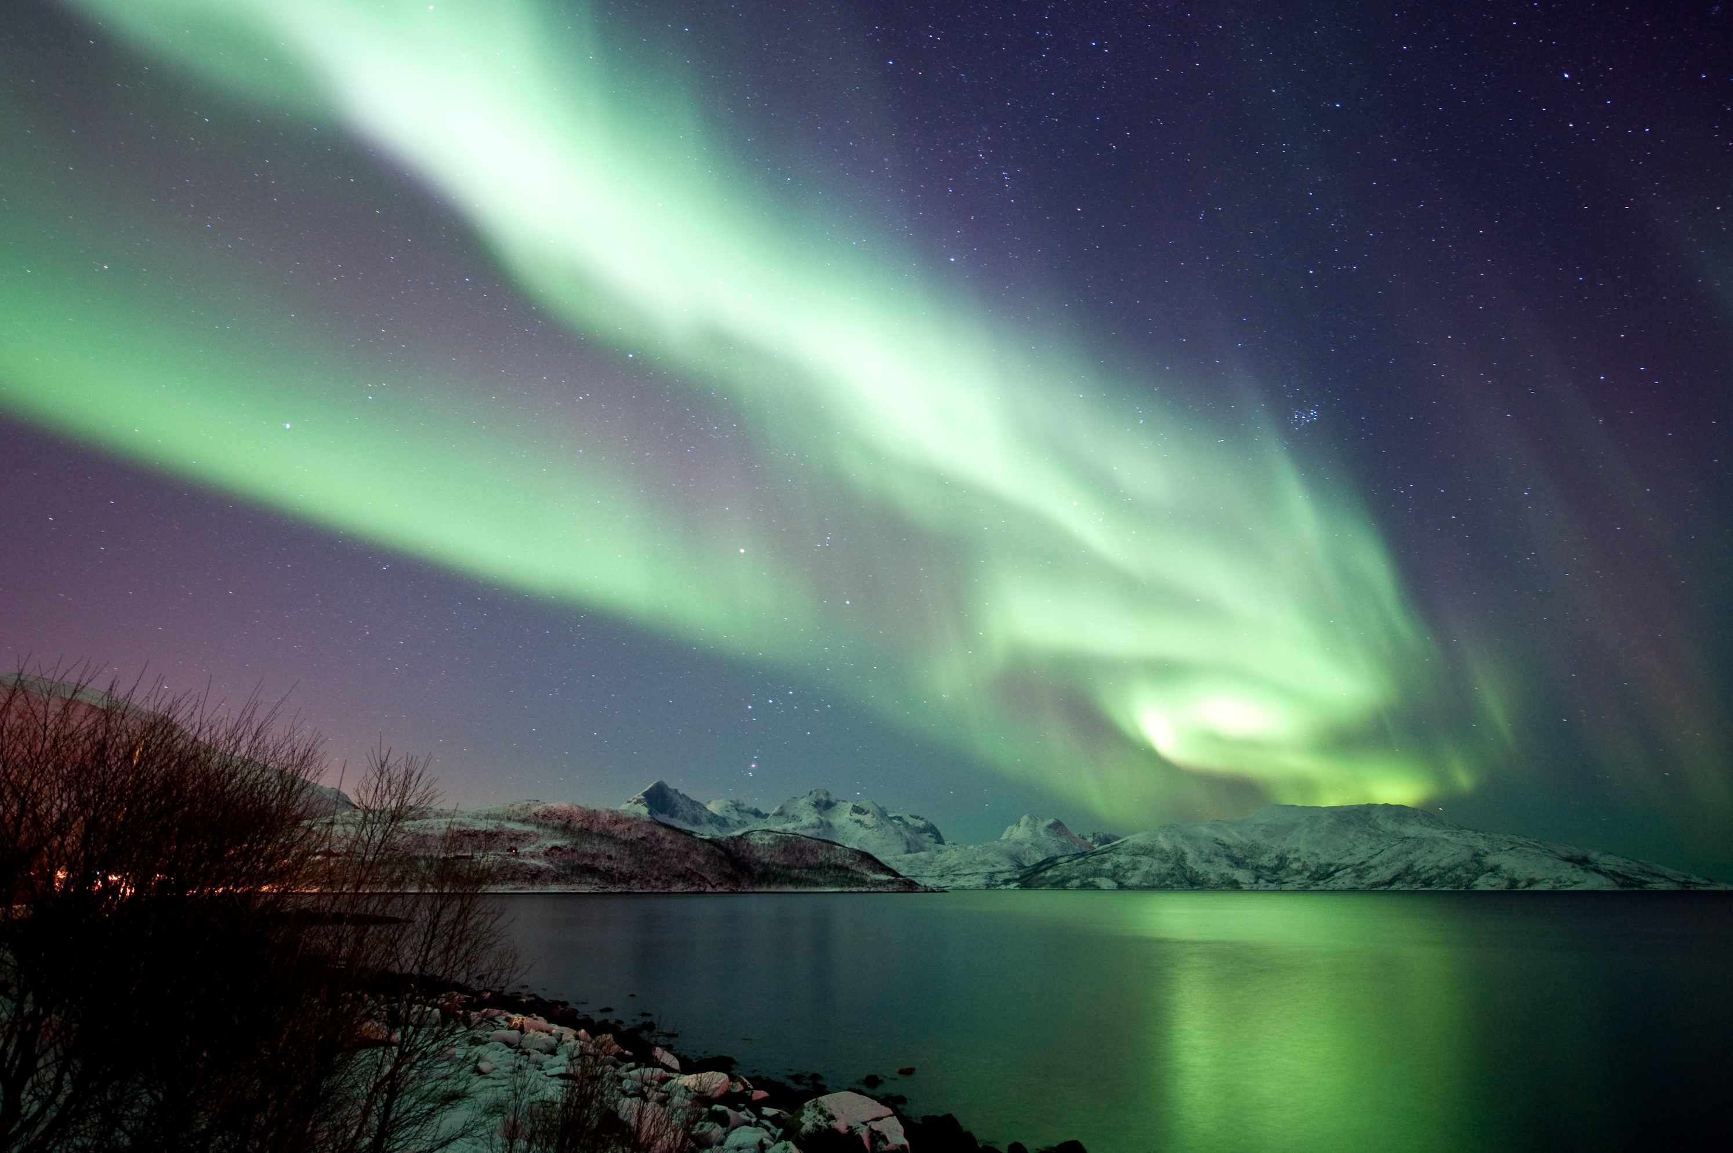

Slide 24
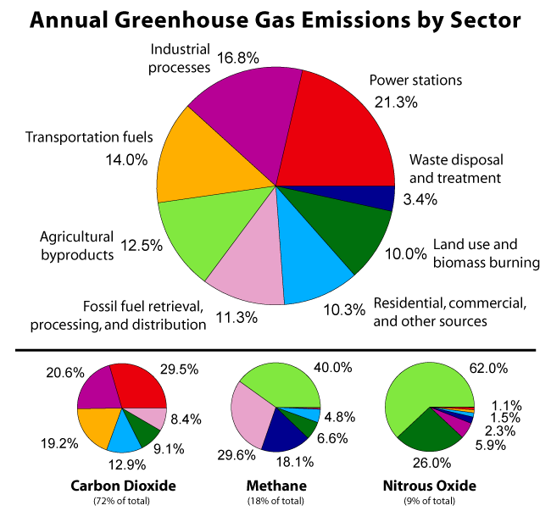
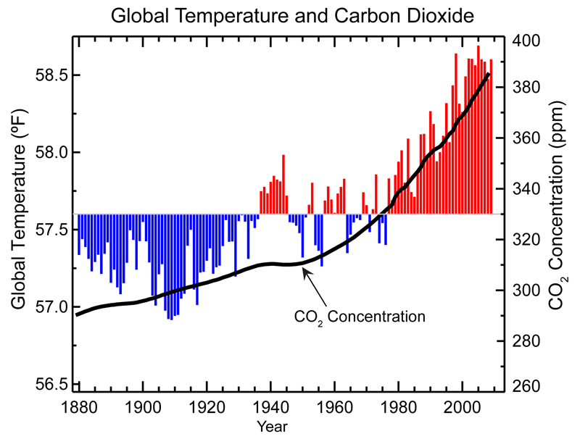
Climate Change – Greenhouse Gasses

