Slide 1
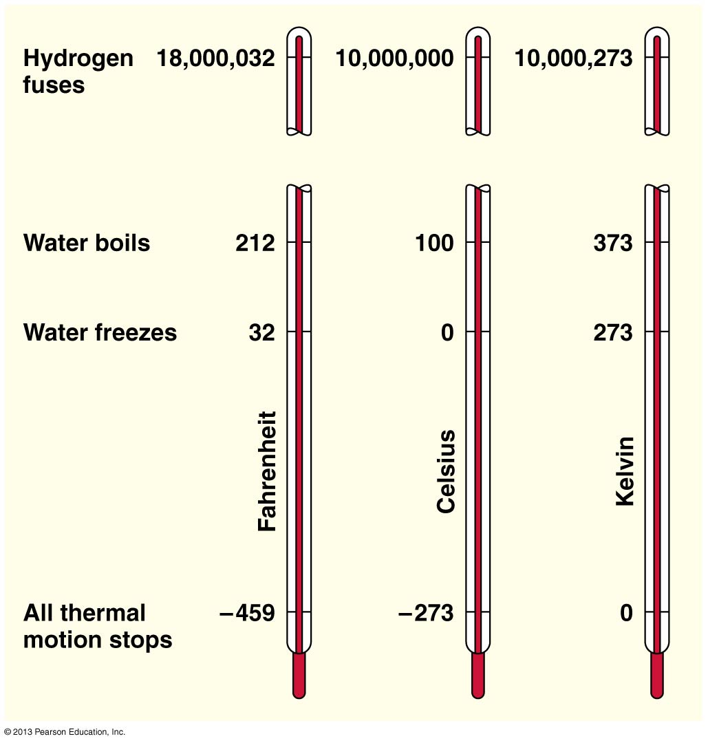

Slide 2
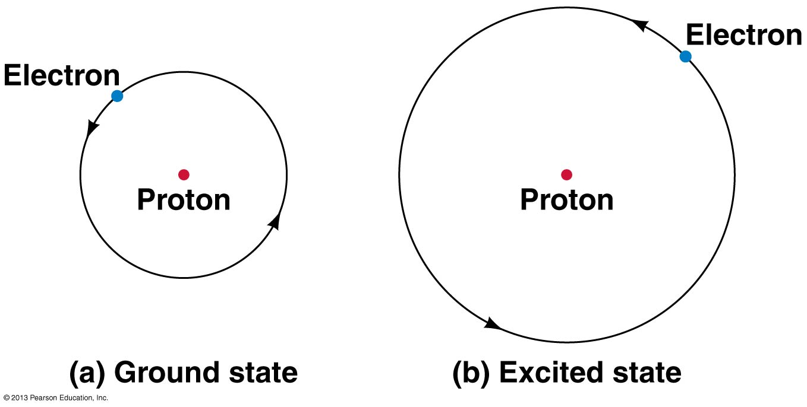

Slide 3
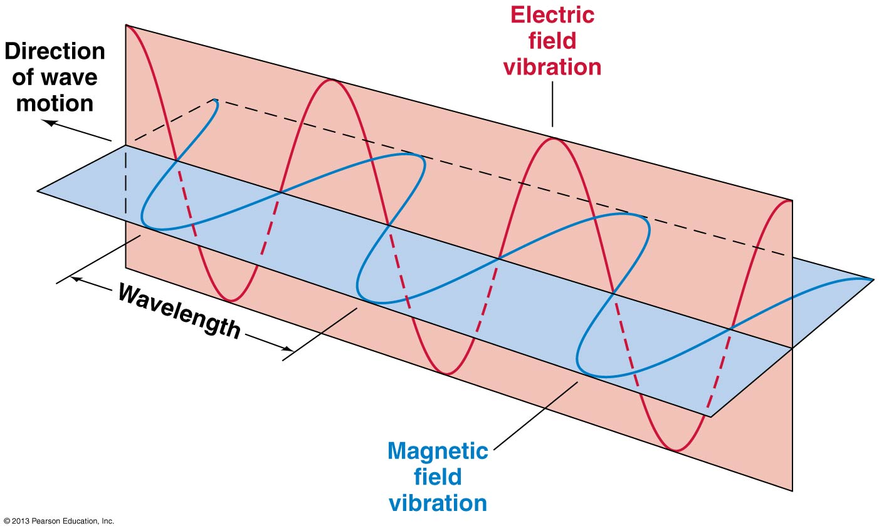
Notes:
https://www.youtube.com/watch?v=ro_a5gw0J6w

Slide 4
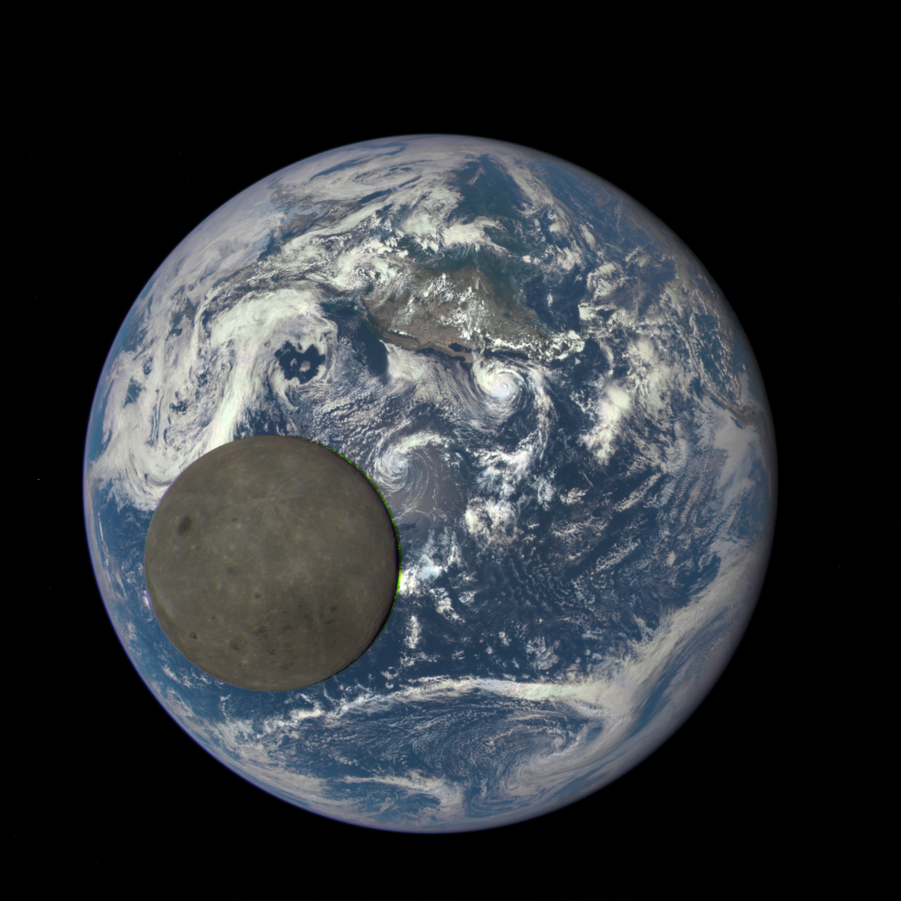
Notes:
Taken in Jan 2016 by the Deep Space Climate Observatory

Slide 5
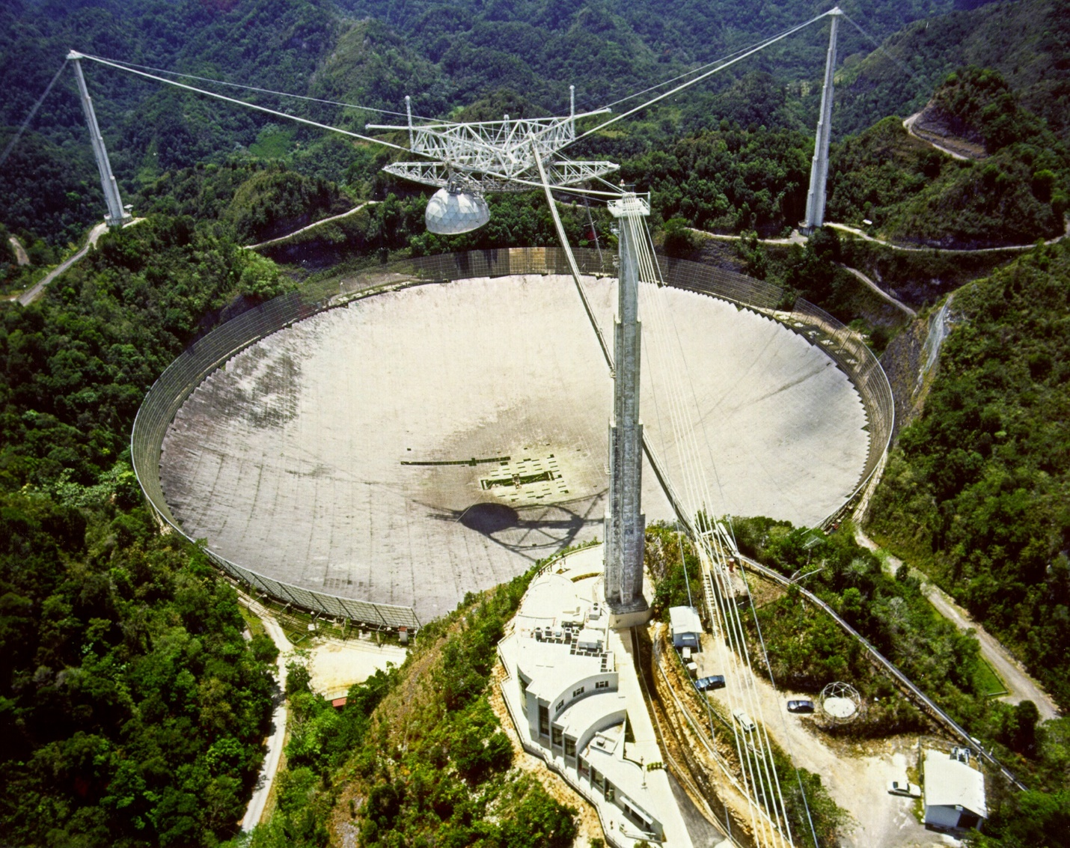
Notes:
https://www.youtube.com/watch?v=ZxPMJ41yTW0

Slide 6
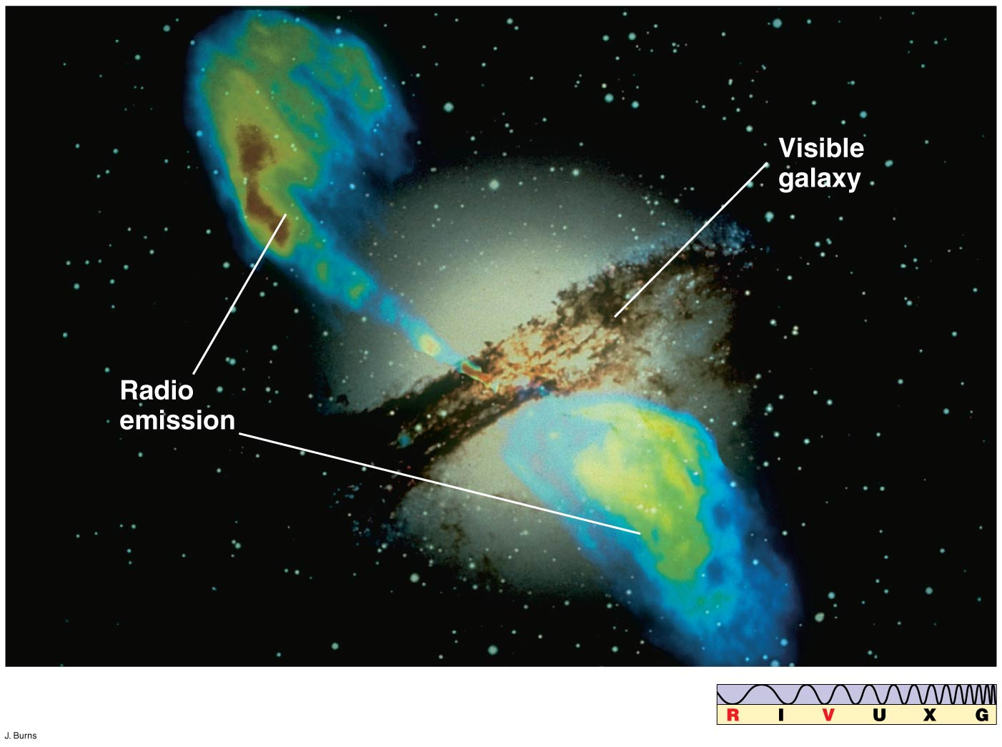

Slide 7
Notes:
https://www.youtube.com/watch?v=ZxPMJ41yTW0

Slide 8
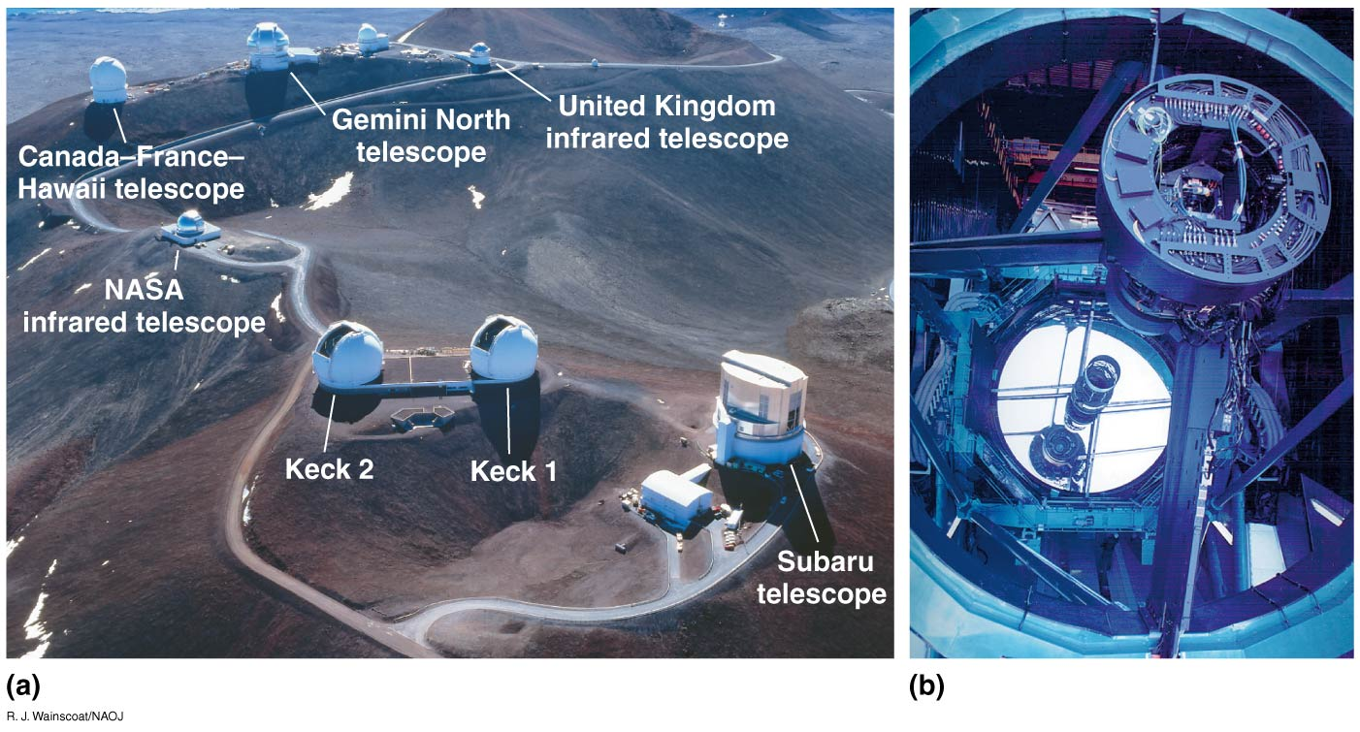

Slide 9
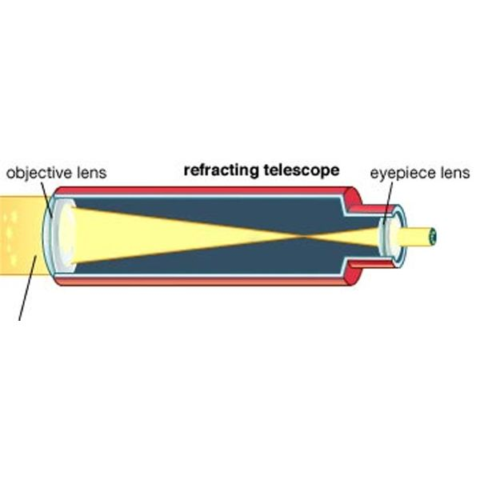
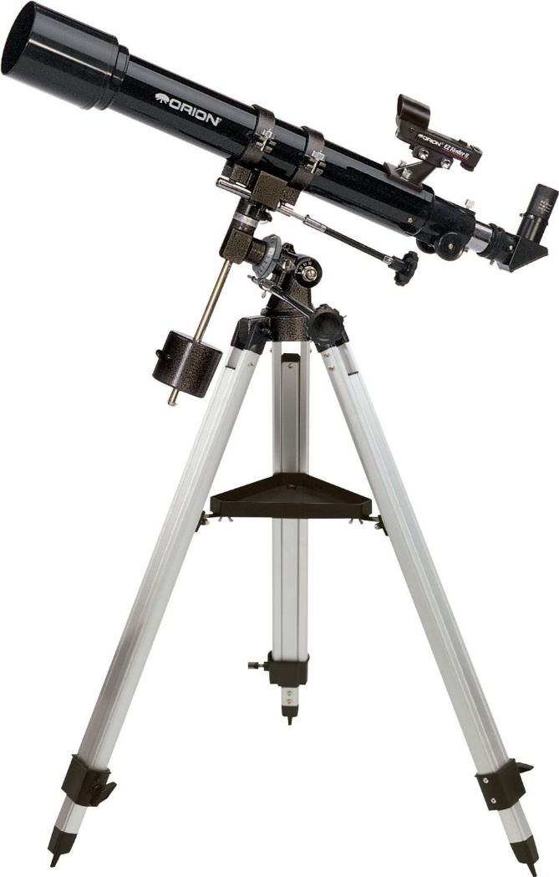
Refracting Telescope

Slide 10
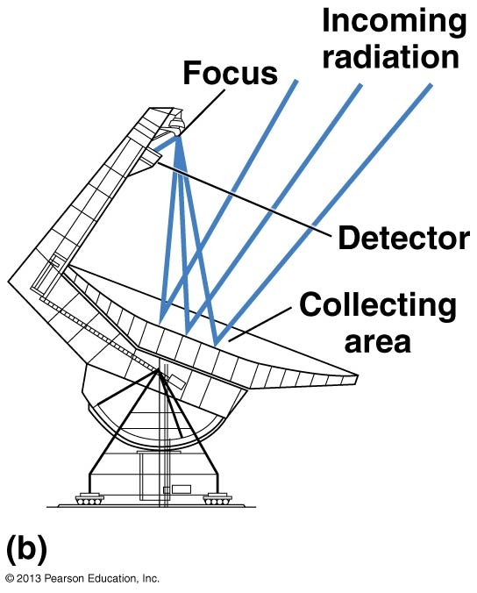
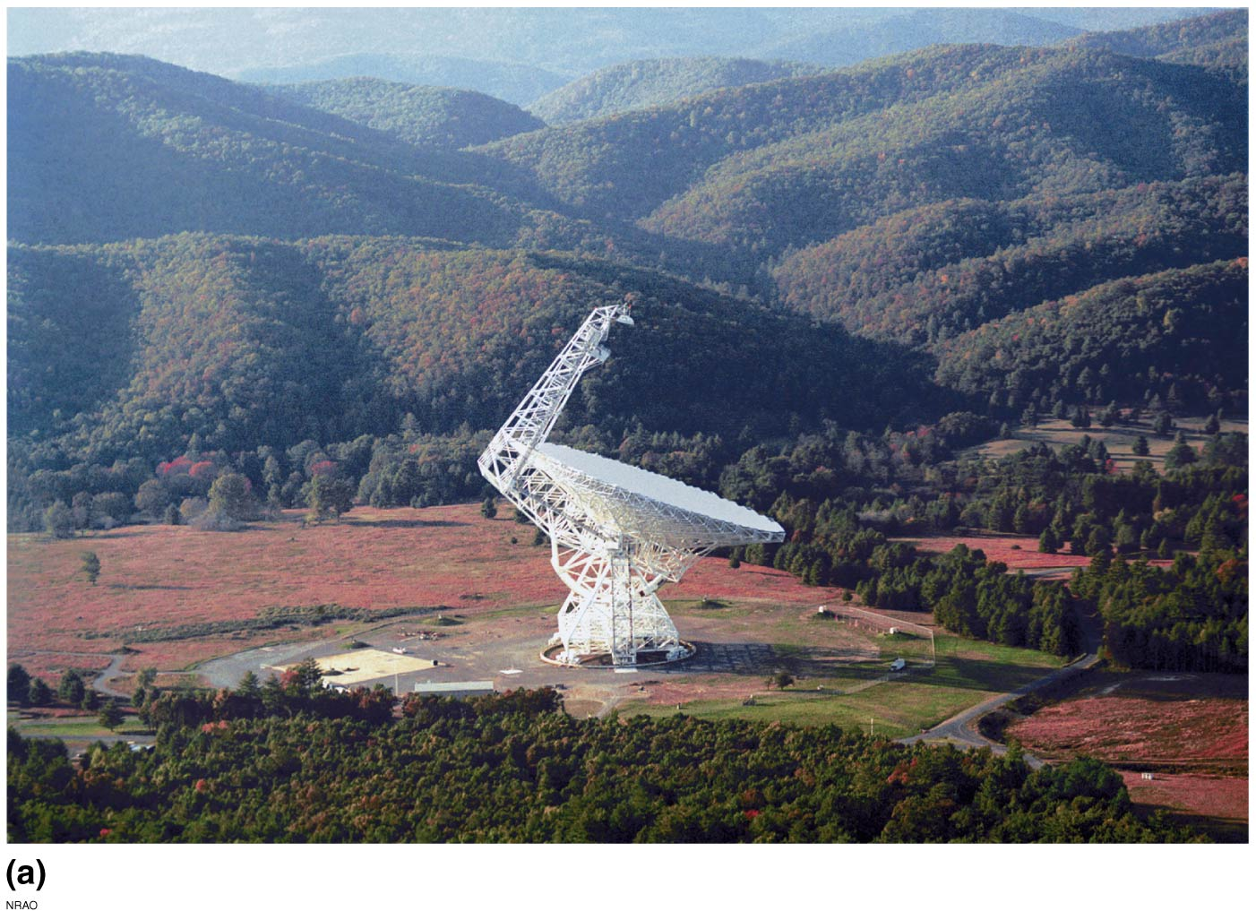
Reflecting Telescope

Slide 11
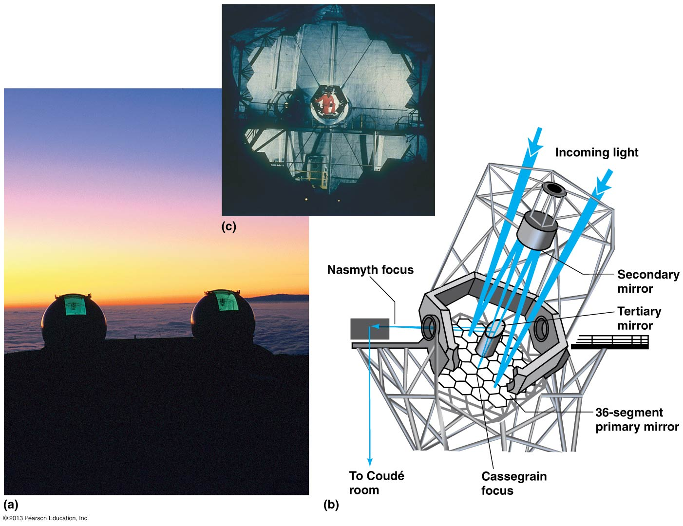
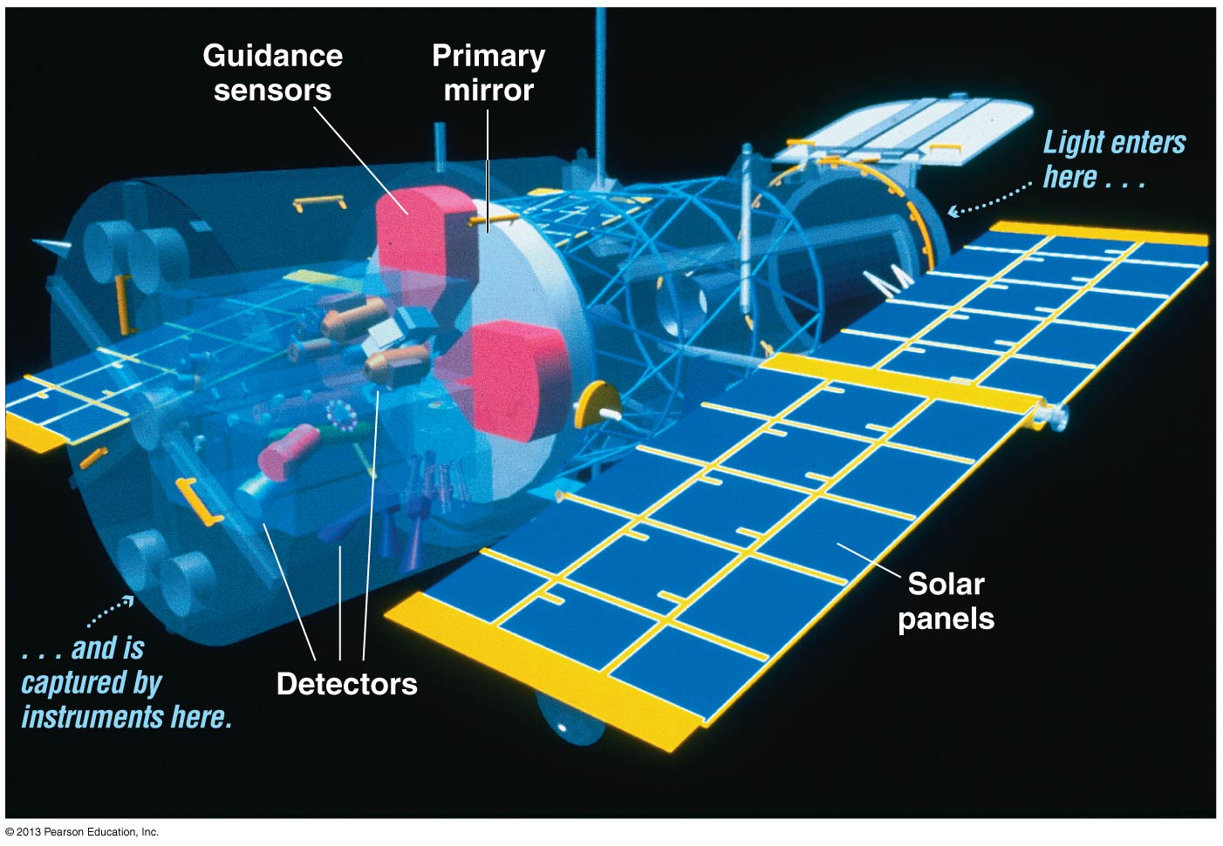
Reflecting Telescope
Notes:
https://www.youtube.com/watch?v=QHkibCZQl3s

Slide 12
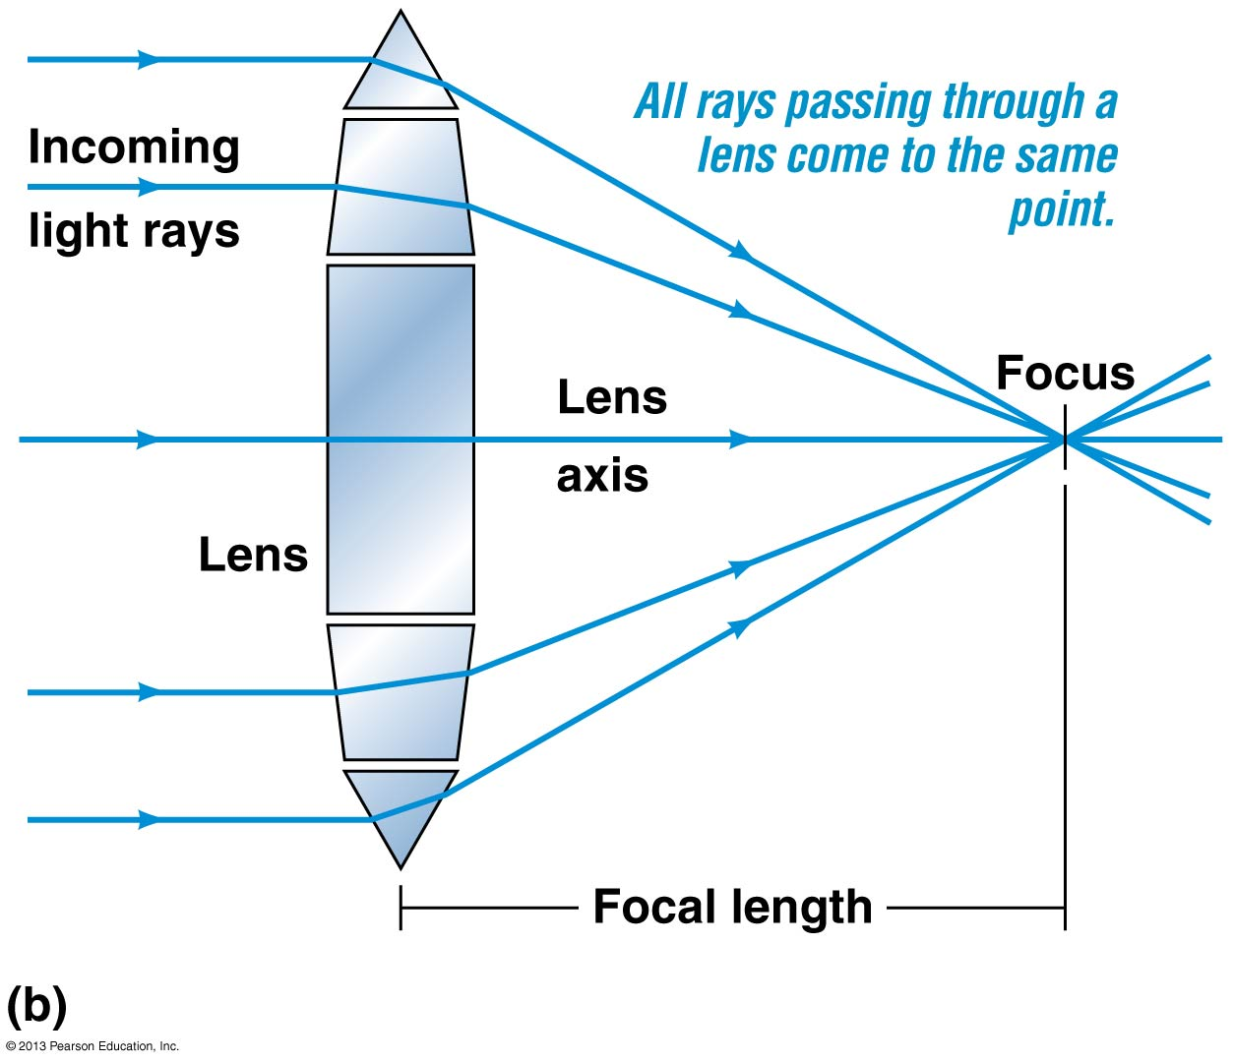
Glass: Focal Length, Focus

Slide 13
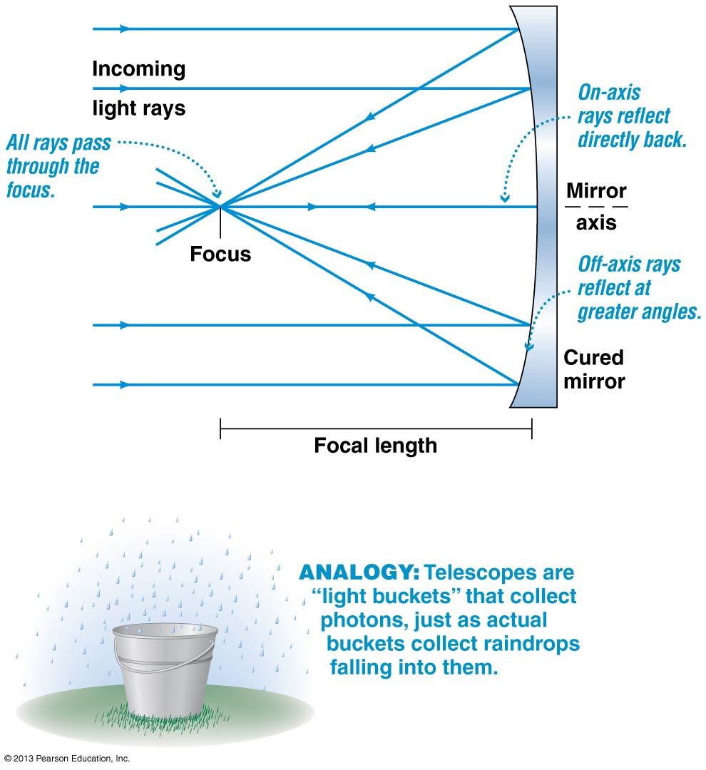
Mirror: Focal Length, Focus

Slide 14
Reflecting Telescope

Slide 15
Reflecting Telescope
Notes:
https://www.youtube.com/watch?v=QHkibCZQl3s

Slide 16
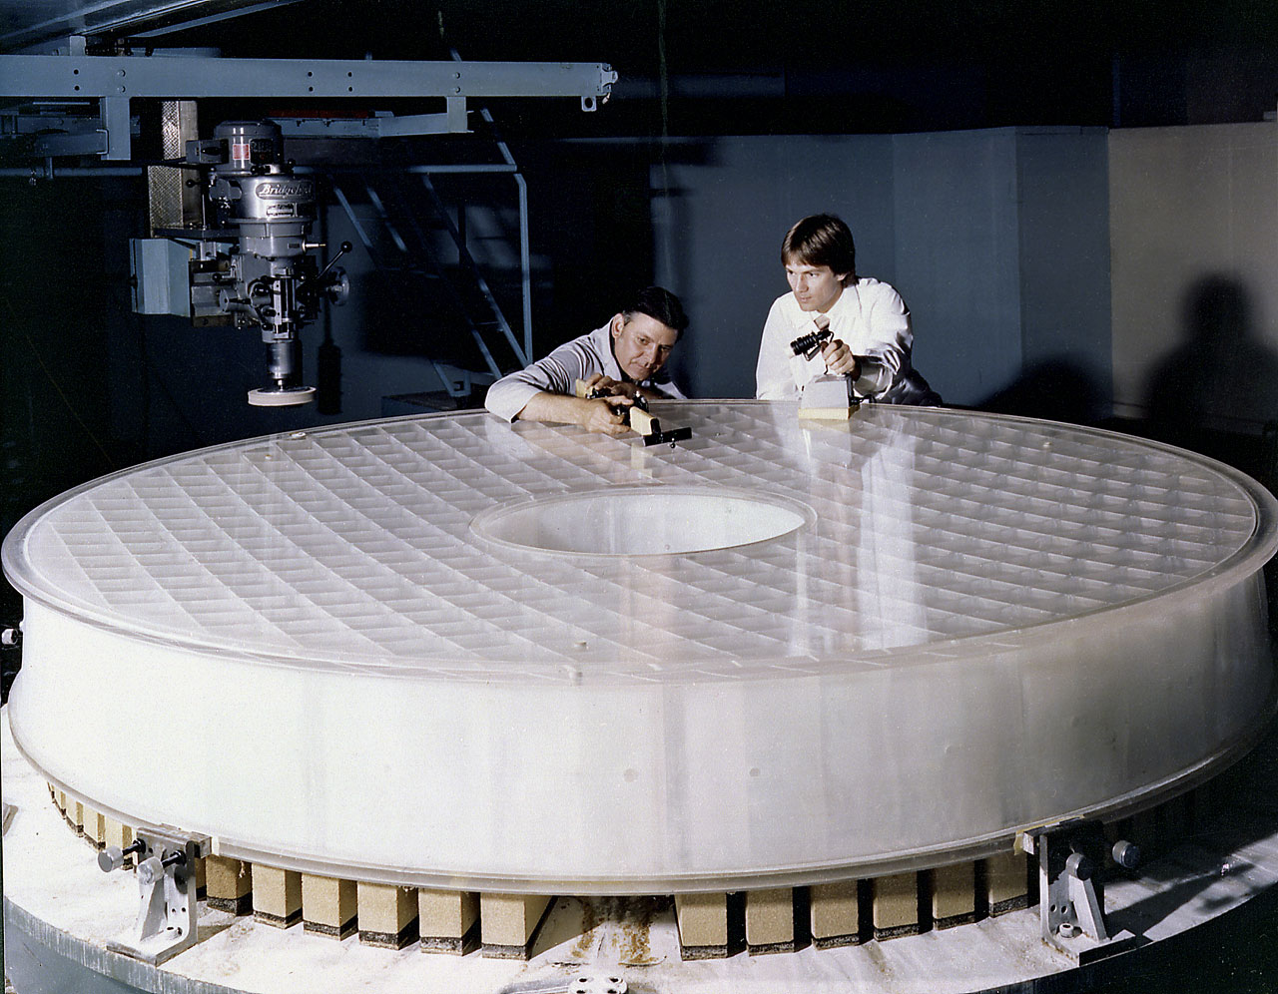
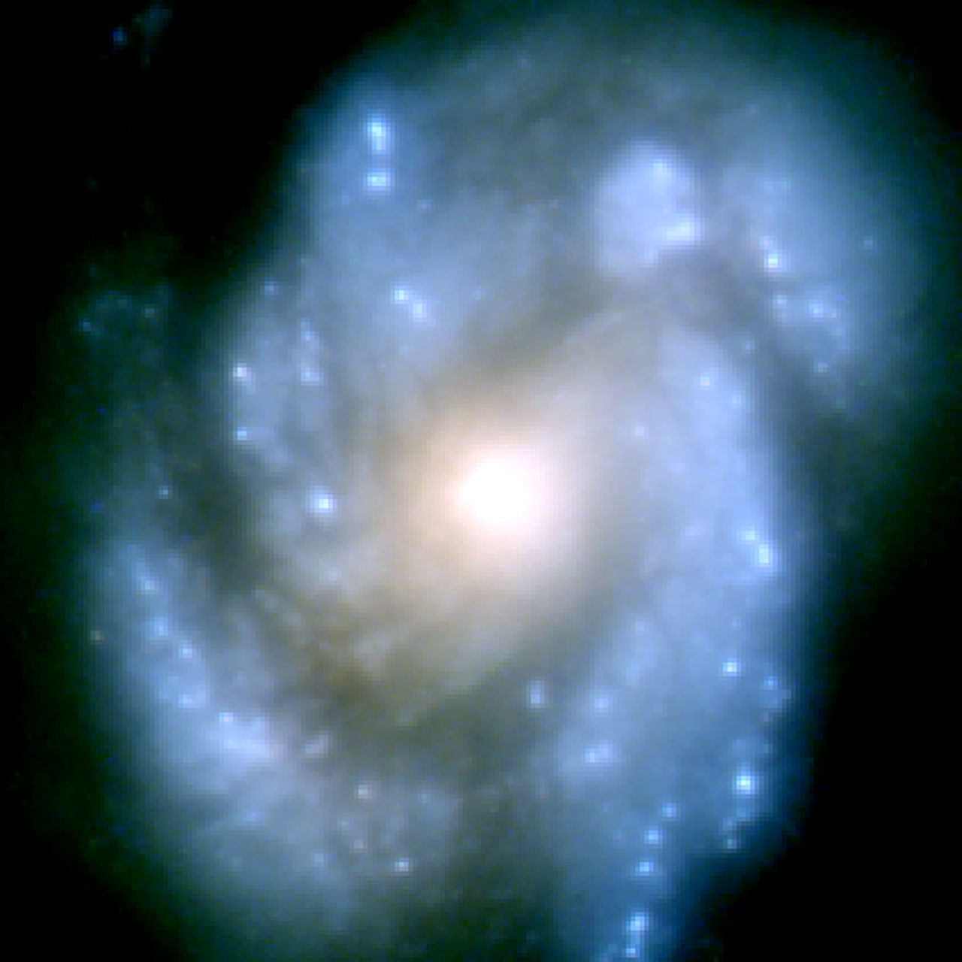
Reflecting Telescope
Notes:
https://www.youtube.com/watch?v=QHkibCZQl3s
http://www.spacetelescope.org/videos/heic1406a/

Slide 17
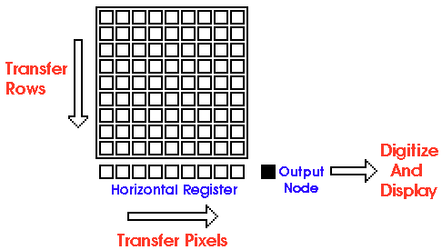
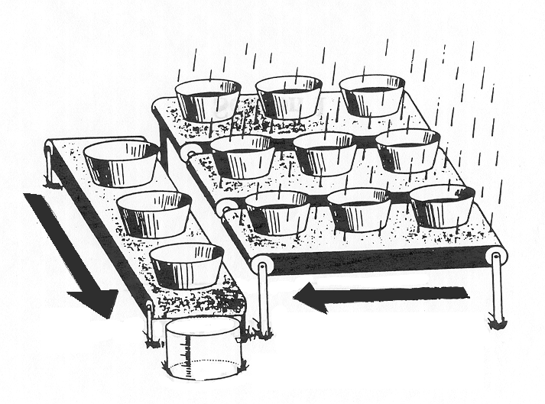
Digital vs. Analog

Slide 18
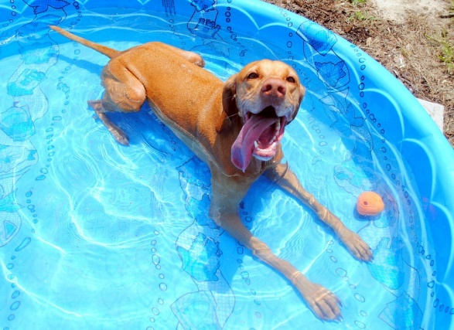
Wave Interference - Interferometry

Slide 19
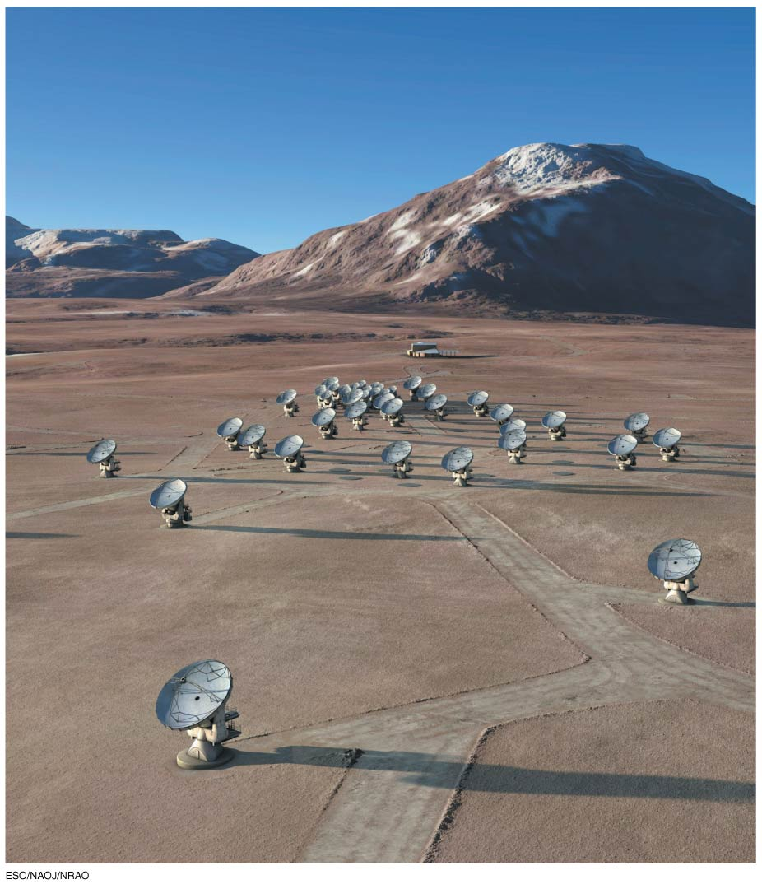
Antenna Field
(Wave Interference – Interferometry)
Notes:
55 https://www.youtube.com/watch?v=SRoj3jK37Vc

Slide 20
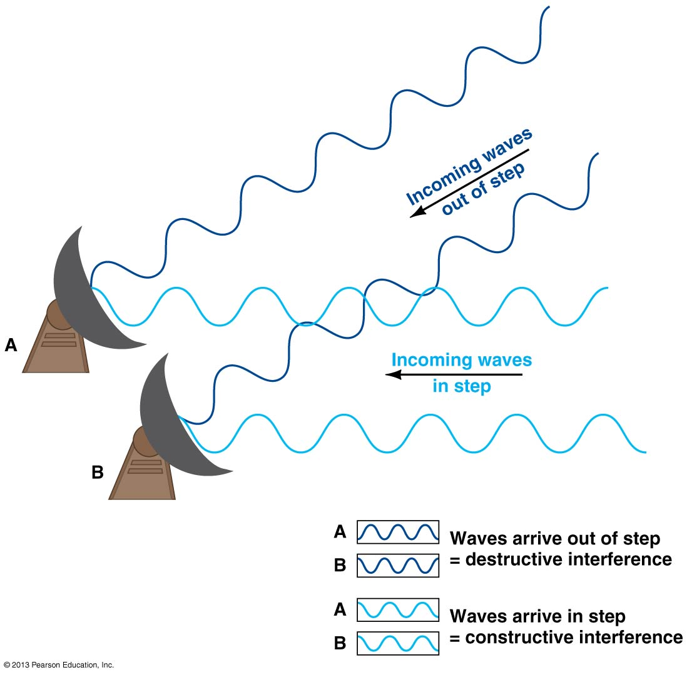
Wave Interference - Interferometry

Slide 21
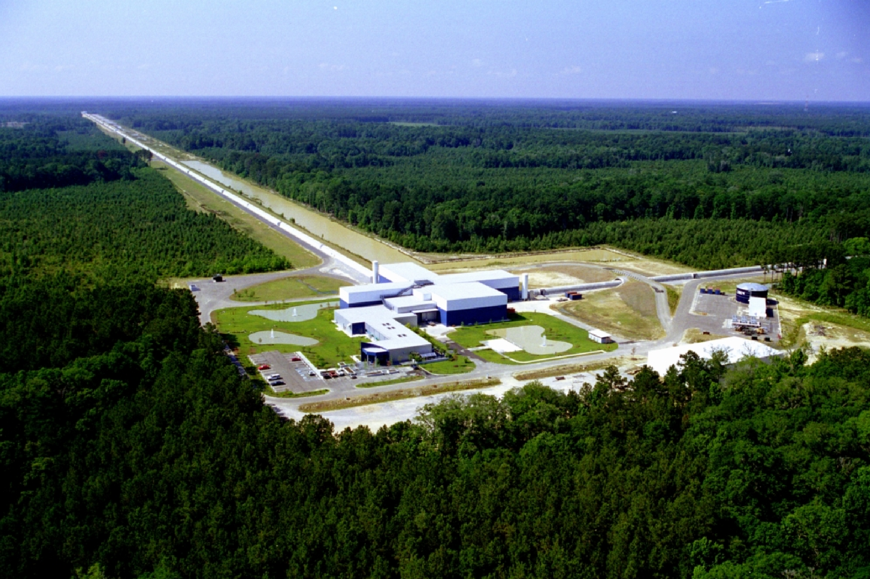
LIGO Interferometry Experiment
Notes:
https://www.youtube.com/watch?v=5N6PtJvT-3o

Slide 22
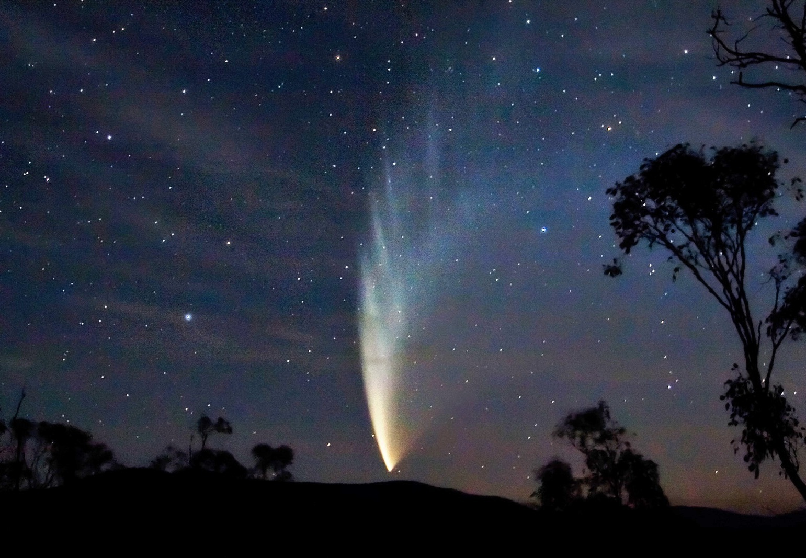
Comets, Asteroids, Meteors

Slide 23
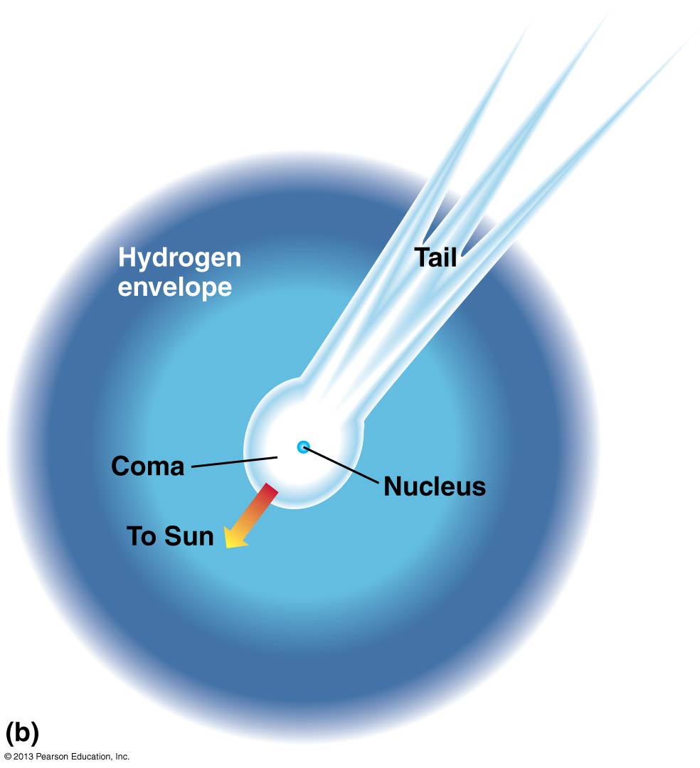
Comets, Asteroids, Meteors

Slide 24
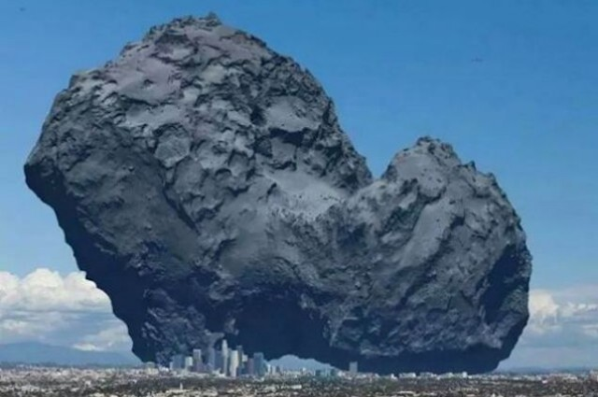
Comets
Notes:
https://www.youtube.com/watch?v=aeDFWqAW-9Y
https://www.youtube.com/watch?v=ktrtvCvZb28
http://www.esa.int/spaceinvideos/Videos/2014/01/Rosetta_s_orbit_around_the_comet

Slide 25
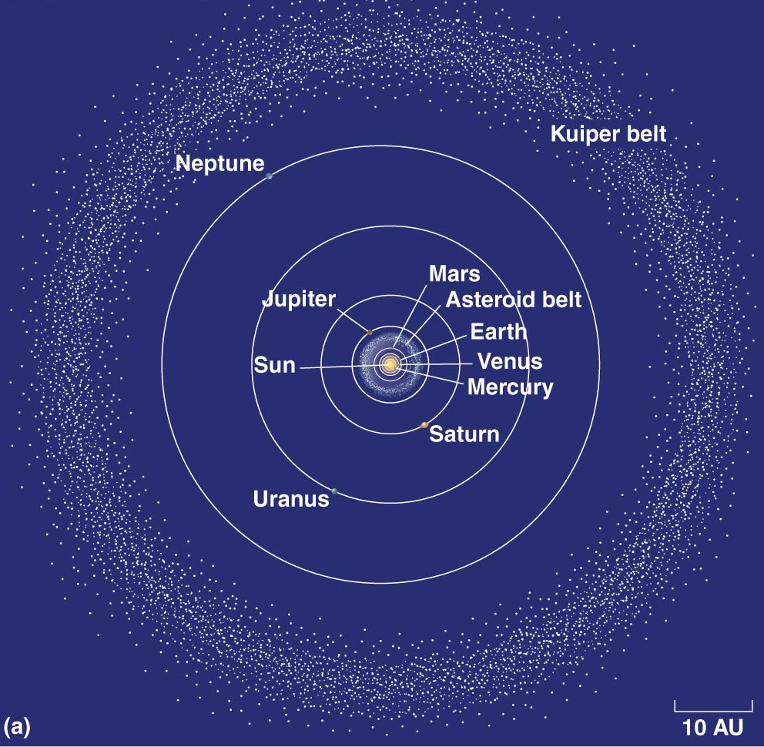

Slide 26
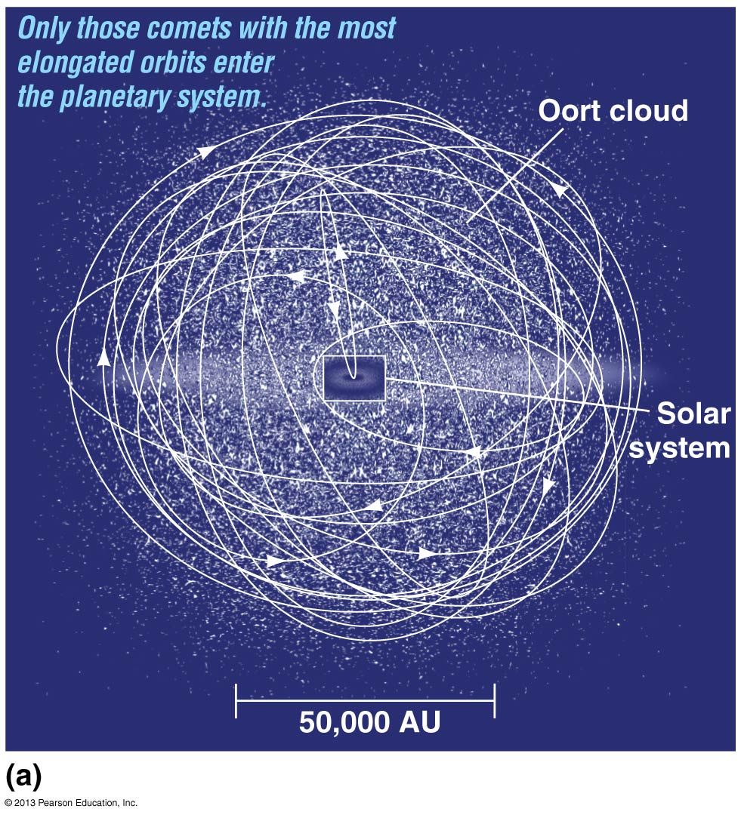

Slide 27
