Slide 1
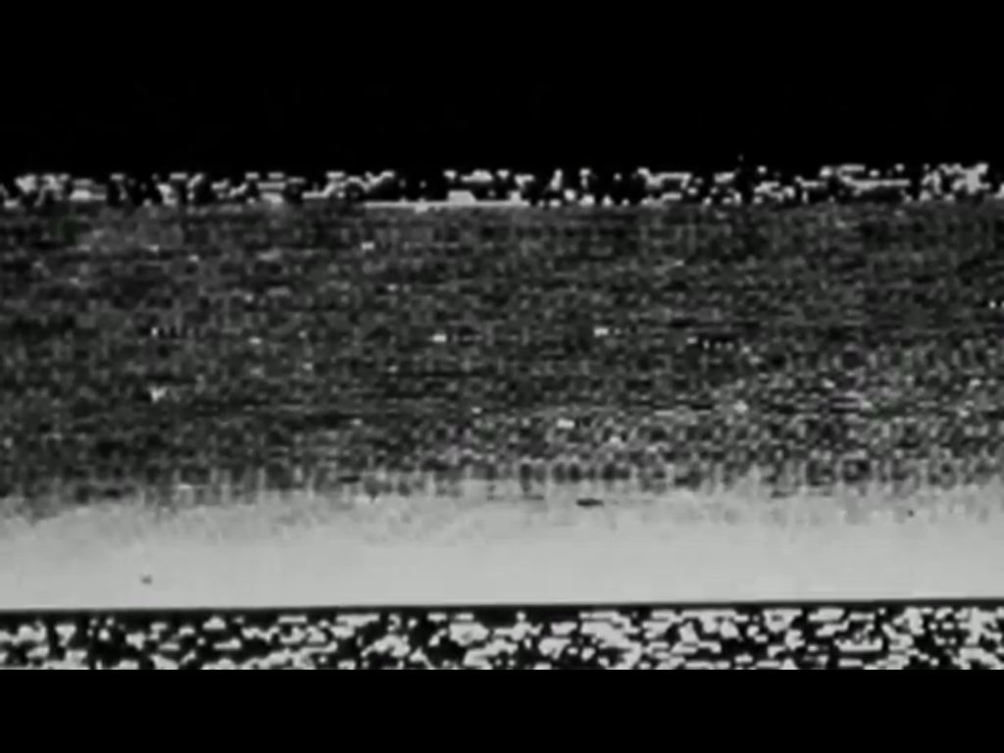

Slide 2
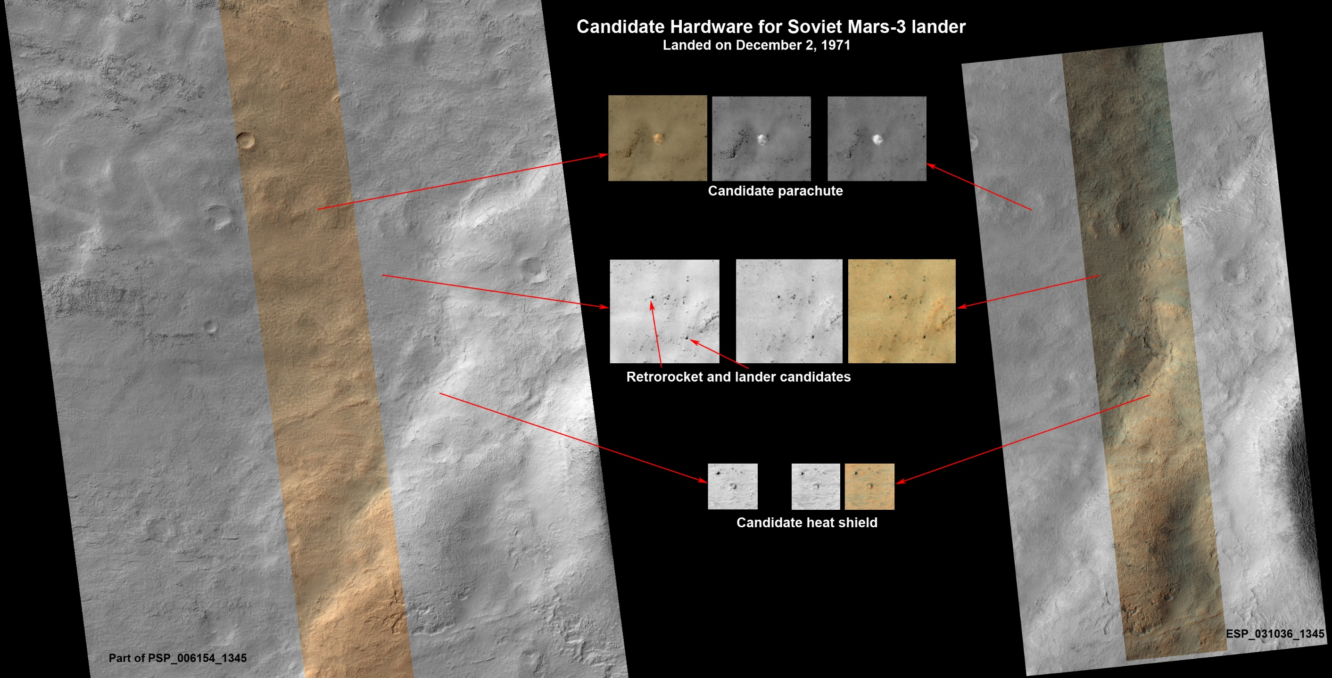
Notes:
Pre-Class Notes File

Slide 3
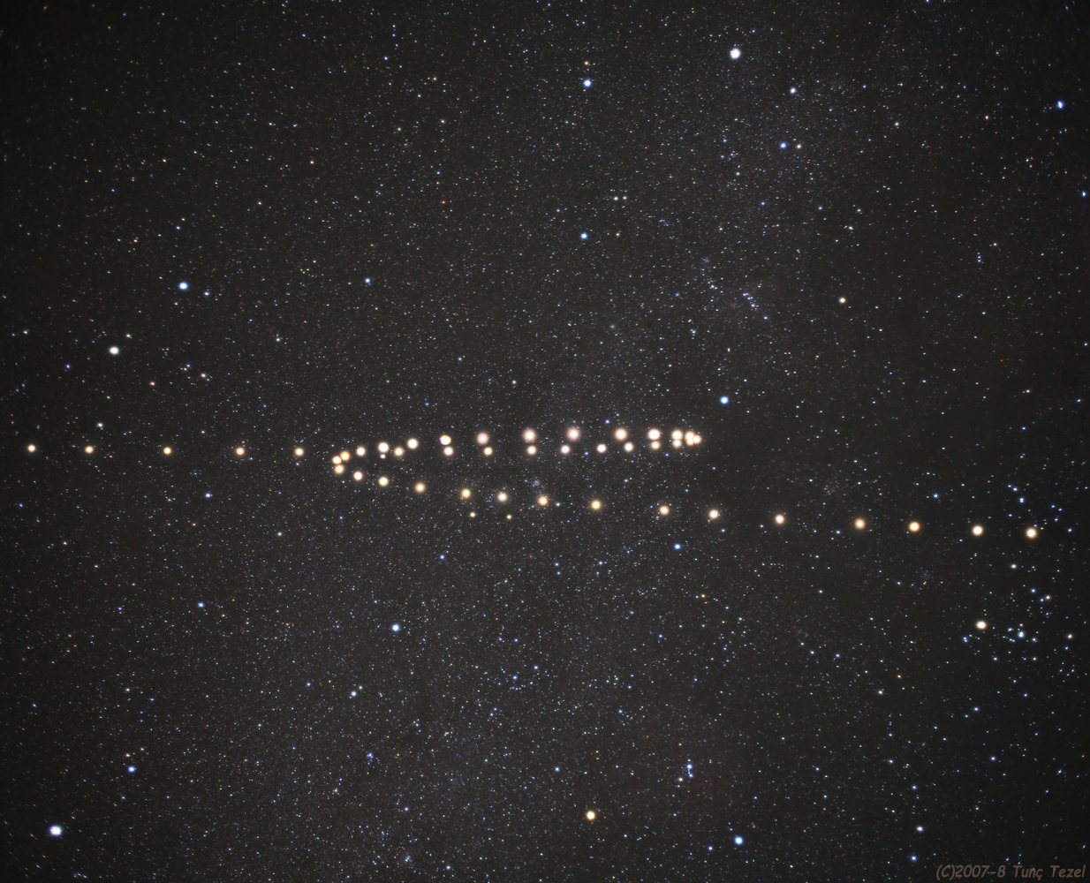
Notes:
http://time.com/3479189/blood-moon/

Slide 4
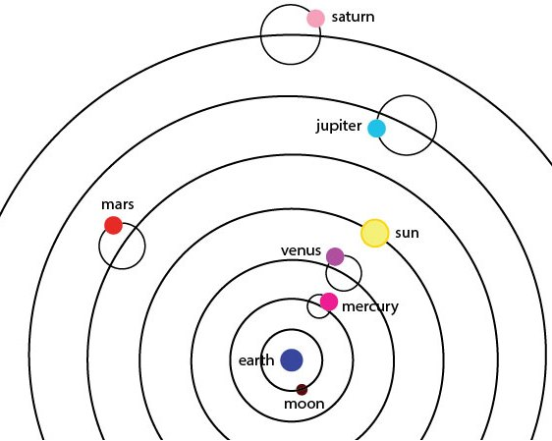
Epicycle / Deferent
The earth is not moving….. because it doesn’t feel like we are moving.
Geometry is natural. Therefore planetary motion must consist of circles or polygons. Circles provided the best “fit”. Prograde and Retrograde movement.
There simply was little reason to reject the idea that the earth was not the center of the universe.

Slide 5
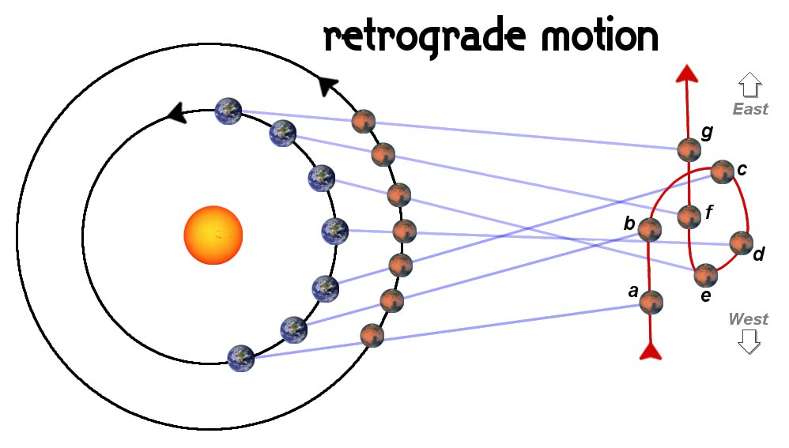
Copernicus / Galileo
Retrograde motion is now a consequence of the heliocentric model rather then an unexplained phoneme.
Although used in secret by academics, the heliocentric model was not yet accepted generally.

Slide 6
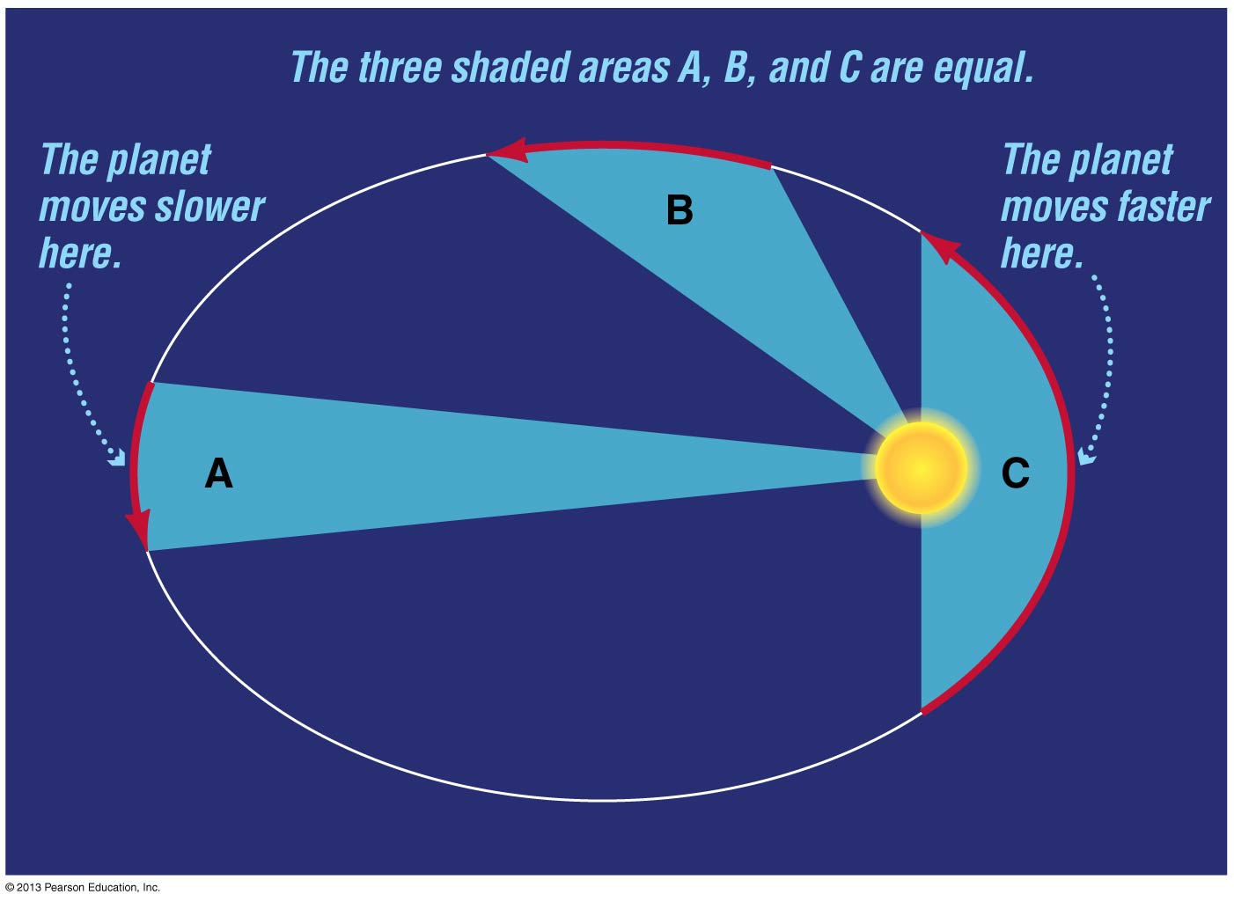
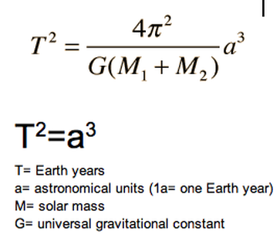
Kepler’s Laws
1. Planet’s have elliptical orbits. NOT circular.
2. During equal time intervals a planet traces out equal area regardless of where it is in the orbit.
3. For any planet, you can figure out how long the orbit takes if you know the distance from the sun (semimajor axis).
Notes:
https://www.youtube.com/watch?v=2PkwMSIjB10

Slide 7
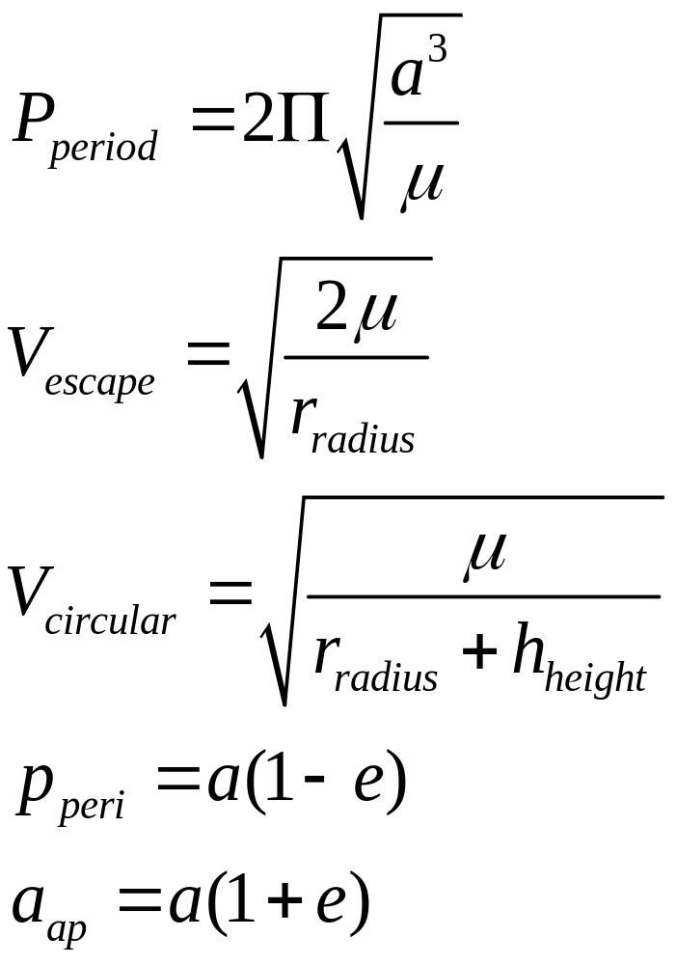
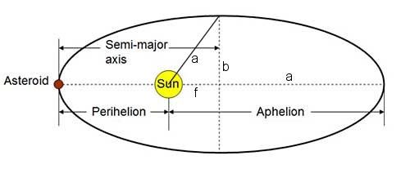
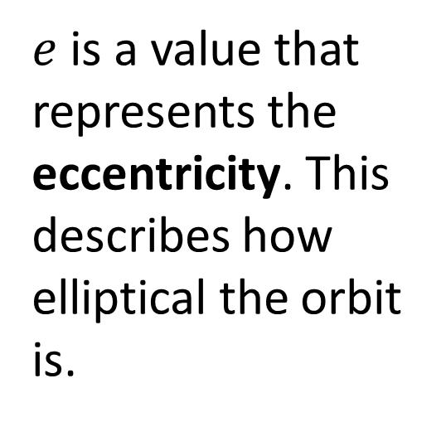
Ellipse Terminology
Perihelion and Aphelion distances
$e$ is a value that represents the eccentricity. This describes how elliptical the orbit is.
Notes:
https://www.youtube.com/watch?v=u9SjjcHd1Ec
https://vimeo.com/69465942

Slide 8
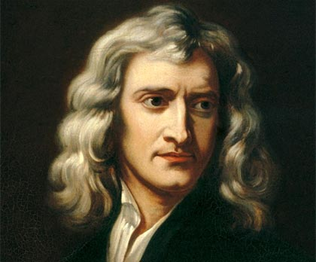
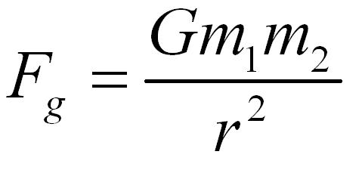
Gravity: Sir Isaac Newton
Find the Mass of both objects
Find the distance between the objects
G =6.67384 × 10⁻¹¹ m³ kg⁻¹ s⁻²

Slide 9
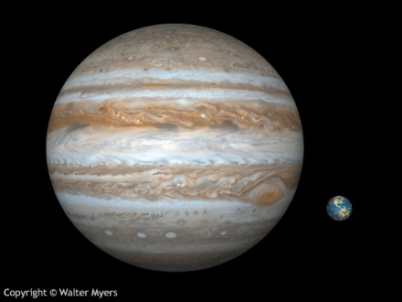

Slide 10
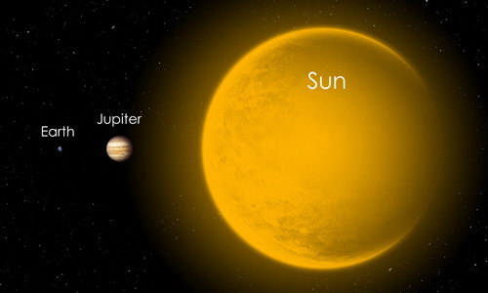

Slide 11
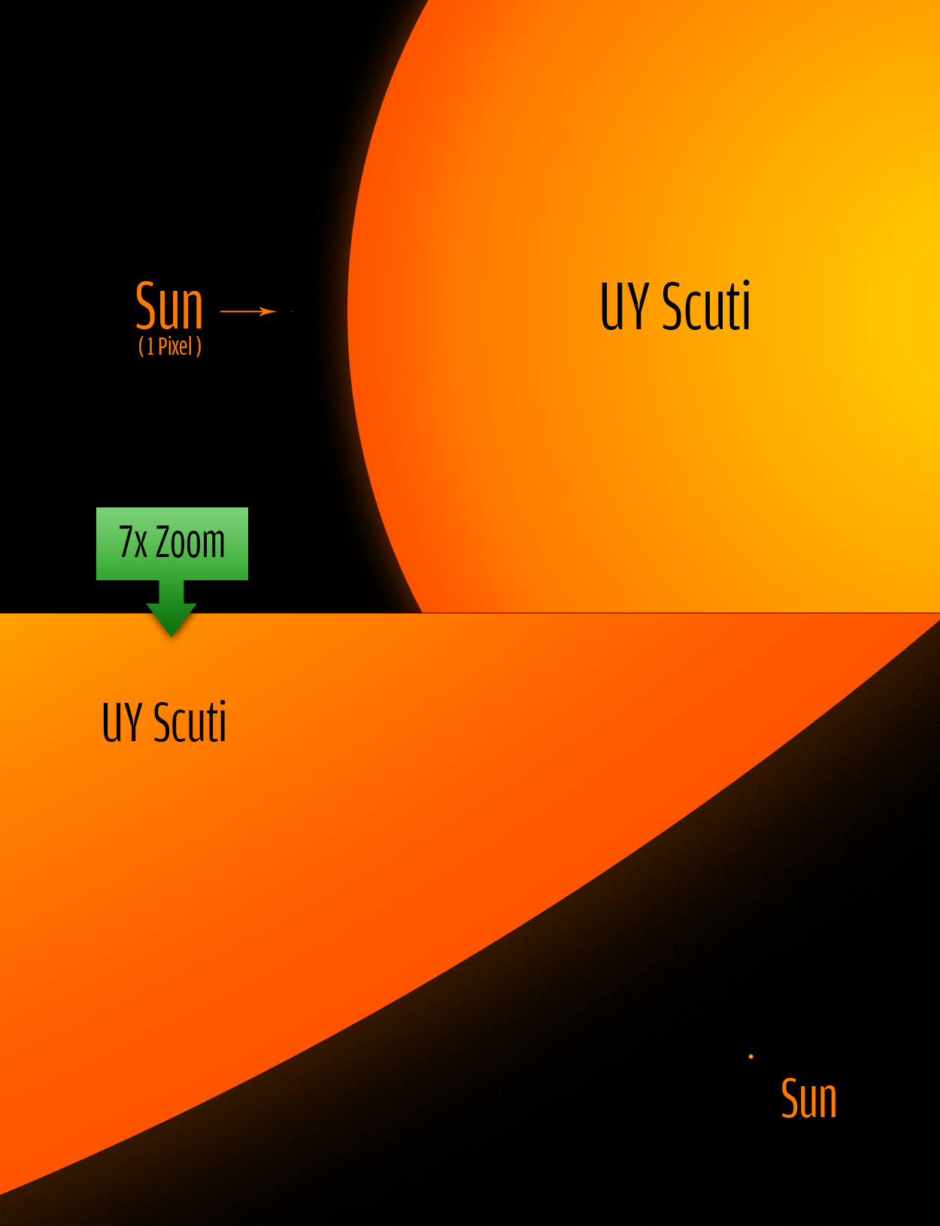

Slide 12
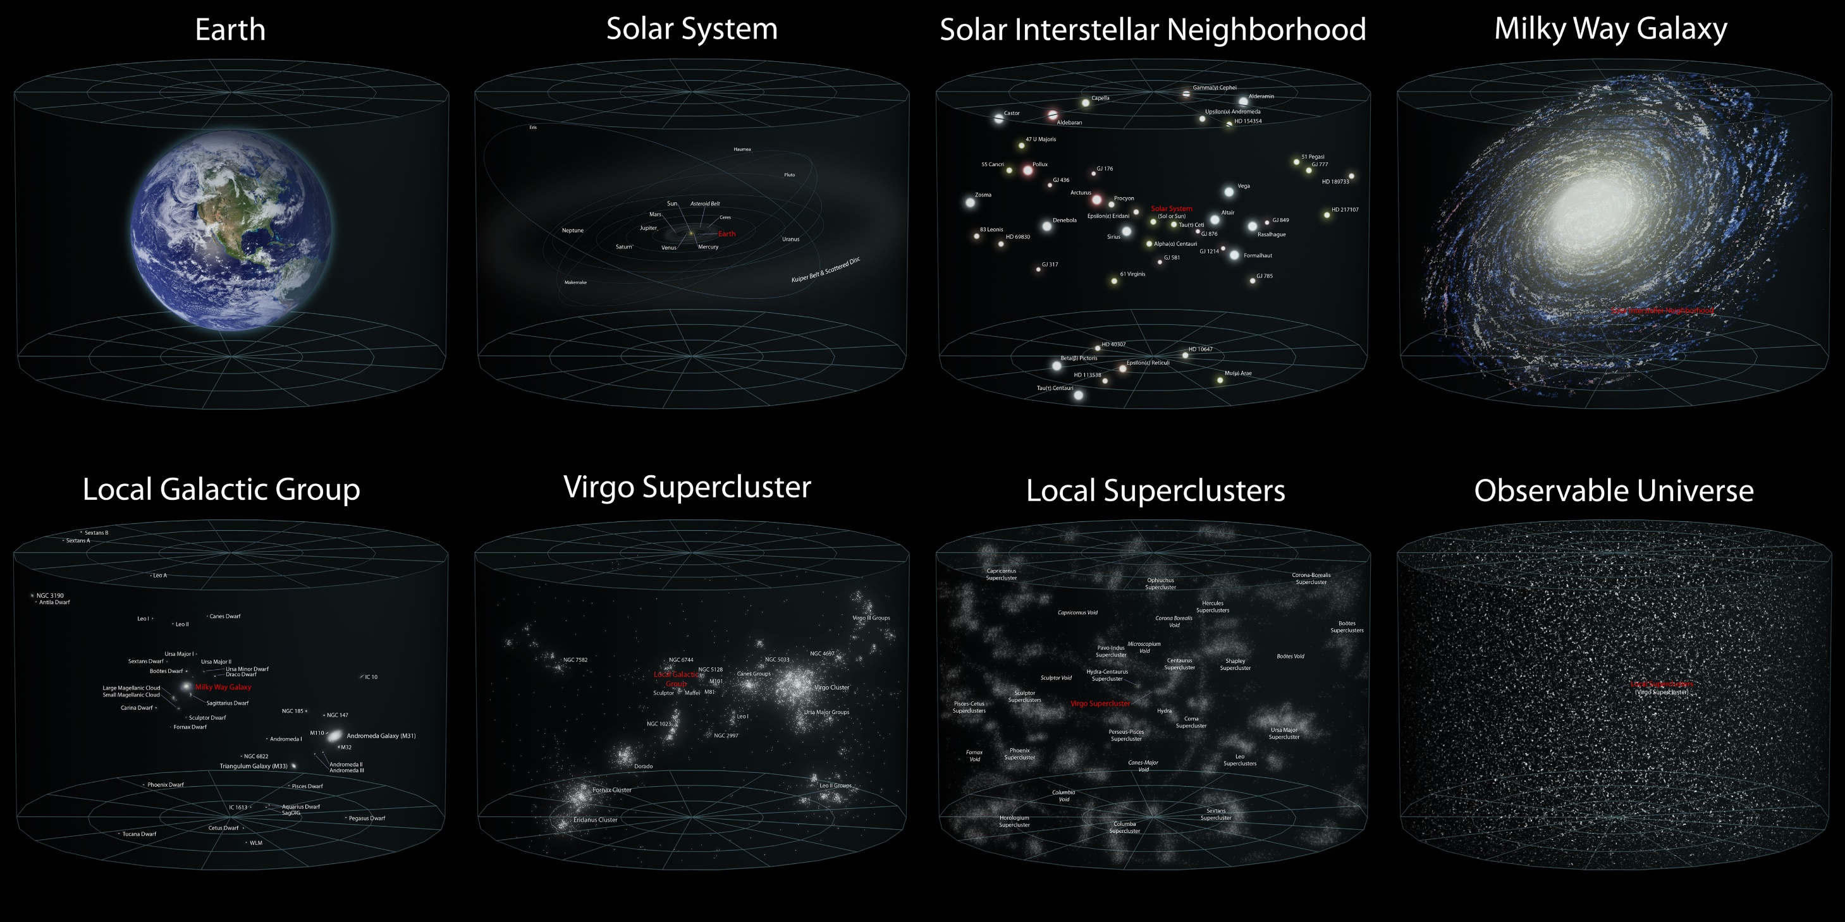

Slide 13
How do we know how large the observable universe is?
How do we know it’s expanding?

Slide 14
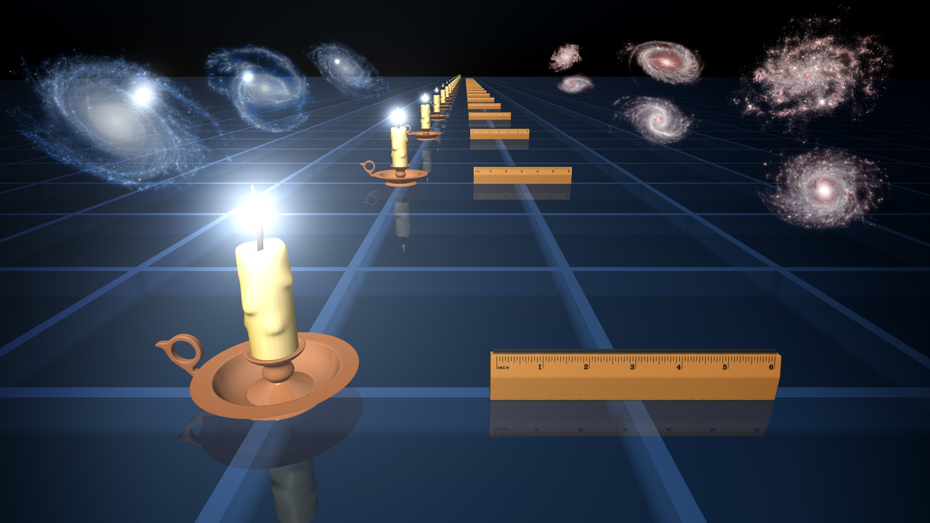

Slide 15
How do we know how large the observable universe is?
How do we know it’s expanding?

Slide 16


Slide 17
How do we know how large the observable universe is?
How do we know it’s expanding?

Slide 18
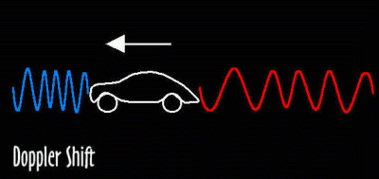

Slide 19
How do we know how large the universe is?
How do we know it’s expanding?
Okay okay, so what is a “standard candle”?
Notes:
https://www.youtube.com/watch?v=9D05ej8u-gU&index=1

Slide 20
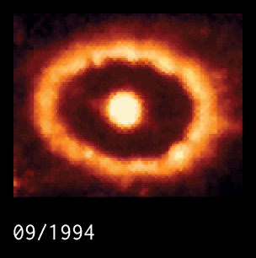

Slide 21
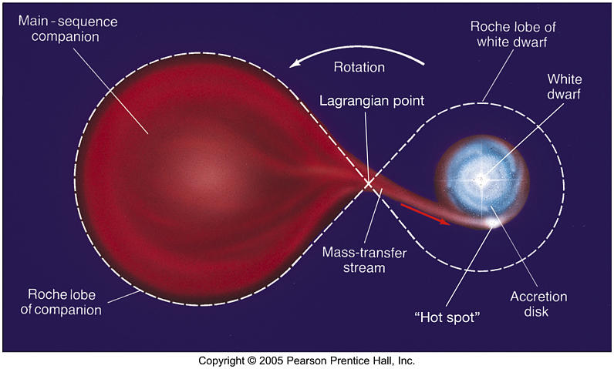
Chandrasekhar Limit

Slide 22
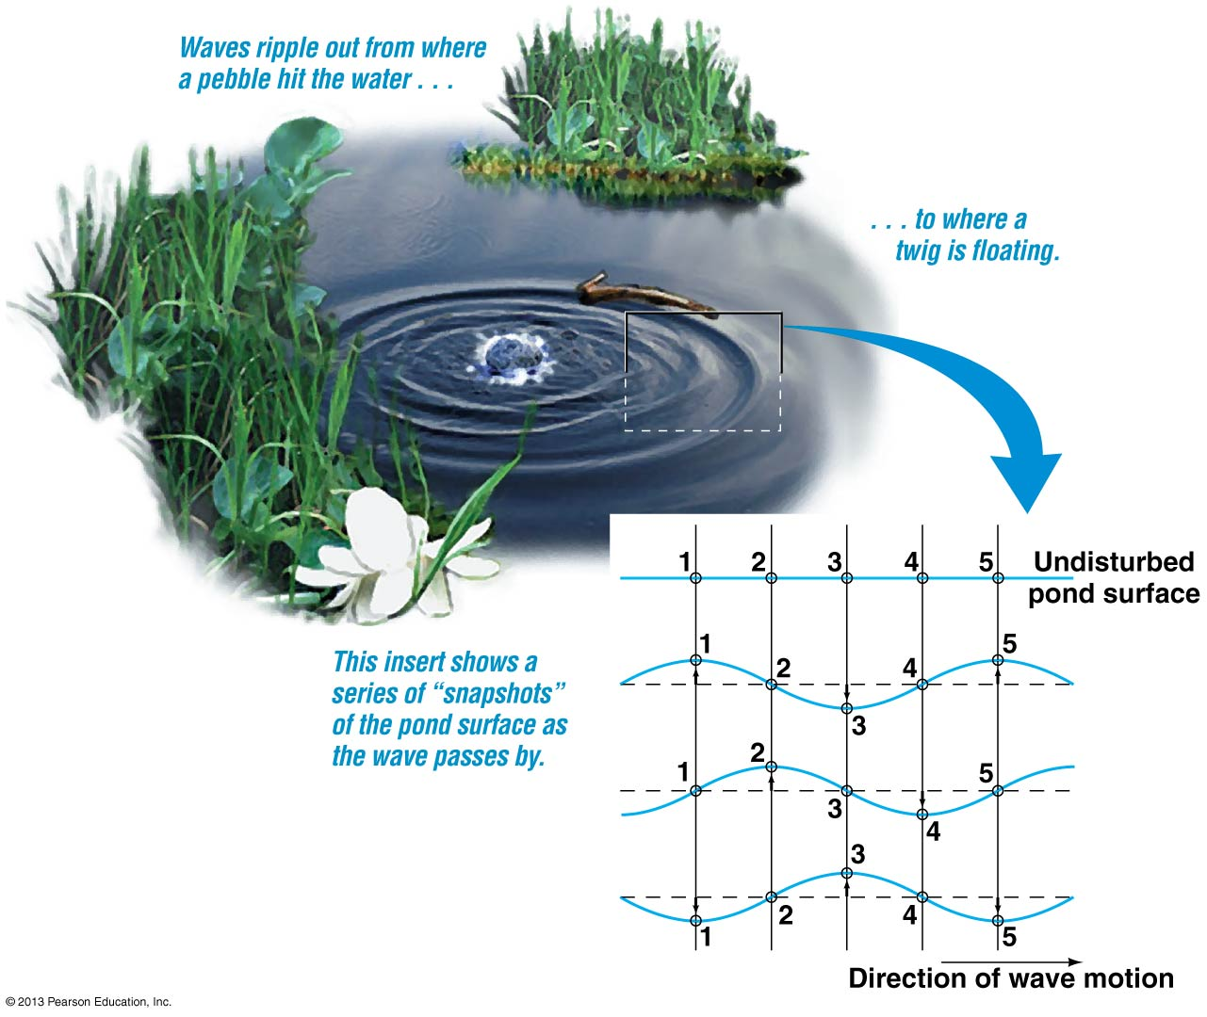

Slide 23
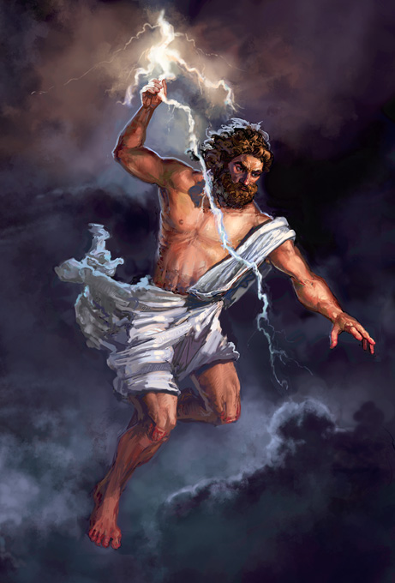

Slide 24
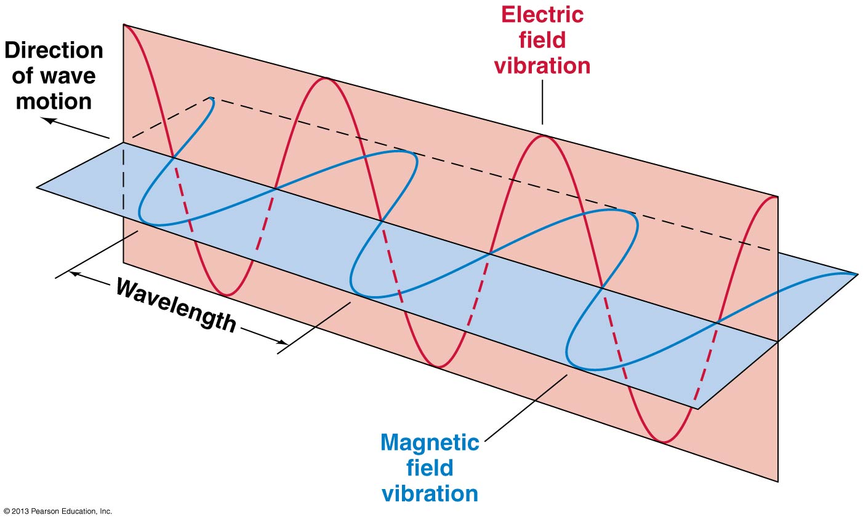
Notes:
https://www.youtube.com/watch?v=ro_a5gw0J6w

Slide 25
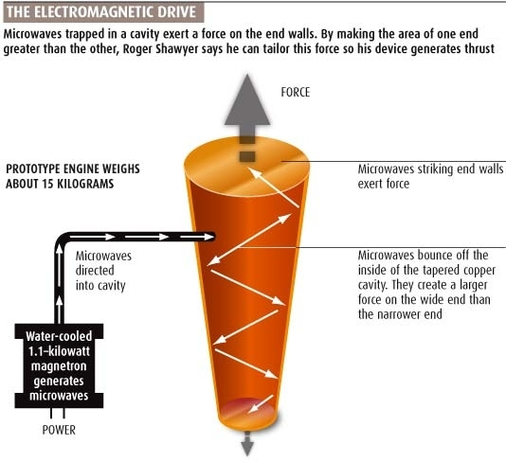

Slide 26
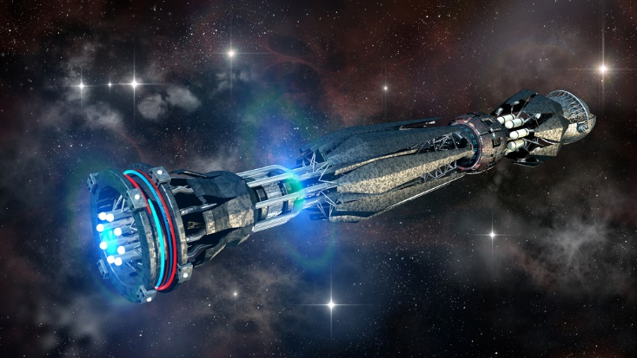

Slide 27
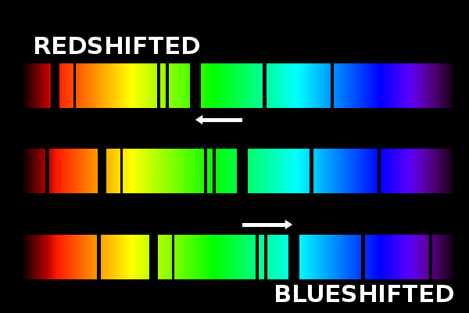

Slide 28
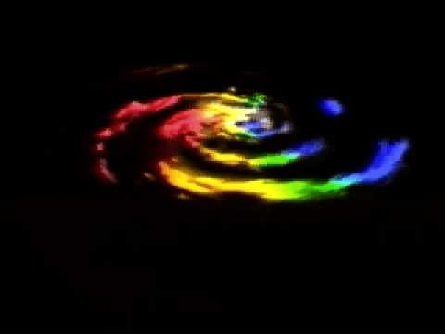
http://news.yahoo.com/one-look-world-sexiest-nurse-225903106.html

Slide 29
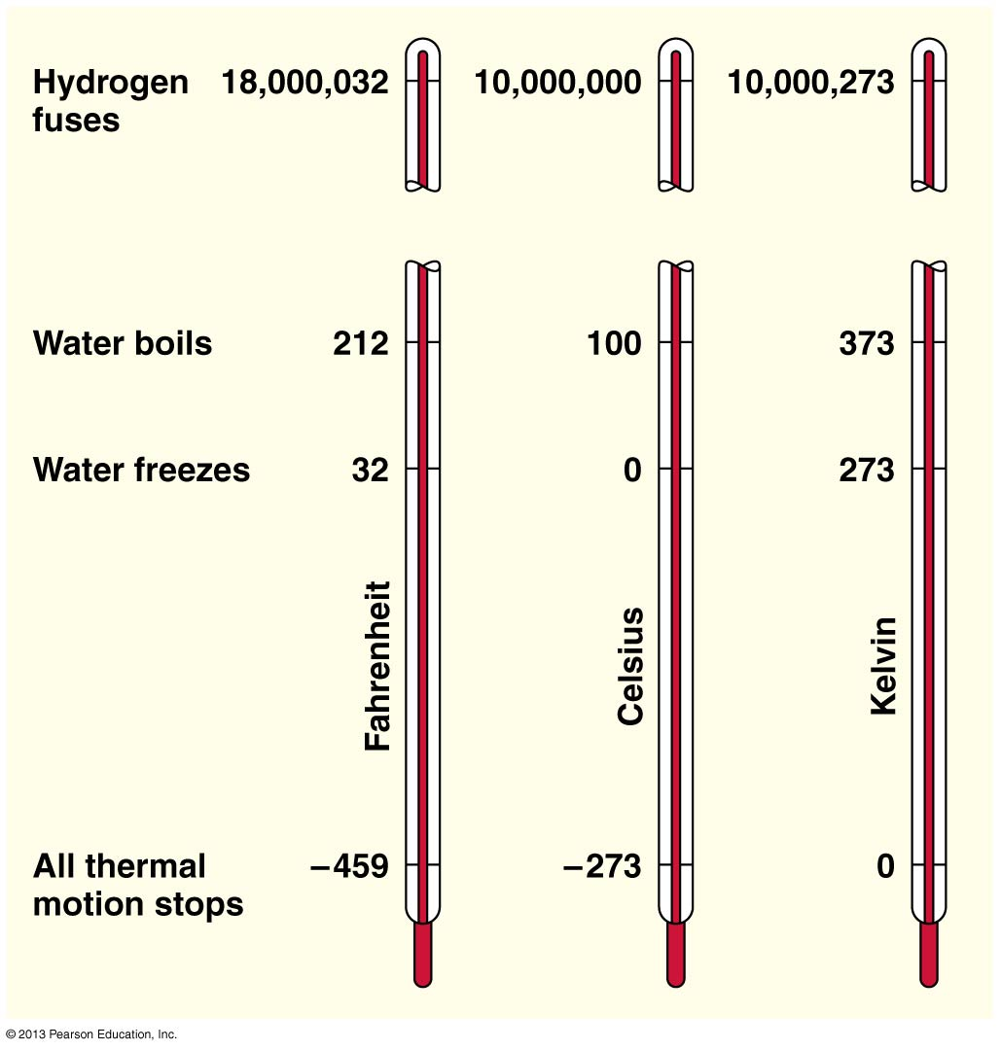

Slide 30
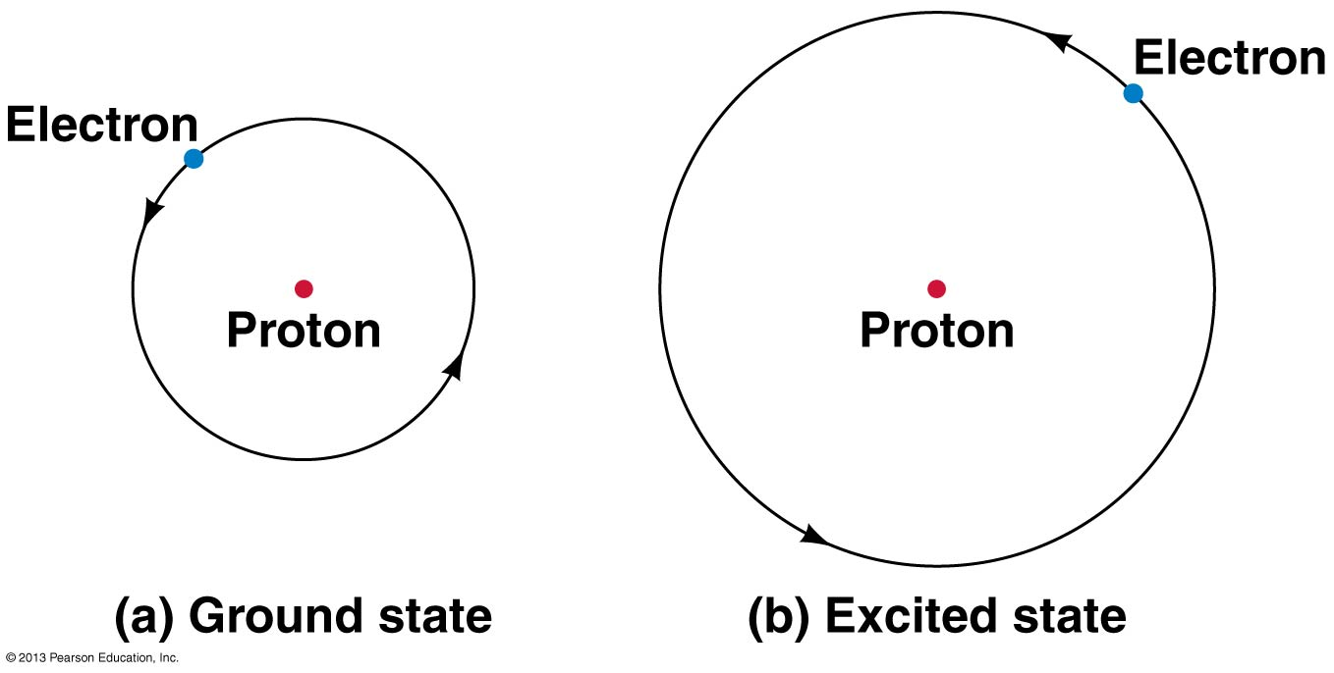

Slide 31
