Slide 1

Notes:
https://www.youtube.com/watch?v=WPA-KpldDVc

Slide 2
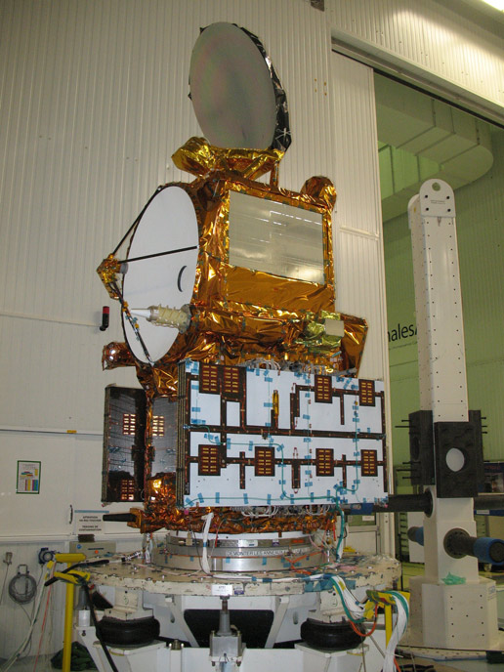
Notes:
https://www.youtube.com/watch?v=QXIhMS4JTGc&index=1&list=PLTiv_XWHnOZocOSyXQu0KjgxylcBMFqRh

Slide 3
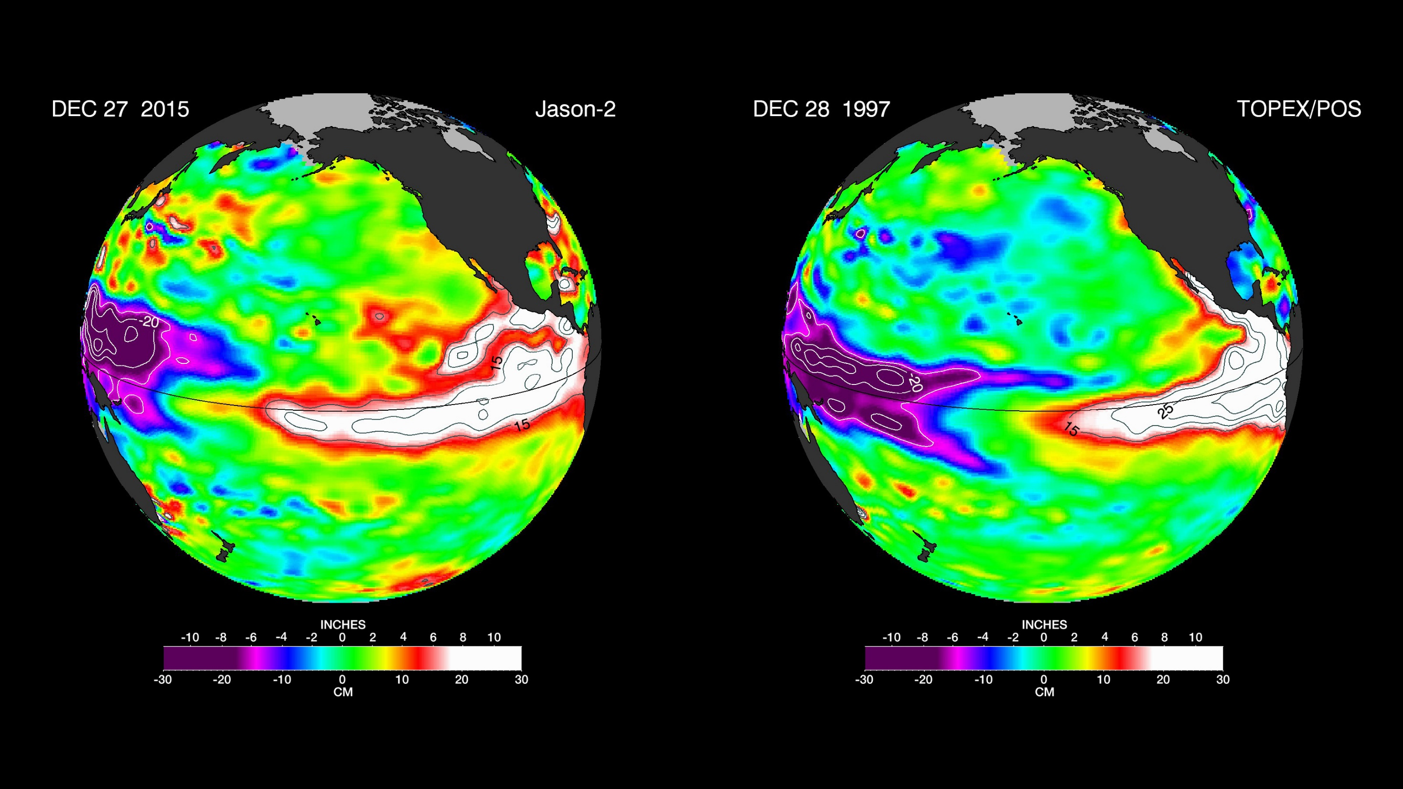

Slide 4
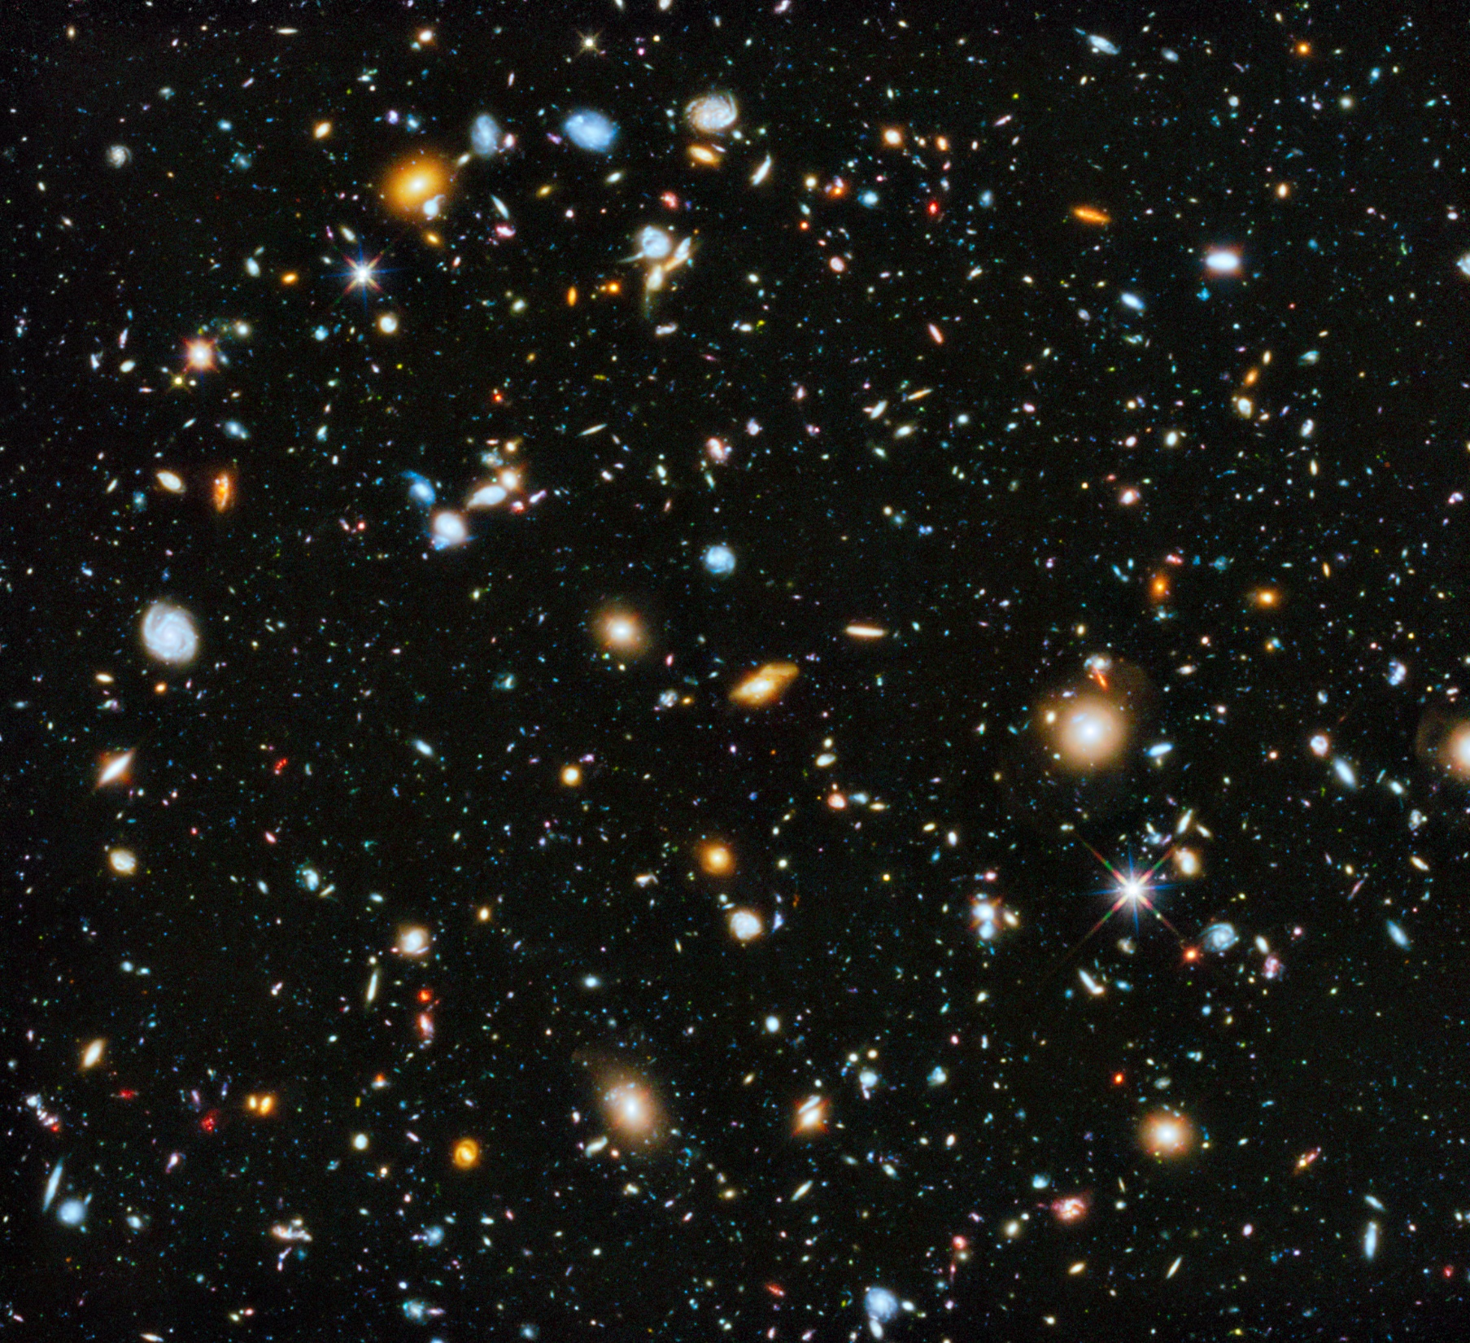
Notes:
https://www.youtube.com/watch?v=GRwfzxr_mf0

Slide 5
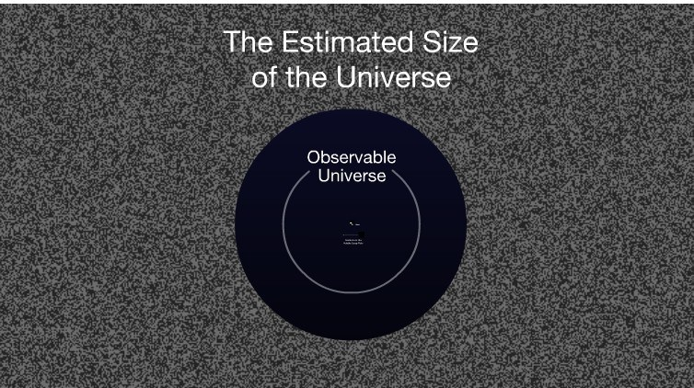

Slide 6
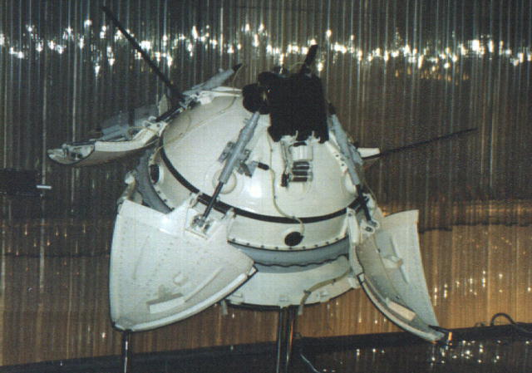
Notes:
Pre-Class Notes File

Slide 7
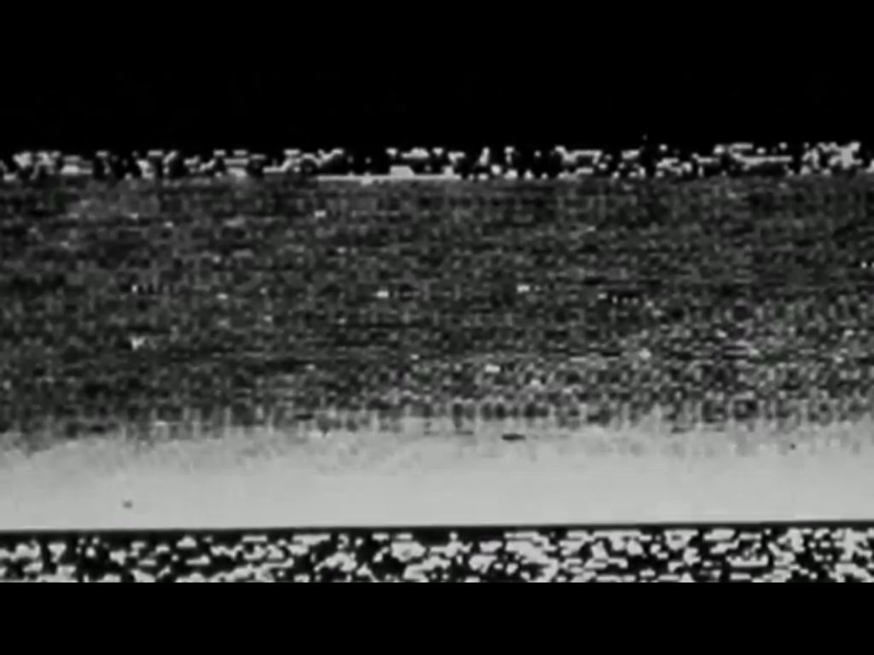

Slide 8
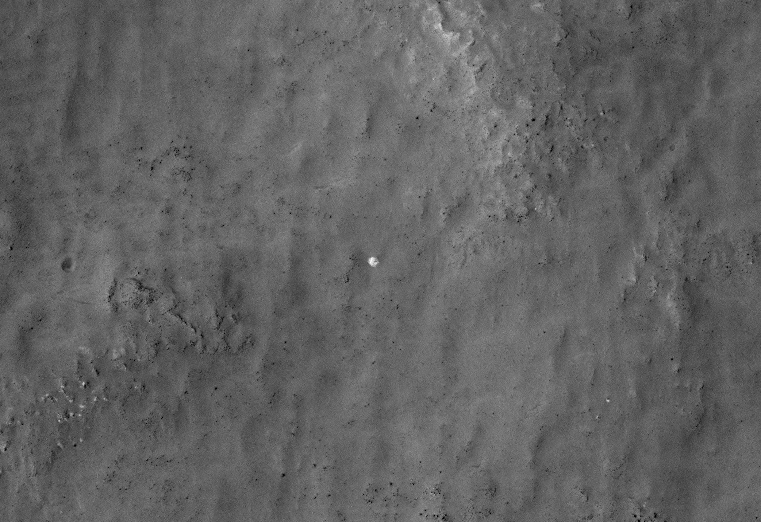
2013
Notes:
Pre-Class Notes File. 2013 discovery.

Slide 9
“I wanted to attract people's attention to the fact that Mars exploration today is available to practically anyone," Egorov said. "At the same time we were able to connect with the history of our country, which we were reminded of after many years through the images from the Mars Reconnaissance Orbiter.“
- Vitali Egorov, Internet Person, St. Petersburg, Russia
Notes:
Pre-Class Notes File

Slide 10
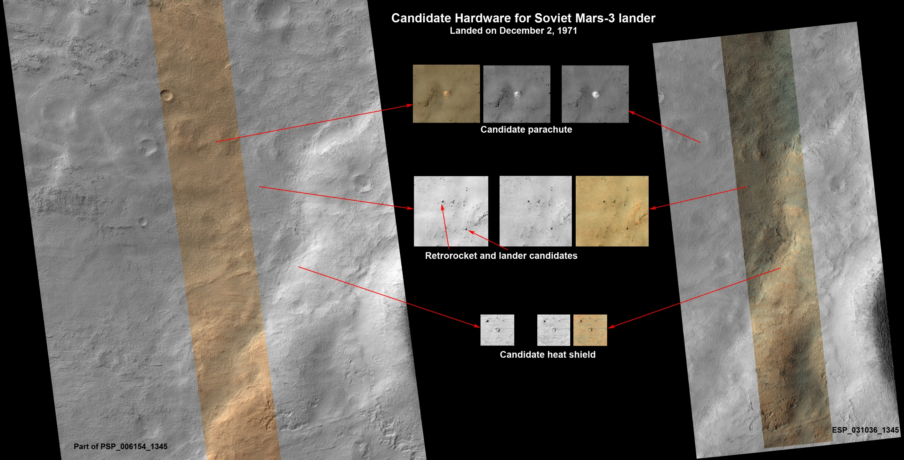
Notes:
Pre-Class Notes File

Slide 11
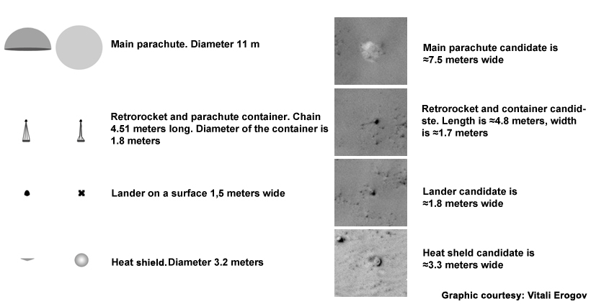
Notes:
Pre-Class Notes File

Slide 12
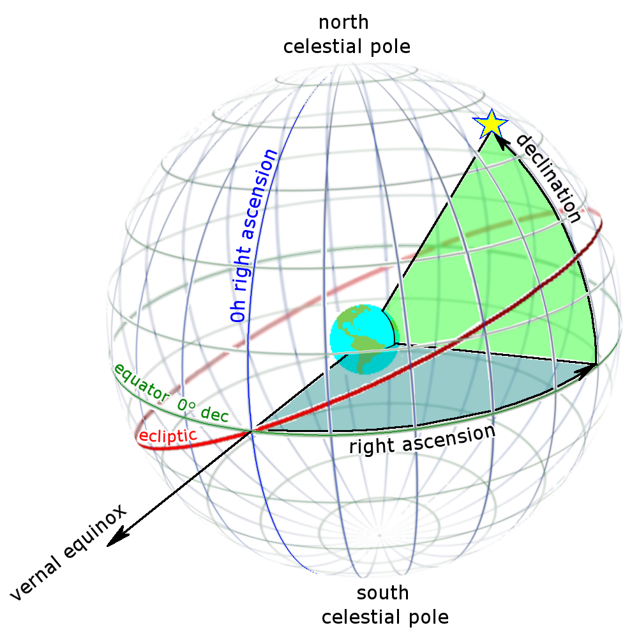
How I sail north?
When do I plant my crops?
When to the nights start getting longer?
When do the fish swim upstream to lay eggs?
When should we start our siege?

Slide 13
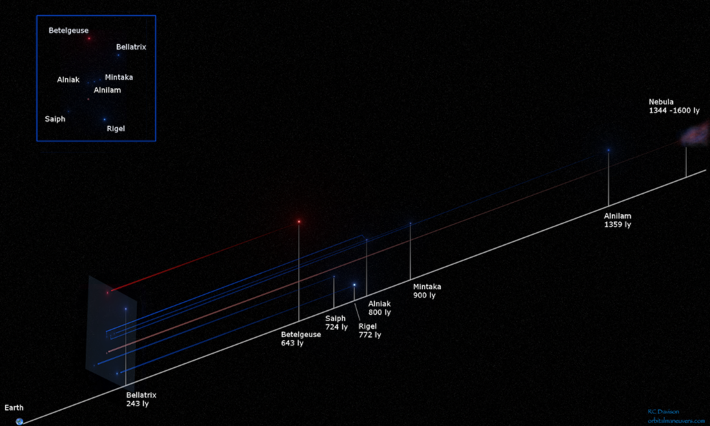

Slide 14
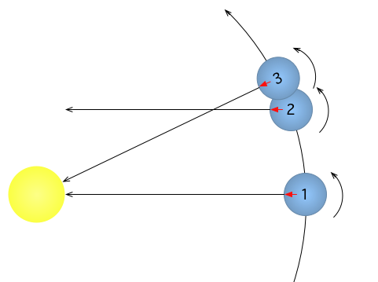
Solar Day and Sidereal Day
Do we care about when the start will be in the same position (Sidereal day)?
Do we care about how long the earth makes a “full” rotation?
I think we just care about when the sun will appear in the same position as yesterday. That is the solar day.

Slide 15
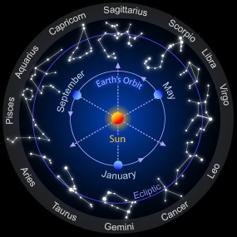

Slide 16
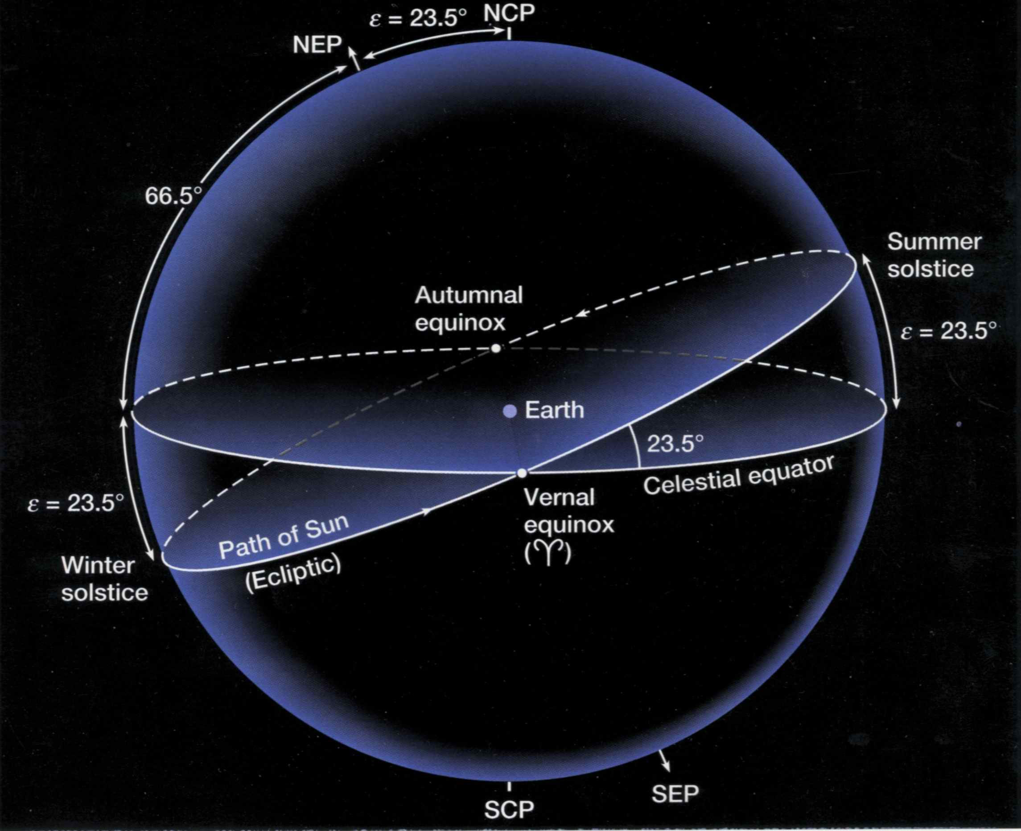

Slide 17
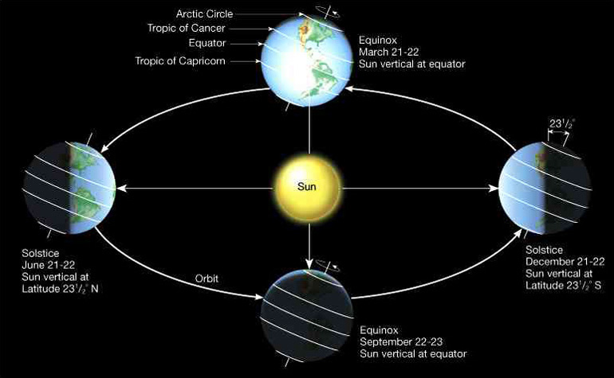

Slide 18
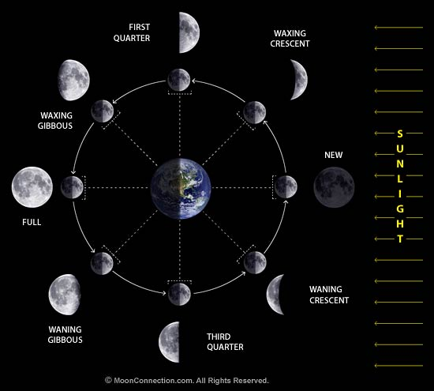

Slide 19
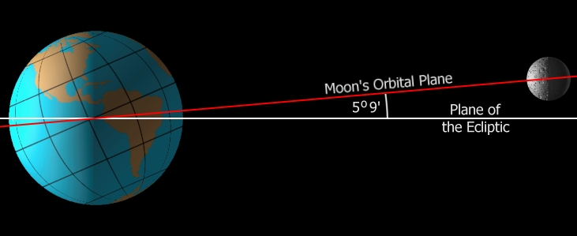
Notes:
http://time.com/3479189/blood-moon/

Slide 20
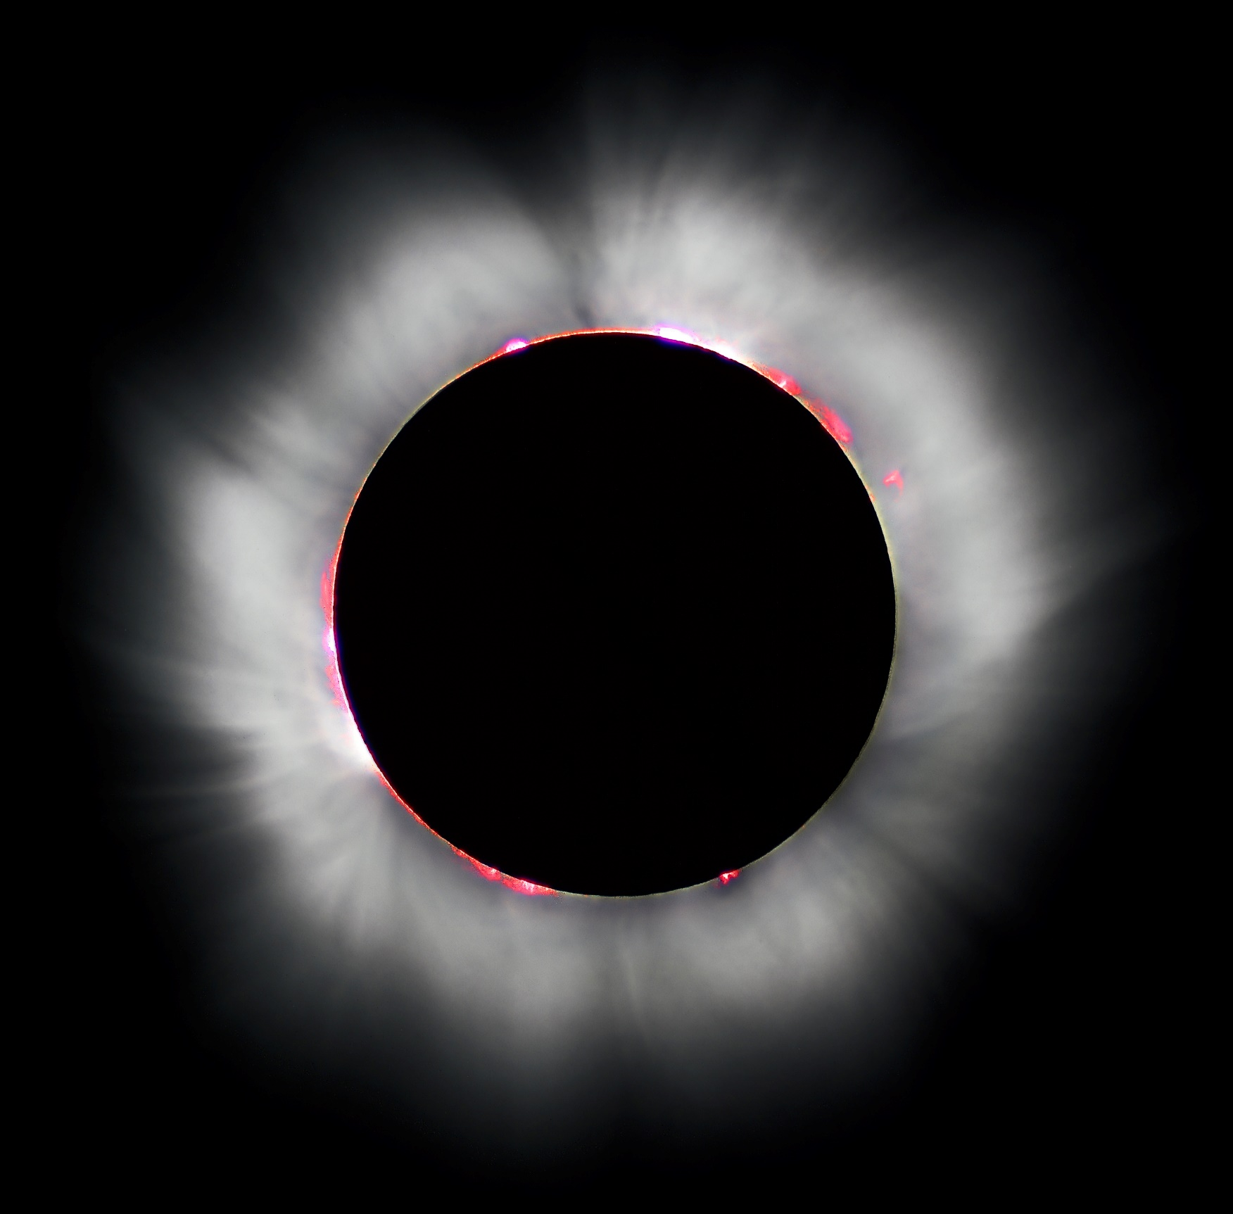
Notes:
https://vimeo.com/122795016
https://www.youtube.com/watch?v=IQdl5bG7Rq8

Slide 21
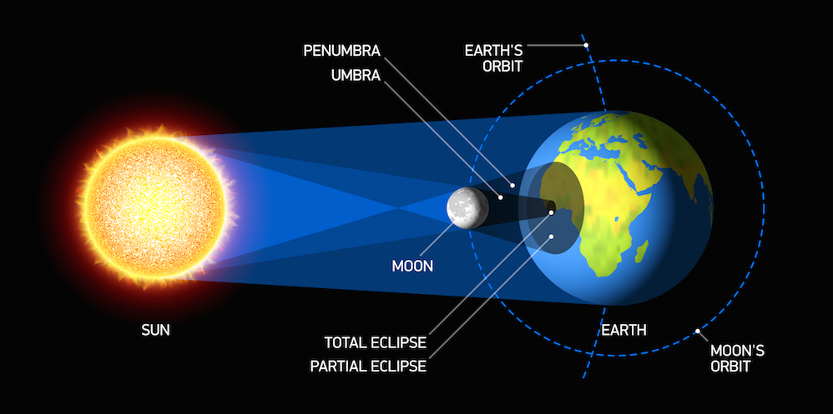
Notes:
http://time.com/3479189/blood-moon/

Slide 22
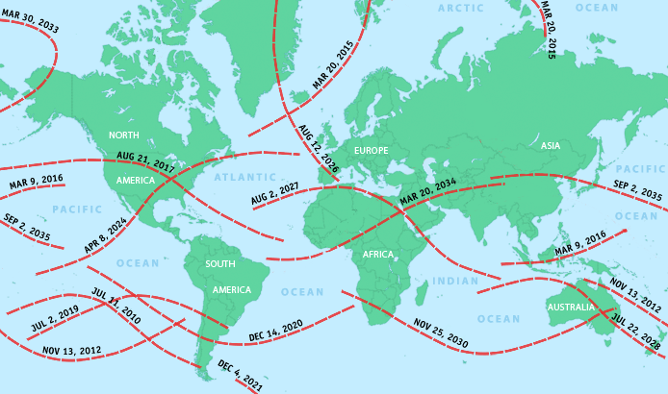

Slide 23
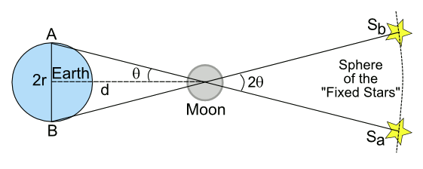
If we measure angle Θ and the radius of the earth, we can estimate the distance to the moon

Slide 24
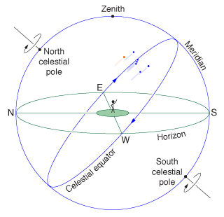
How I sail north?
When do I plant my crops?
When to the nights start getting longer?
When do the fish swim upstream to lay eggs?
When should we start our siege?
What is that weird thing doing?

Slide 25
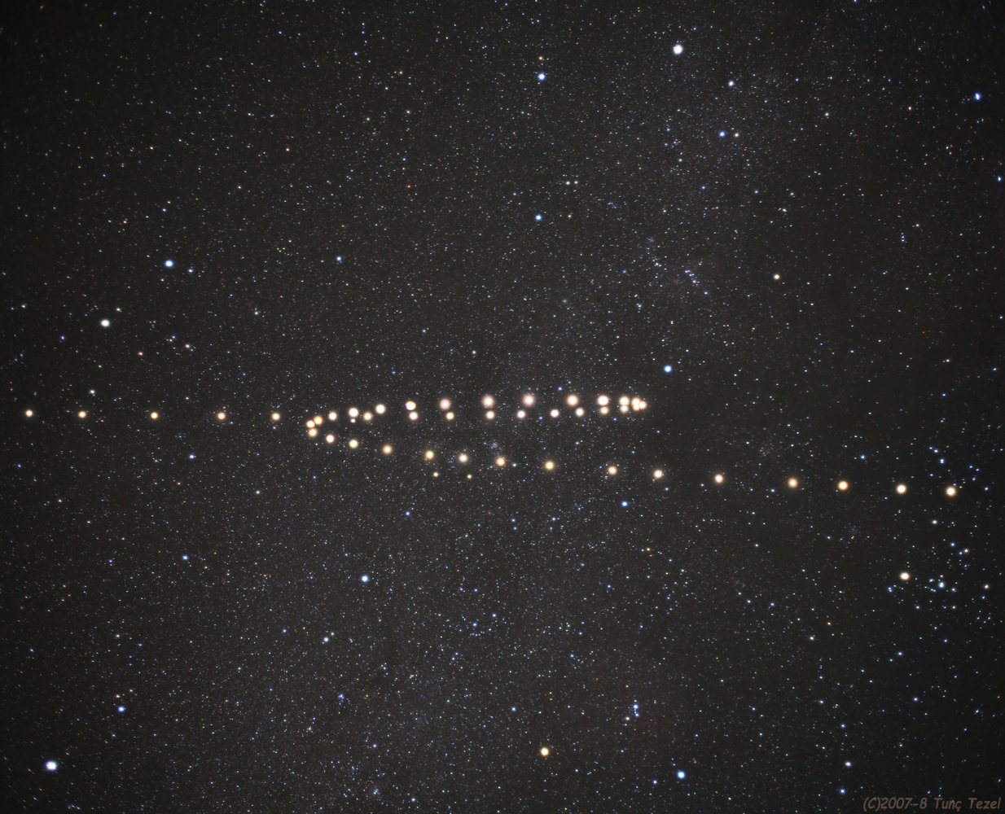
Notes:
http://time.com/3479189/blood-moon/

Slide 26
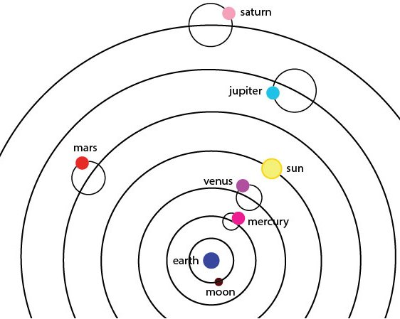
Epicycle / Deferent
The earth is not moving….. because it doesn’t feel like we are moving.
Geometry is natural. Therefore planetary motion must consist of circles or polygons. Circles provided the best “fit”. Prograde and Retrograde movement.
There simply was little reason to reject the idea that the earth was not the center of the universe.

Slide 27
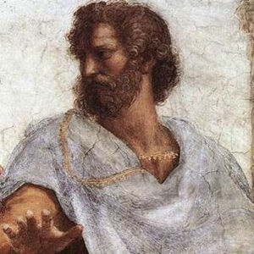
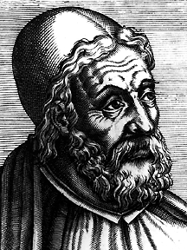
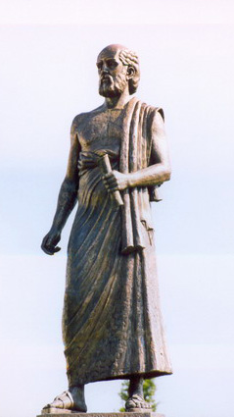
Aristotle / Ptolemy / Aristarchus

Slide 28
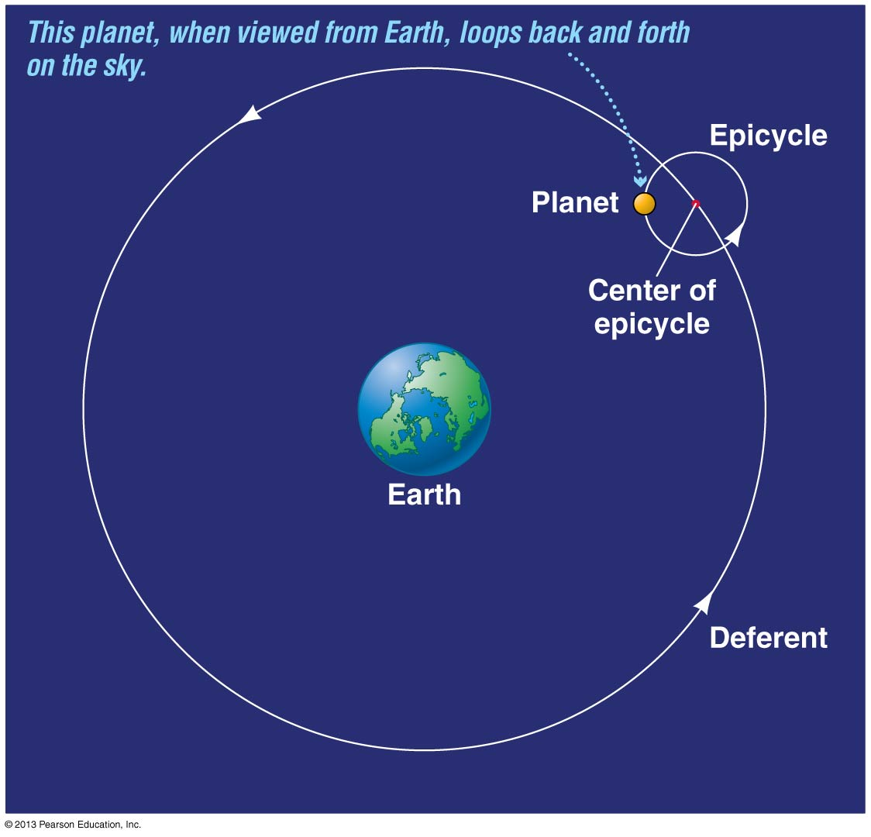
Aristotle / Ptolemy / Aristarchus
Aristotle was one of the originators of the geocentric model
Ptolemy made minor but impactful adjustments. The deferents were re-centered to be near (but not exactly on) earth.
The Ptolemy model is very accurate. It is still used in systems that do not have computing power (planetariums).
Notes:
https://www.youtube.com/watch?v=UjNNX2sLIro

Slide 29
Aristotle / Ptolemy / Aristarchus
Notes:
https://youtu.be/BSr4hUcROwo?t=3m43s

Slide 30
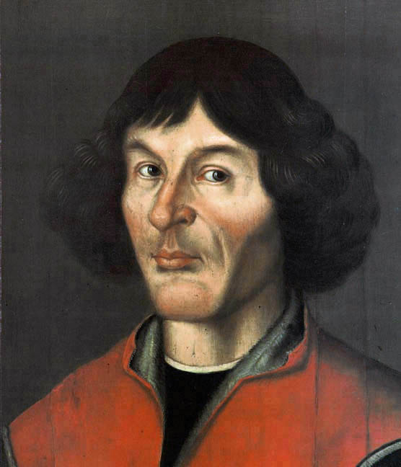
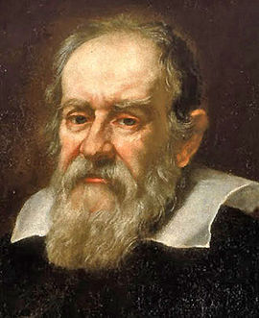
Copernicus / Galileo

Slide 31
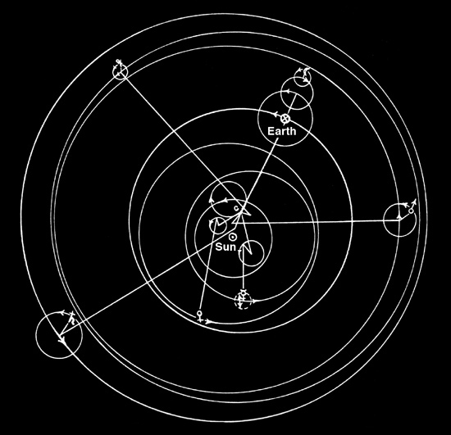
Copernicus / Galileo
We revolve around the sun! “Simplicity is a virtue”. This model is heliocentric.
His model did use epicycles. The circular orbits were centered close to the sun, but not exactly on it.
We revolve around the sun! His work was published after his death due to fear of retribution form the Catholic Church.
Notes:
https://youtu.be/PuNymhcTtSQ?t=36s

Slide 32
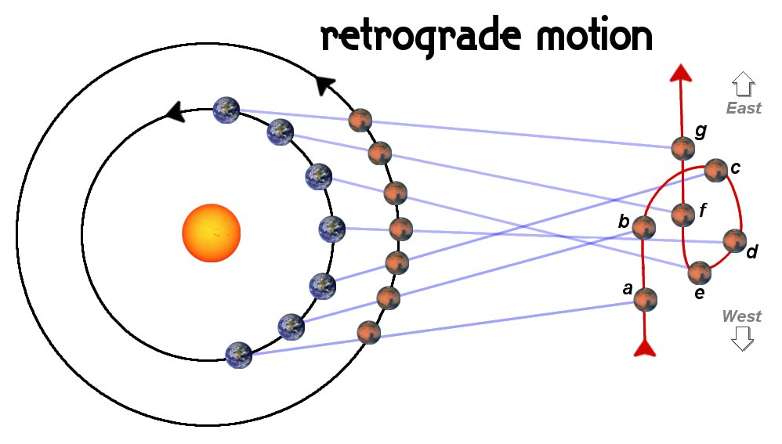
Copernicus / Galileo
Retrograde motion is now a consequence of the heliocentric model rather then an unexplained phoneme.
Although used in secret by academics, the heliocentric model was not yet accepted generally.

Slide 33
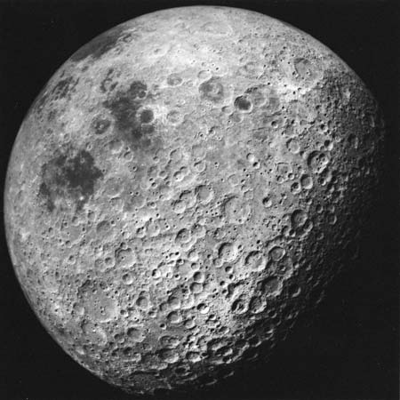
Copernicus / Galileo

Slide 34
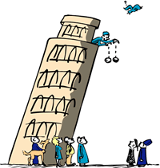
Copernicus / Galileo
Notes:
https://www.youtube.com/watch?v=5C5_dOEyAfk
http://www.gfycat.com/CrispFavorableDuckbillplatypus

Slide 35
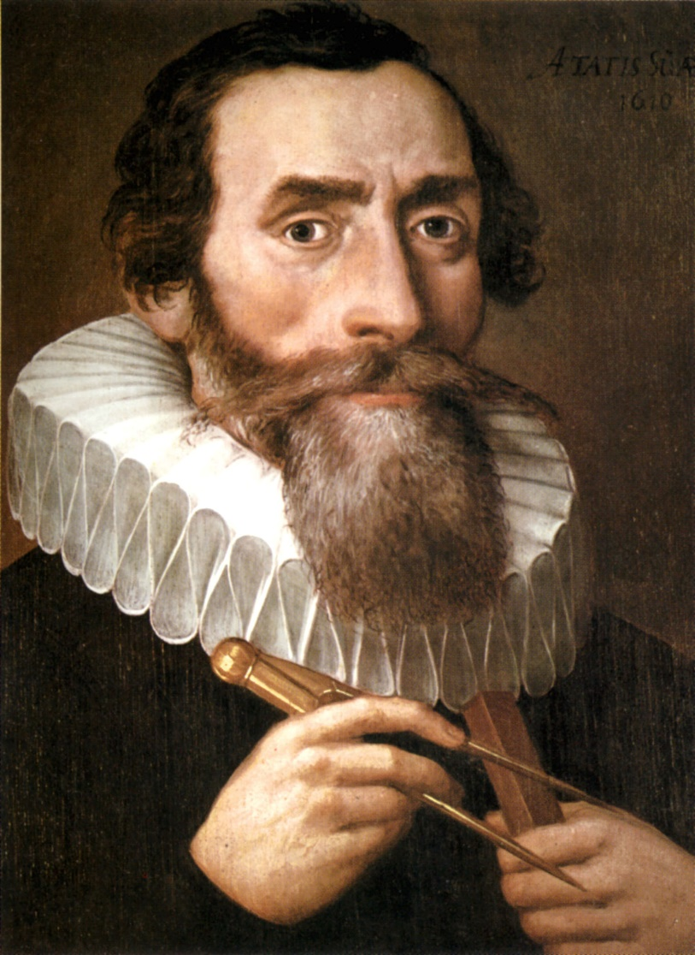
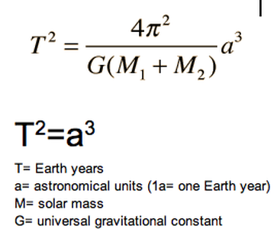
Kepler’s Laws
1. Planet’s have elliptical orbits. NOT circular.
2. During equal time intervals a planet traces out equal area regardless of where it is in the orbit.
3. For any planet, you can figure out how long the orbit takes if you know the distance from the sun (semimajor axis).

Slide 36
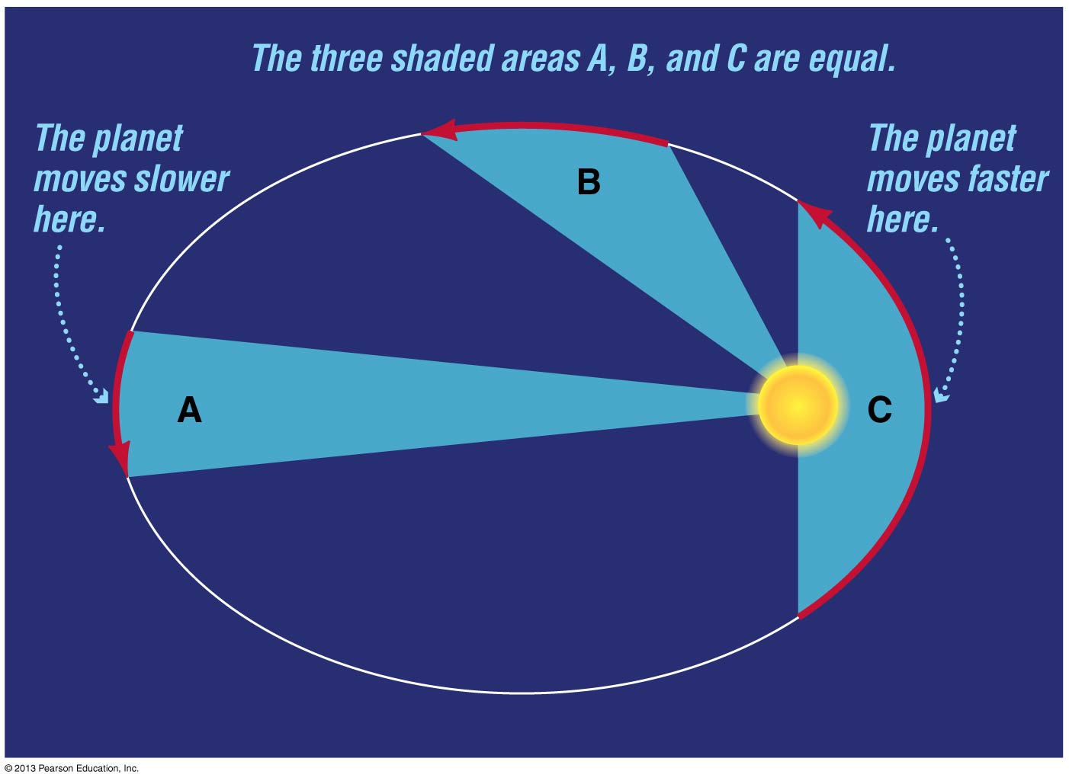
Kepler’s Laws
1. Planet’s have elliptical orbits. NOT circular.
2. During equal time intervals a planet traces out equal area regardless of where it is in the orbit.
3. For any planet, you can figure out how long the orbit takes if you know the distance from the sun (semimajor axis).
Notes:
https://www.youtube.com/watch?v=2PkwMSIjB10

Slide 37
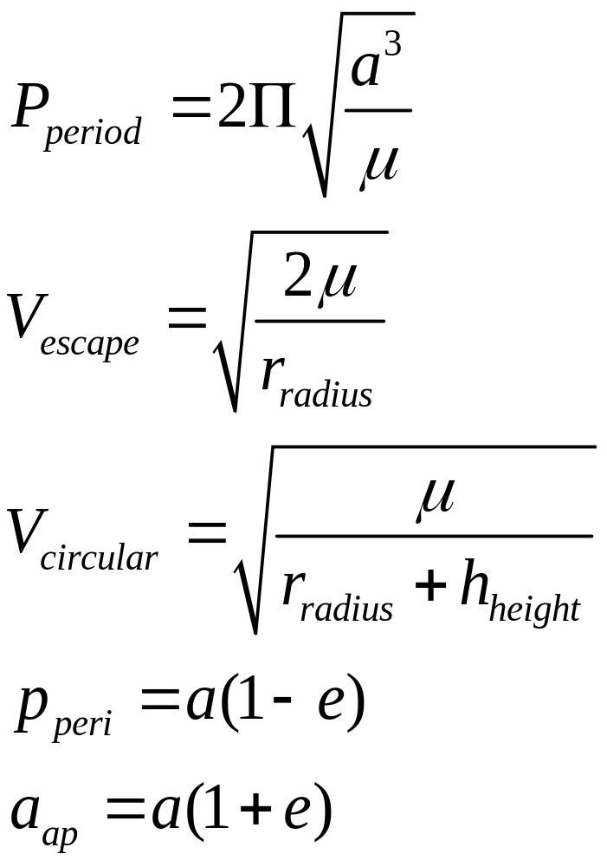
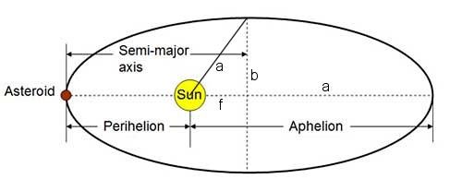
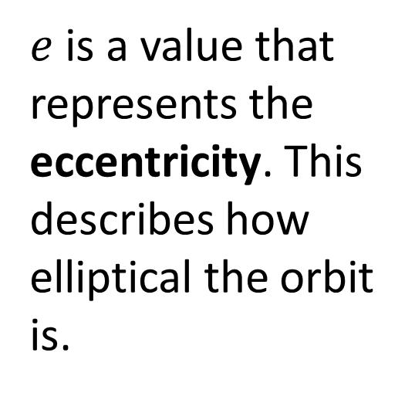
Ellipse Terminology
Perihelion and Aphelion distances
$e$ is a value that represents the eccentricity. This describes how elliptical the orbit is.
Notes:
https://www.youtube.com/watch?v=u9SjjcHd1Ec (Voyager – intro – first two min)
https://vimeo.com/69465942 (gravity assist)

Slide 38
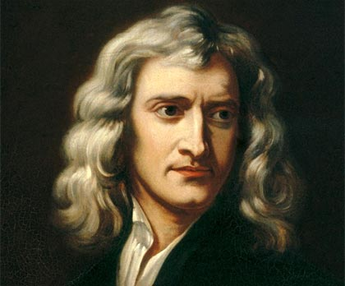
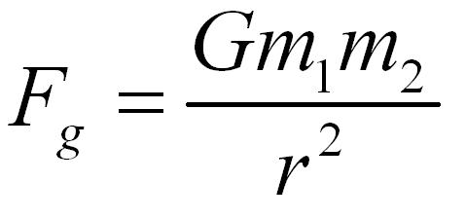
Gravity: Sir Isaac Newton
Find the Mass of both objects
Find the distance between the objects
G =6.67384 × 10⁻¹¹ m³ kg⁻¹ s⁻²

Slide 39
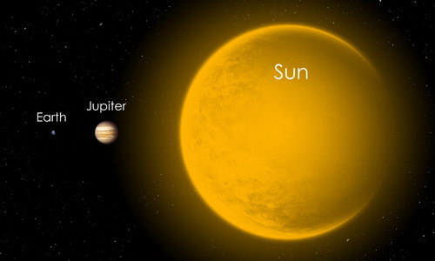

Slide 40
Notes:
https://www.youtube.com/watch?v=GRwfzxr_mf0

