Slide 1
Astronomy 150
Dr. Gamble

Slide 2
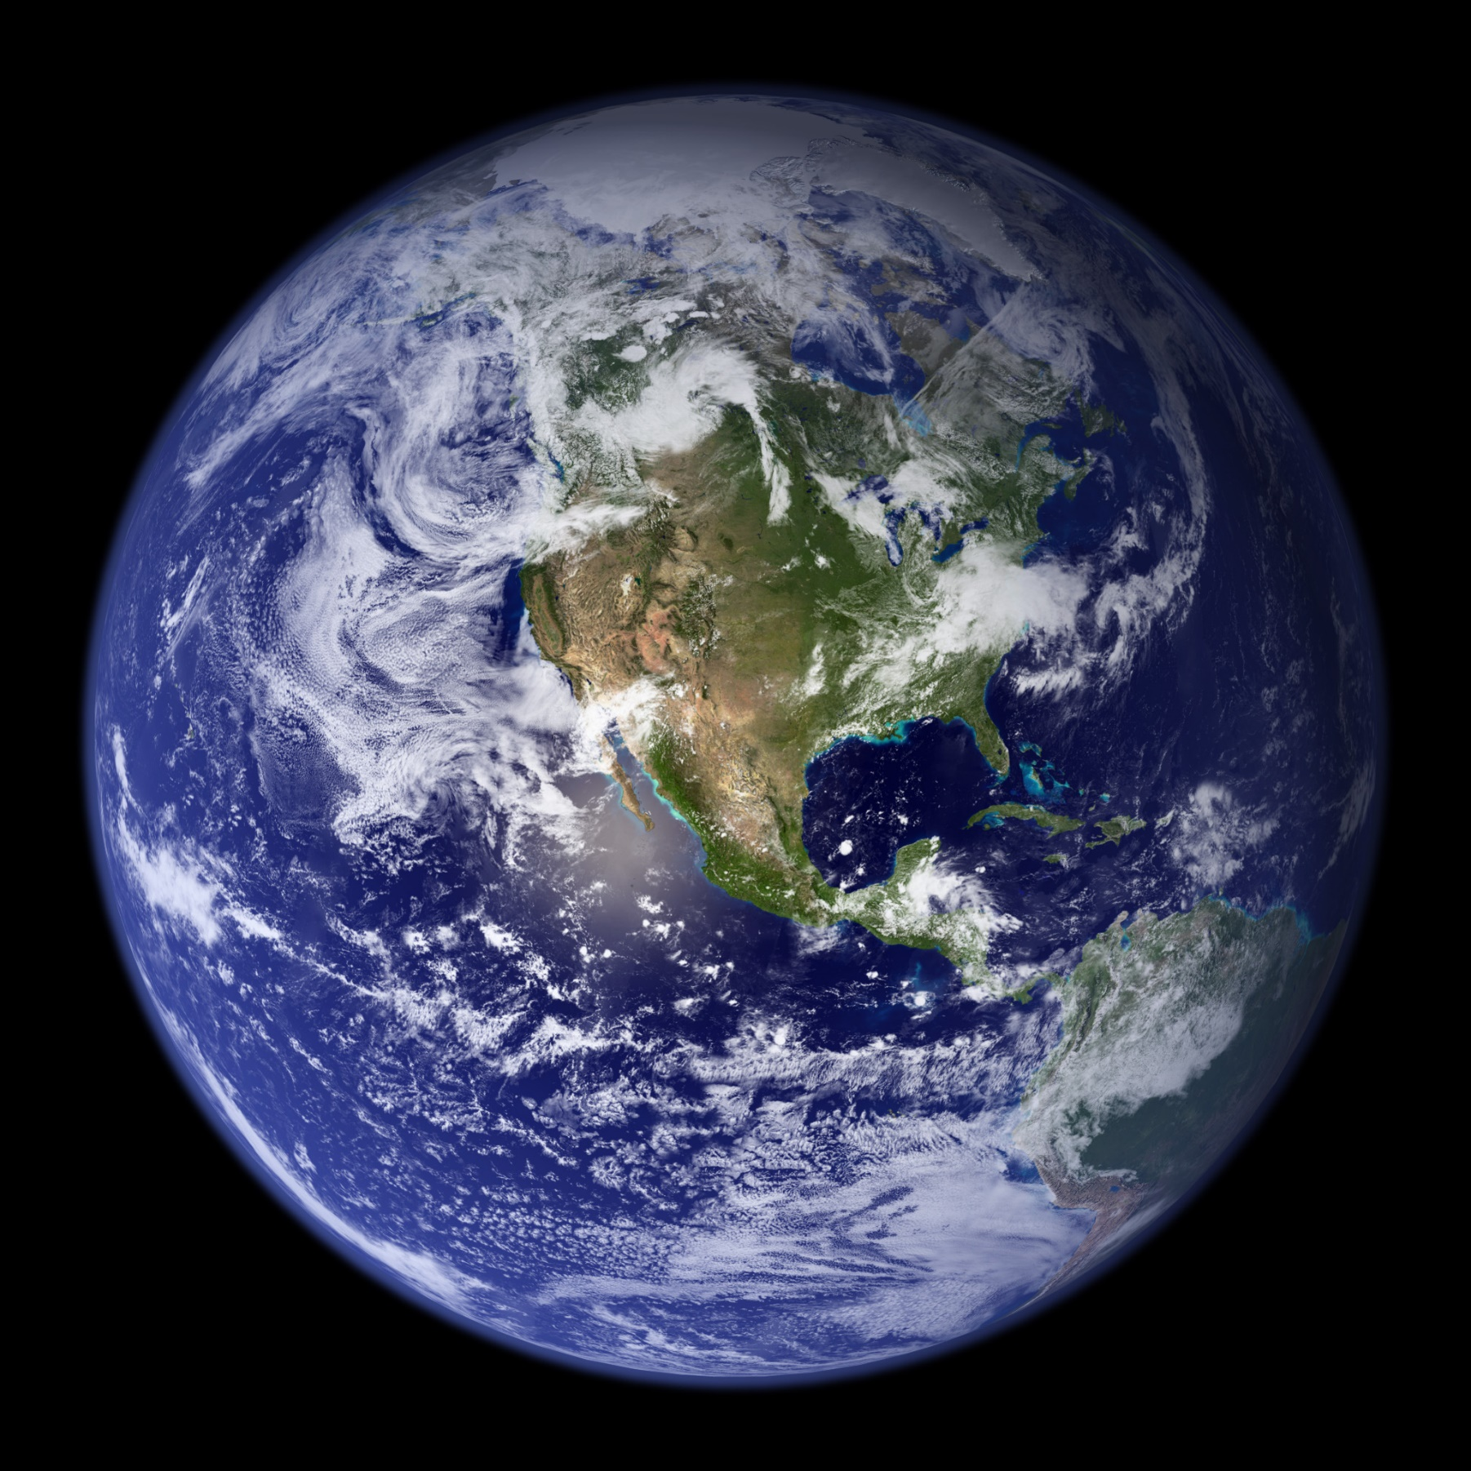

Slide 3

Notes:
https://www.youtube.com/watch?v=WPA-KpldDVc

Slide 4
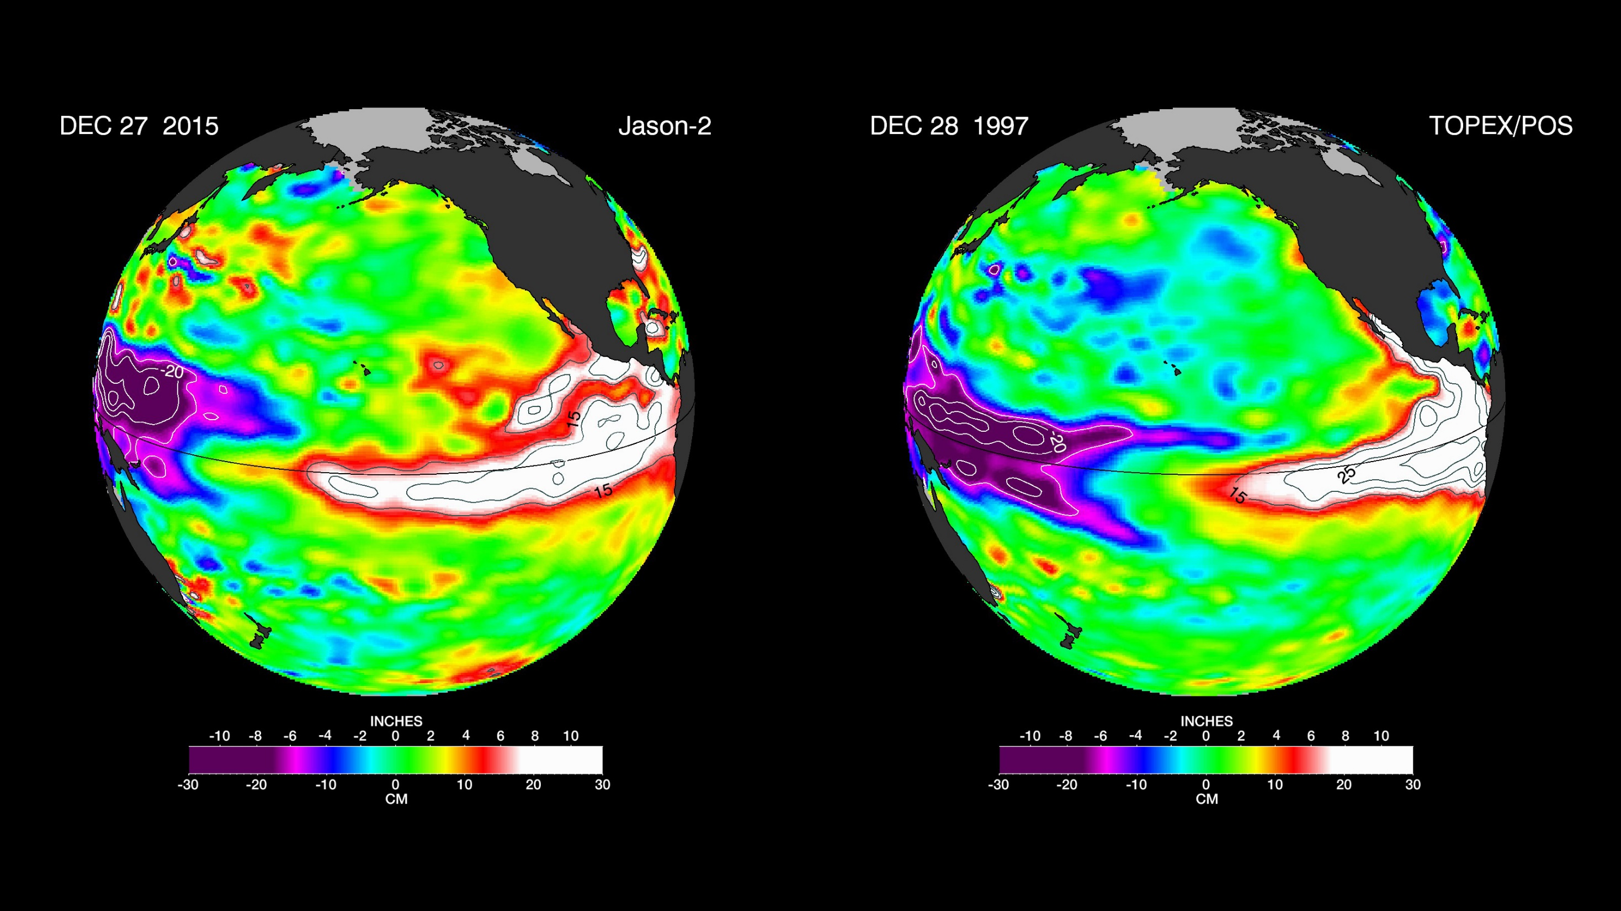

Slide 5
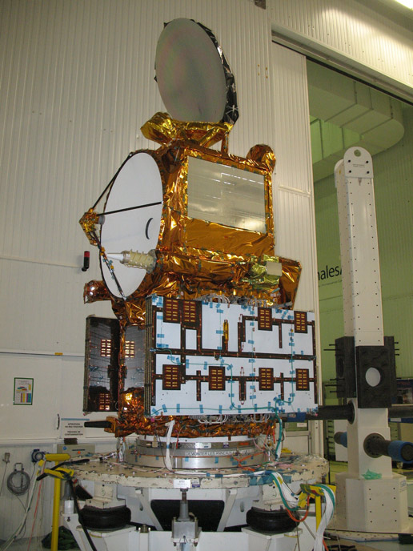
Notes:
https://www.youtube.com/watch?v=QXIhMS4JTGc&index=1&list=PLTiv_XWHnOZocOSyXQu0KjgxylcBMFqRh

